Slide 1
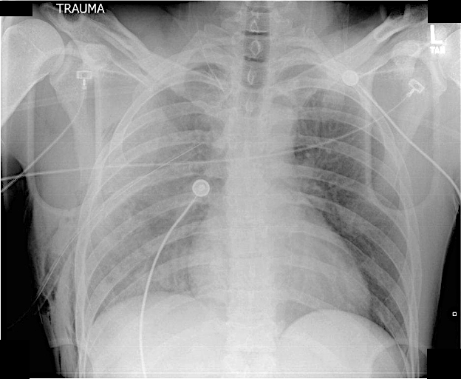
Patient T
Slide 1

Slide 2
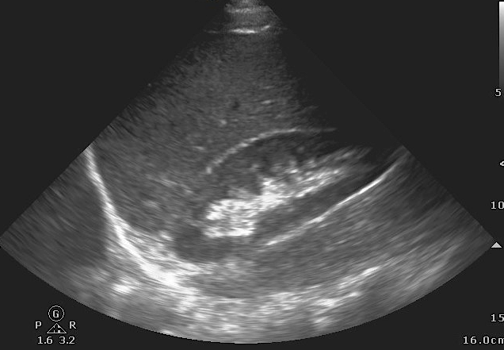
Patient T
Slide 2

Slide 3
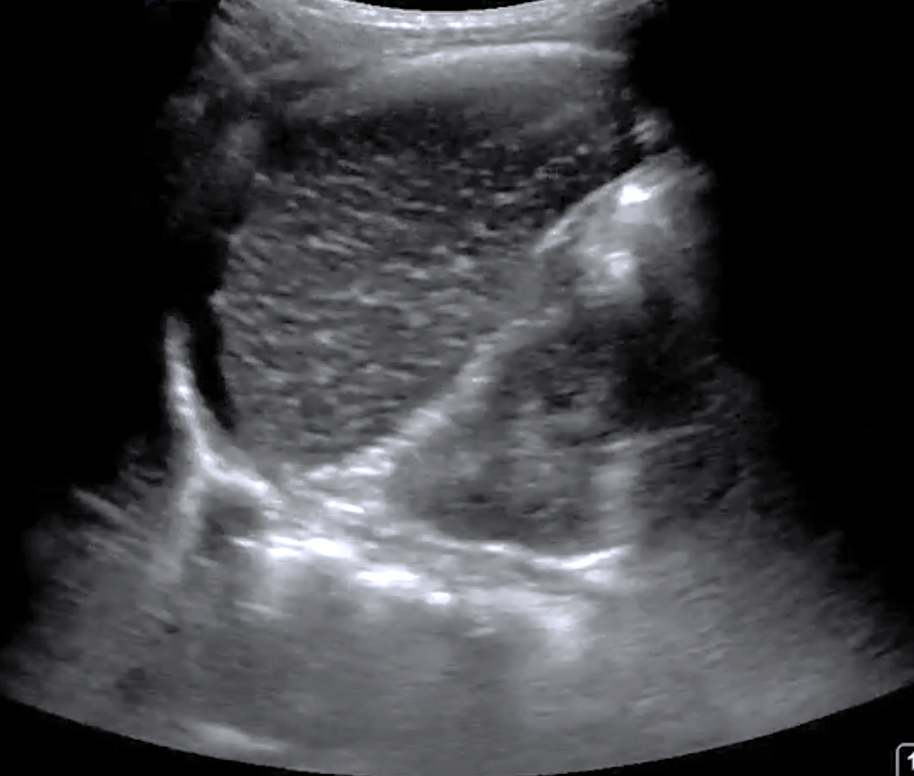
Patient T
A
Slide 3

