Slide 1
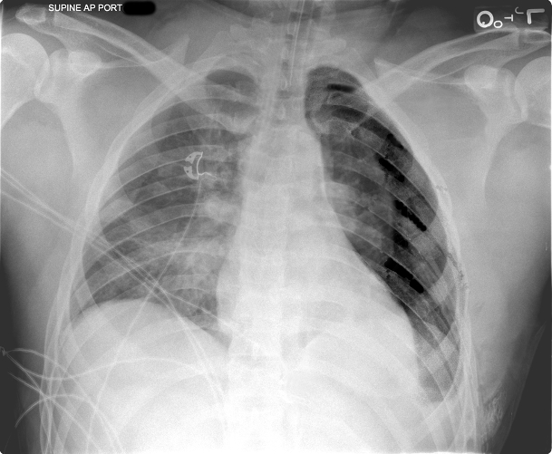
Patient Q
A
Slide 1
A

Slide 2
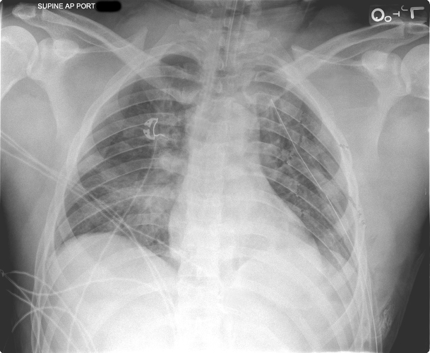
Patient Q
A
Slide 2
A

Slide 3
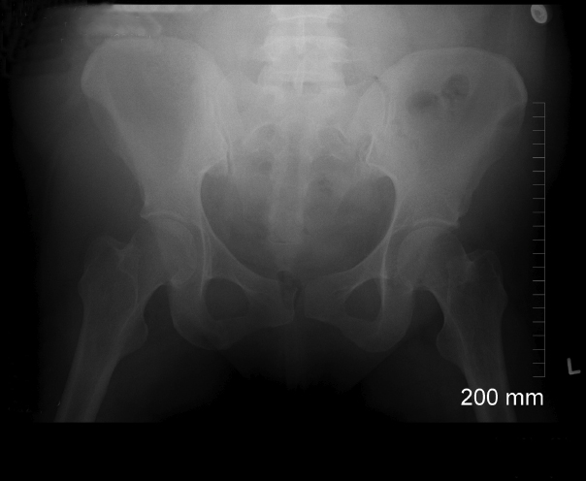
Patient Q
A
Slide 3
A

Slide 4
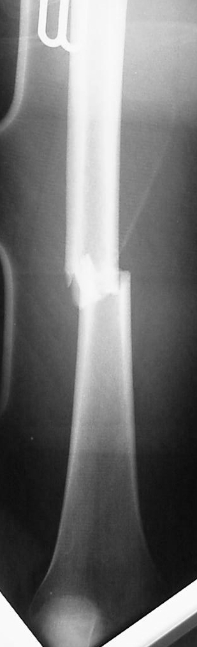
Patient Q
A
Slide 4
A

