Slide 1
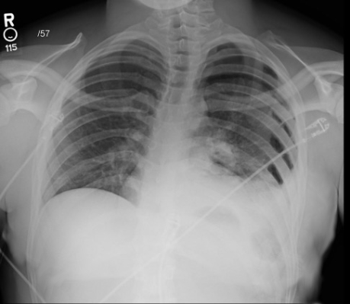
Patient I
Notes:
Chest tube without intubation

Slide 2
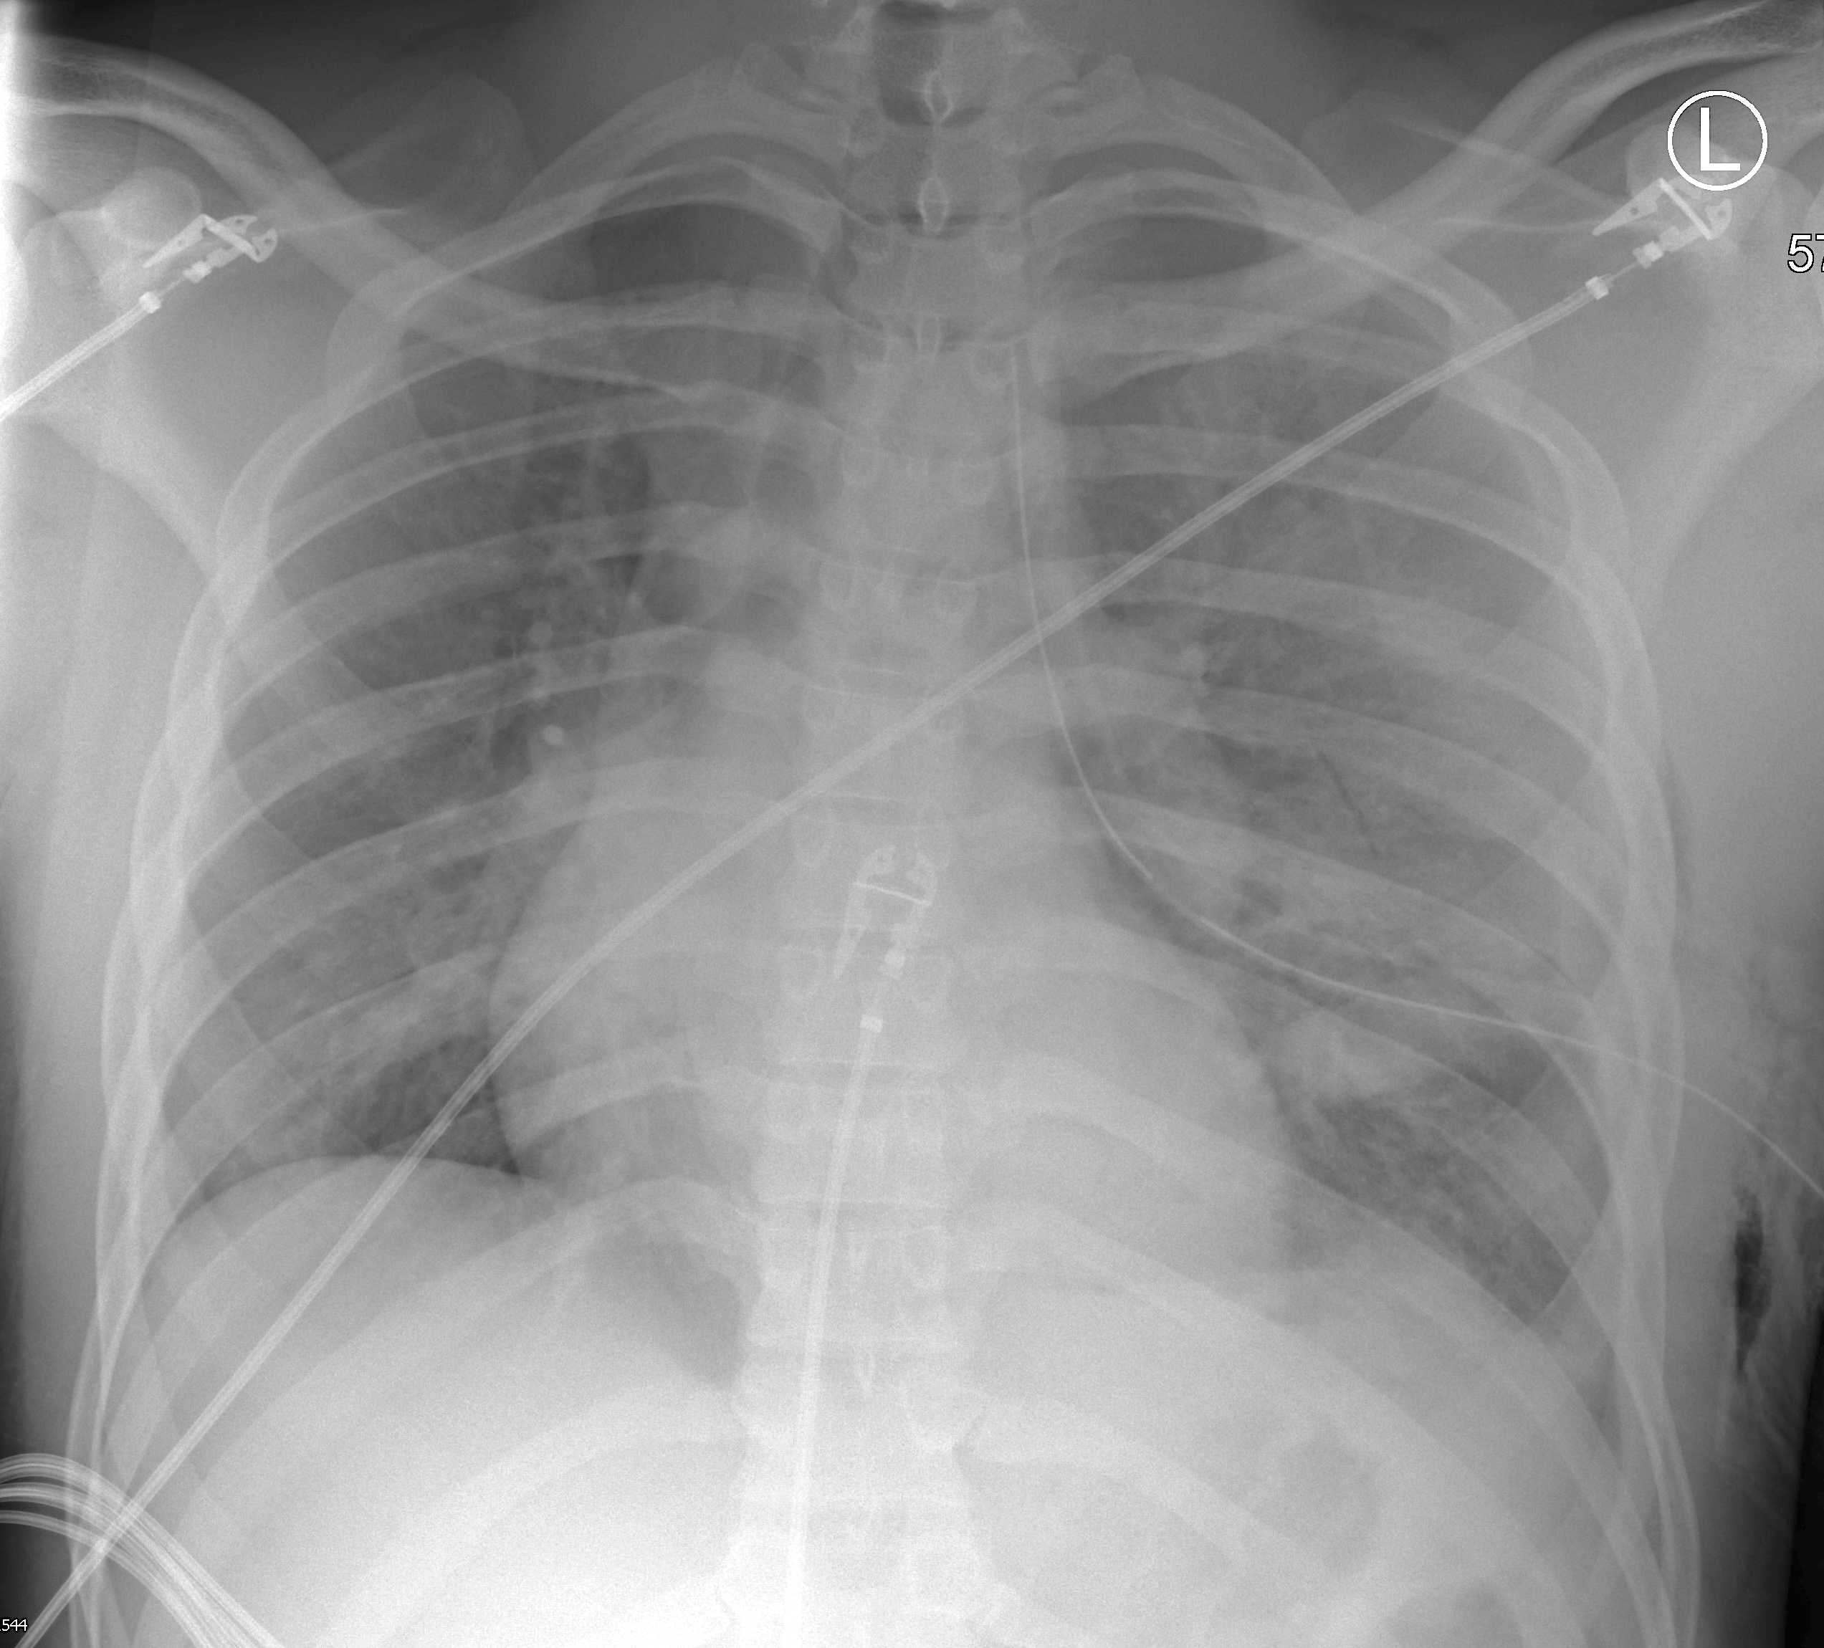
Patient I
Notes:
Chest tube with intubation

Slide 3
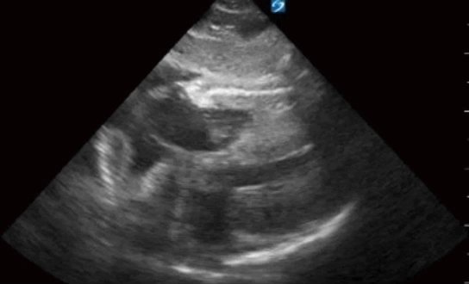
Patient I
Notes:
Fast exam with subcostal view of pericardial effus

Slide 4
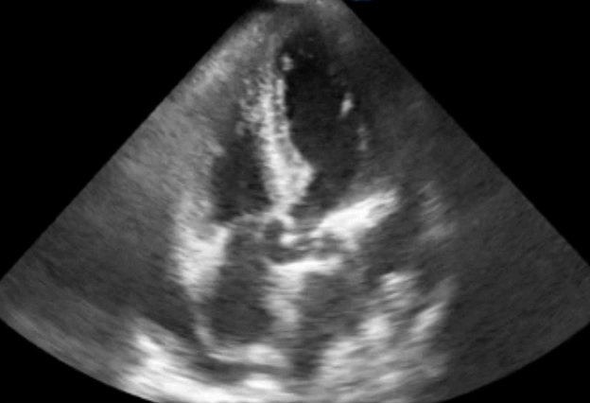
Patient I
Notes:
Apical view of impressive pneumothorax

Slide 5
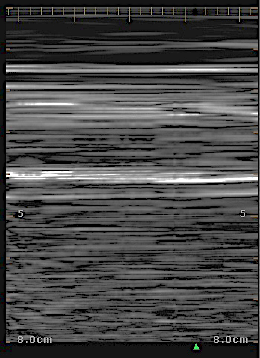
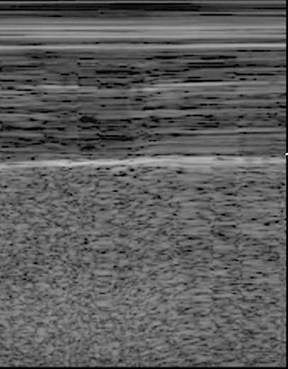
Patient I
#Right
#Left
Notes:
E-fast consistent with pneumothoraxon the left; expected immediately after chest tube placement. Right side has lung sliding.

