Slide 1

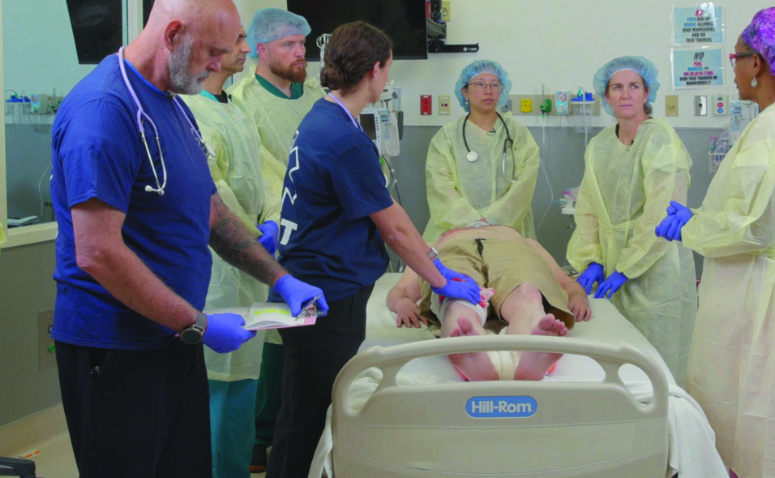

Refresher
Patientfall T
Notes:
Välkommen

Slide 2
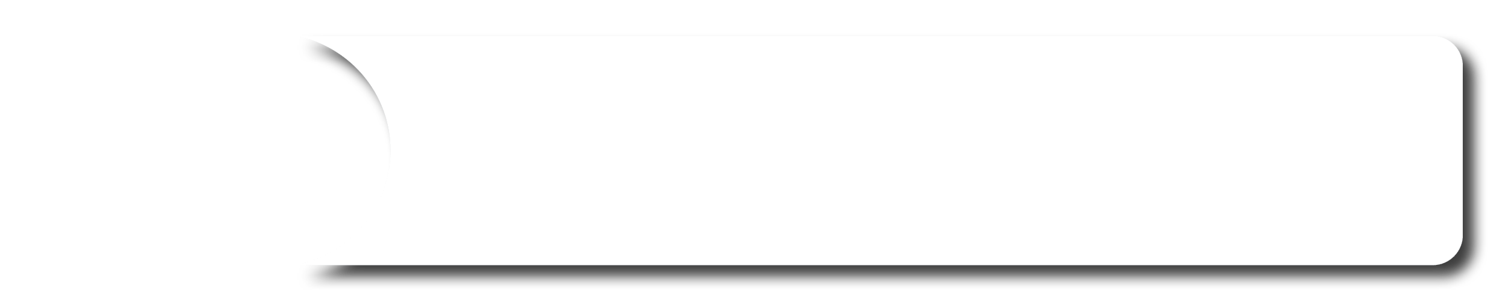





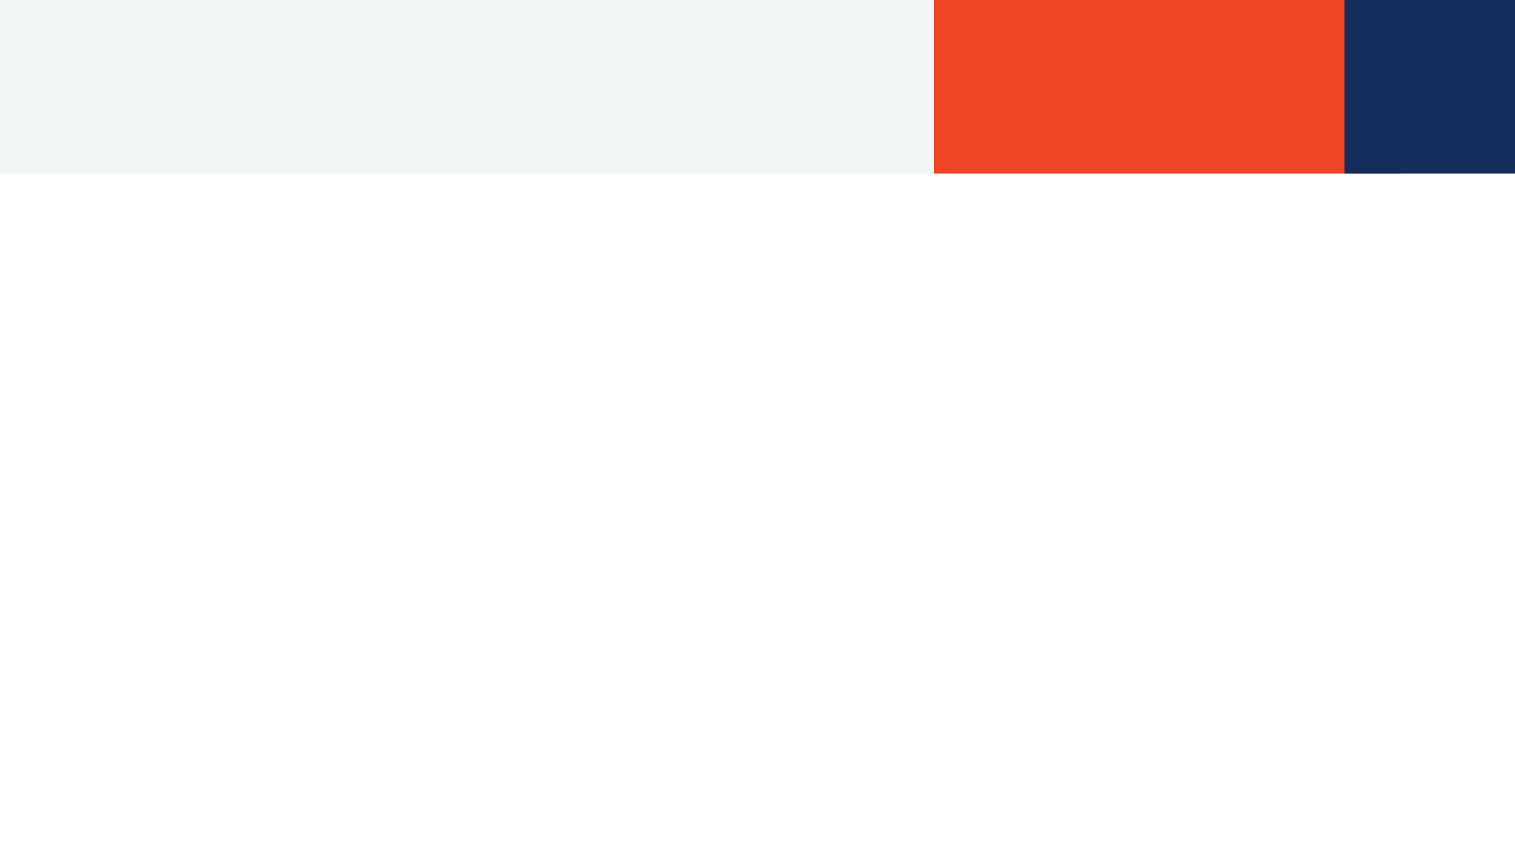
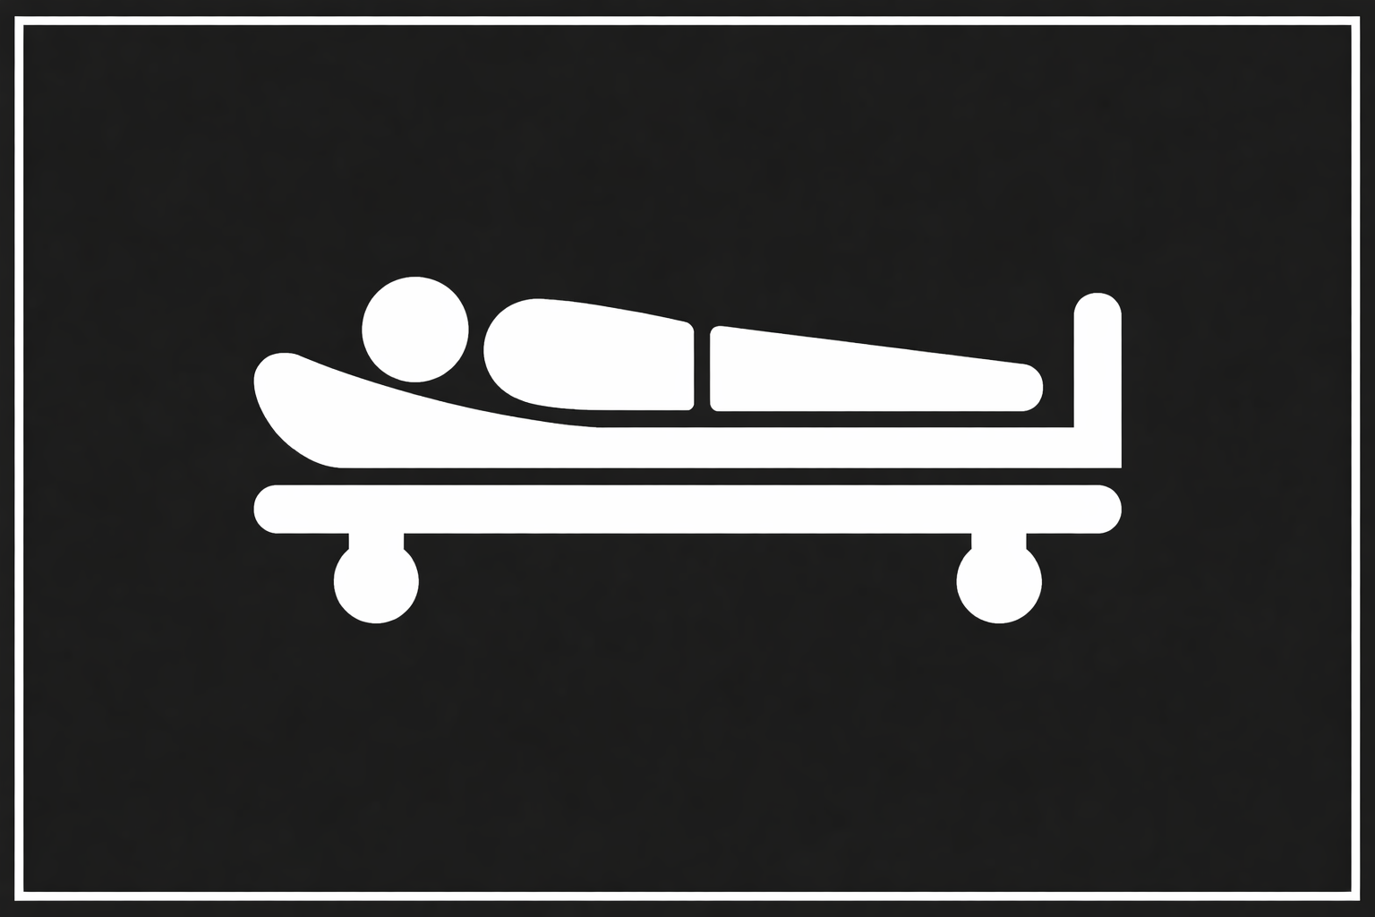
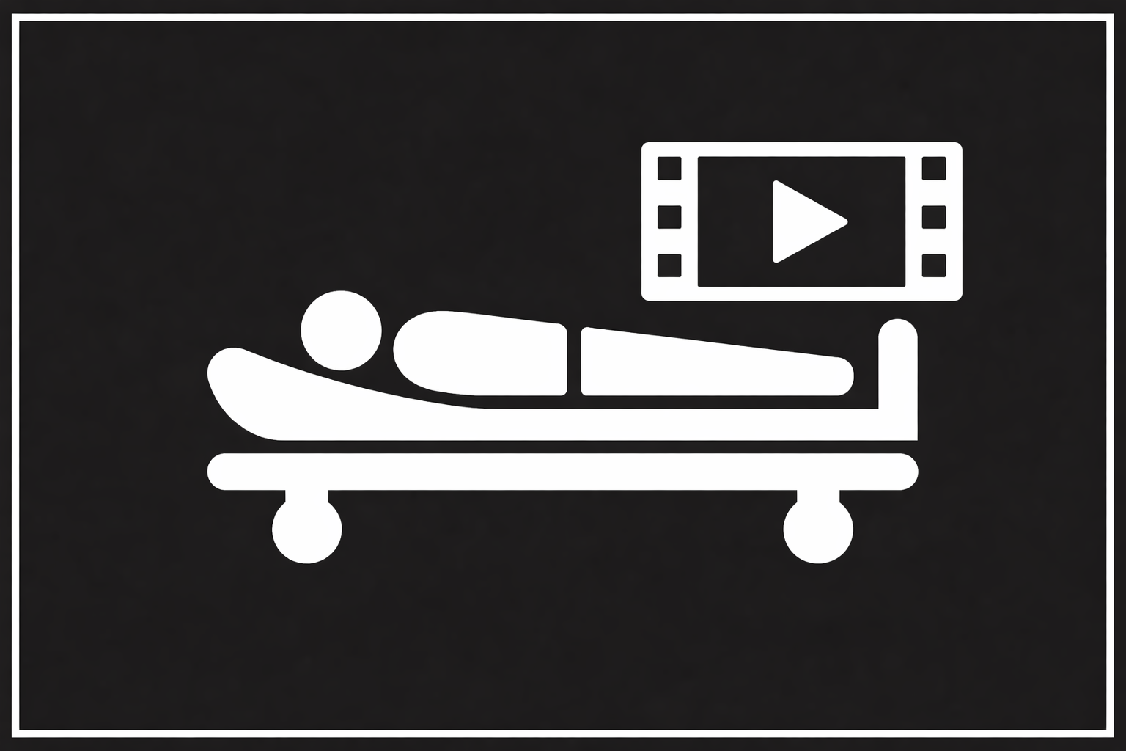




Scenario
M
A 24-year-old is brought to the ER by a friend who heard screams approximately 20 min ago and found the patient lying on the floor with multiple stab wounds.
The friend reports the patient was stabbed in the right chest and left abdomen. The friend heard a bubbling noise coming from the right chest.
ED of a community hospital with surgical capabilities.
S
The friend reports the patient was moaning, agitated, and breathing rapidly.
T
No treatments.
©ACS
Notes:
CASE Scenario

Slide 3


x-Ray / Thorax
Radiographer is on the way
©ACS

Slide 4


FAST
©ACS
Notes:
CASE Progression

Slide 5

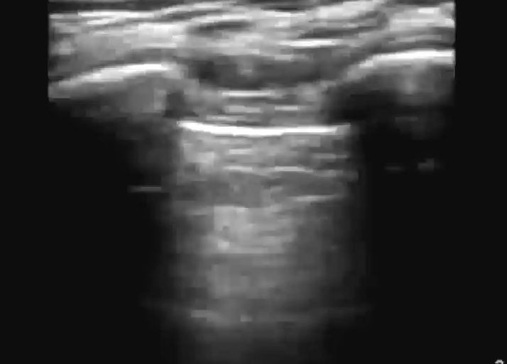
e-FAST / Vänster Lunga
M-Mode
©ACS
Notes:
CASE Progression

Slide 6
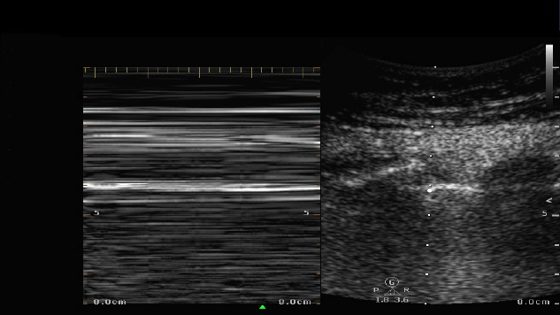
e-FAST / Vänster Lunga / M-Mode
©ACS
Notes:
CASE Progression

Slide 7

e-FAST / Höger Lunga
M-Mode
©ACS
Notes:
CASE Progression

Slide 8

e-FAST / Höger Lunga / M-Mode
©ACS
Notes:
CASE Progression

Slide 9

FAST / Subxiphoidalt
©ACS
Notes:
CASE Progression

Slide 10
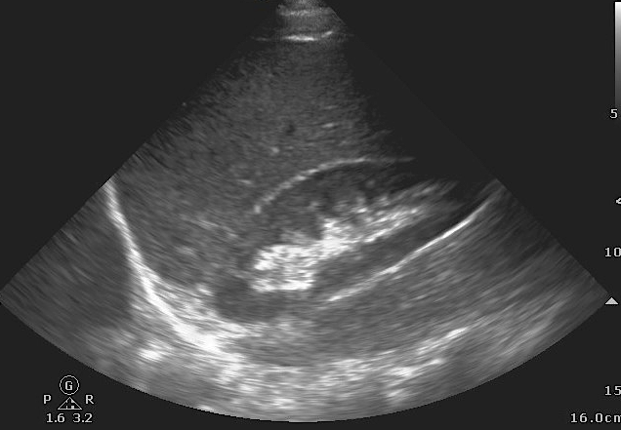
FAST / RUQ
©ACS
Notes:
FAST image (right upper quadrant) – no intra-abdominal fluid

Slide 11
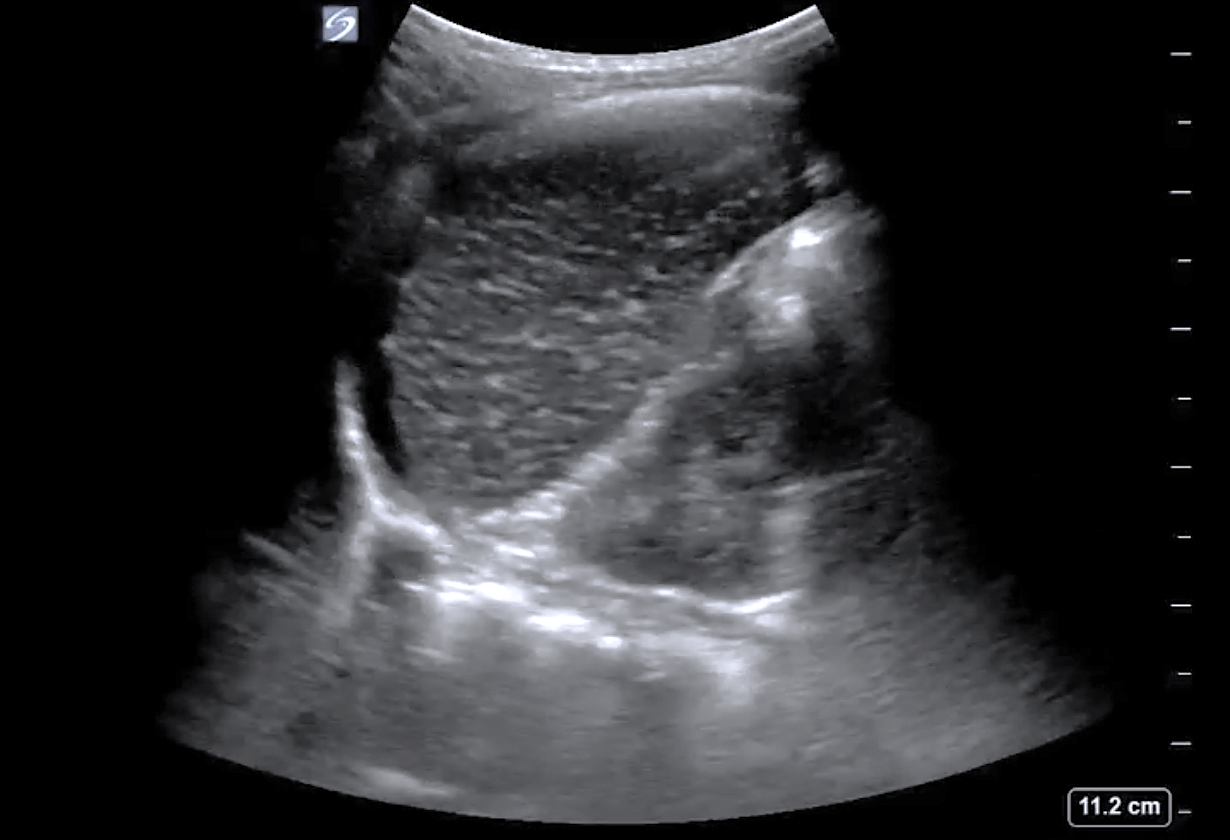
FAST / LUQ
©ACS
Notes:
FAST image (left upper quadrant) – intra-abdominal fluid around the spleen; kidney image is distorted

Slide 12

FAST / Pelvis
Dålig insyn
©ACS

Slide 13
x-Ray / Bäcken
Radiographer is on the way
©ACS

Slide 14
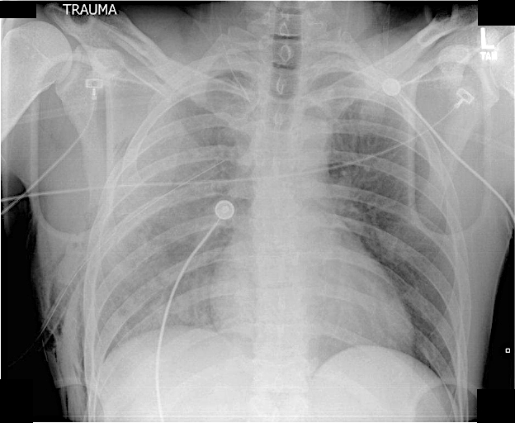
Akut behandling
©ACS
Notes:
Chest x-ray – appropriately position right thoracostomy tube with residual hemothorax

Slide 15
©ACS
Notes:
CASE Progression

Slide 16

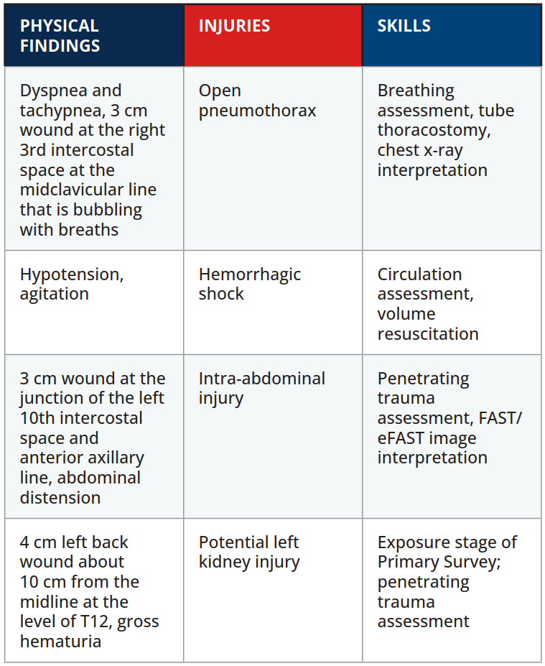

Scenario Sammanfattning
EXAMINATION
©ACS
Notes:
.

Slide 17

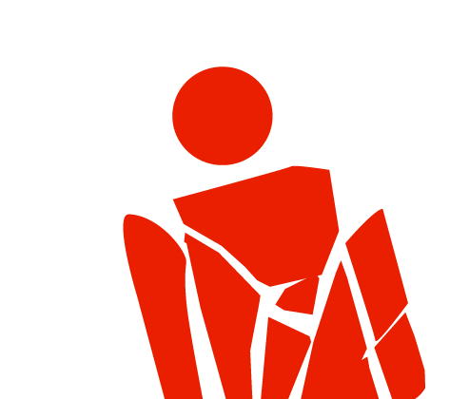
Tack
©ACS

