Slide 1

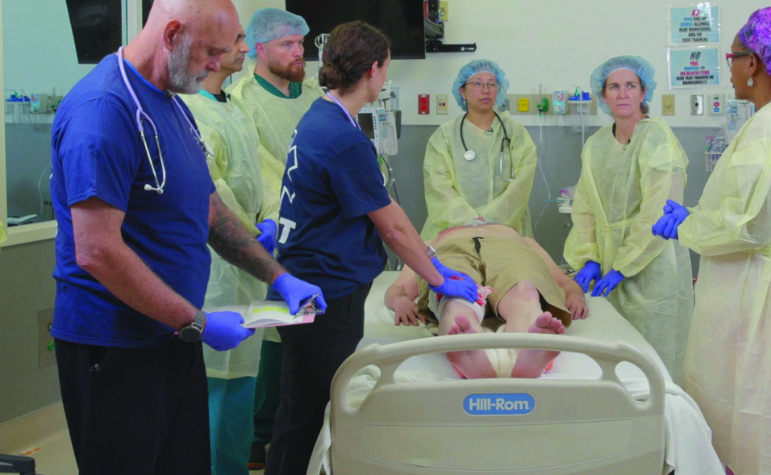

Examination
Patientfall Q
Notes:
Välkommen

Slide 2













A 25-year-old female reportedly jumped from the third floor of an apartment complex in an attempt at self-injury.
Scenario
M
The patient reports severe left leg pain. Large contusion on the left forehead. Left thigh deformed without an open wound. Lucid interval reported from scene.
ED of a community hospital without surgical capabilities.
S
SAT 89%, AF 24, BT 100/60, HF 110,
GCS 14 (E4 V4 M6)
Oxygen 6 L/min via mask, i.v. with kristalloid fluid bolus, SMR, Traction splint to the left leg.
T
©ACS
Notes:
CASE Scenario

Slide 3
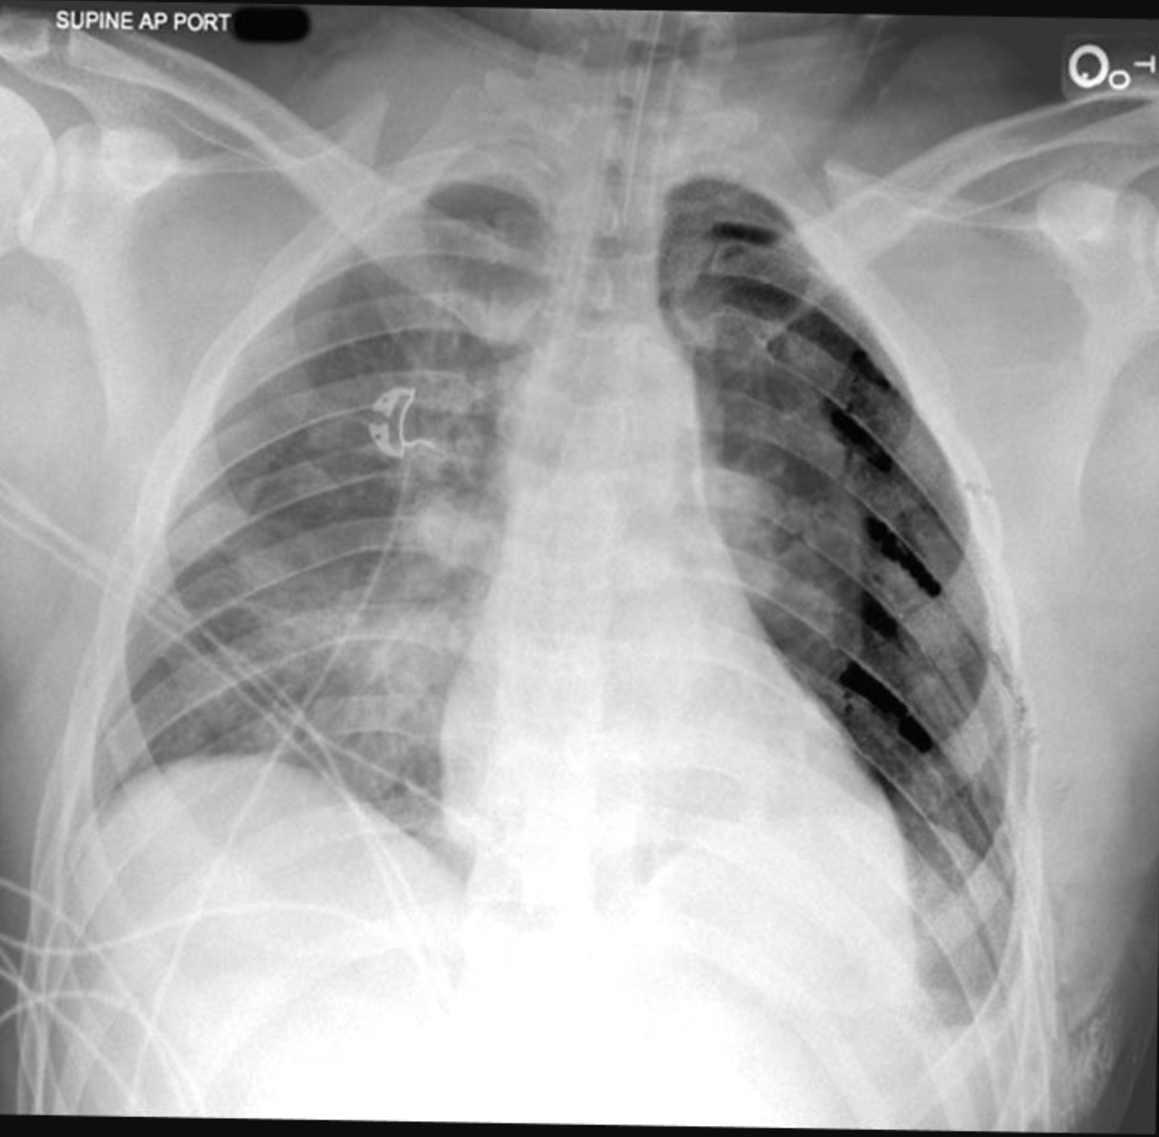

x-Ray / Thorax
©ACS
Notes:
Chest x-ray - definitive airway in appropriate position, multiple left rib fractures, left pneumothorax

Slide 4


FAST
©ACS
Notes:
CASE Progression

Slide 5

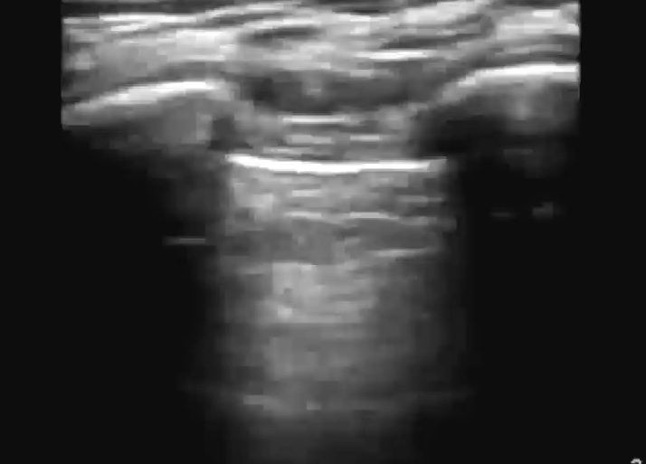
e-FAST / Vänster Lunga
M-Mode
©ACS
Notes:
No Lung Sliding

Slide 6
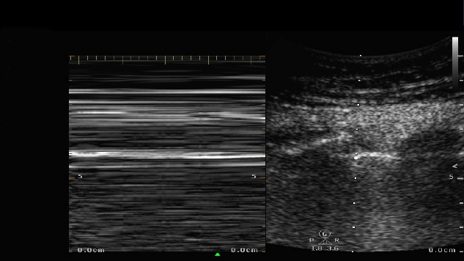
e-FAST / Vänster Lunga / M-Mode
©ACS
Notes:
Barcode Sign

Slide 7

e-FAST / Höger Lunga
M-Mode
©ACS
Notes:
CASE Progression

Slide 8

e-FAST / Höger Lunga / M-Mode
©ACS
Notes:
CASE Progression

Slide 9

FAST / Subxiphoidalt
©ACS
Notes:
CASE Progression

Slide 10

FAST / RUQ
©ACS
Notes:
CASE Progression

Slide 11

FAST / LUQ
©ACS

Slide 12

FAST / Pelvis
Dålig insyn
©ACS

Slide 13
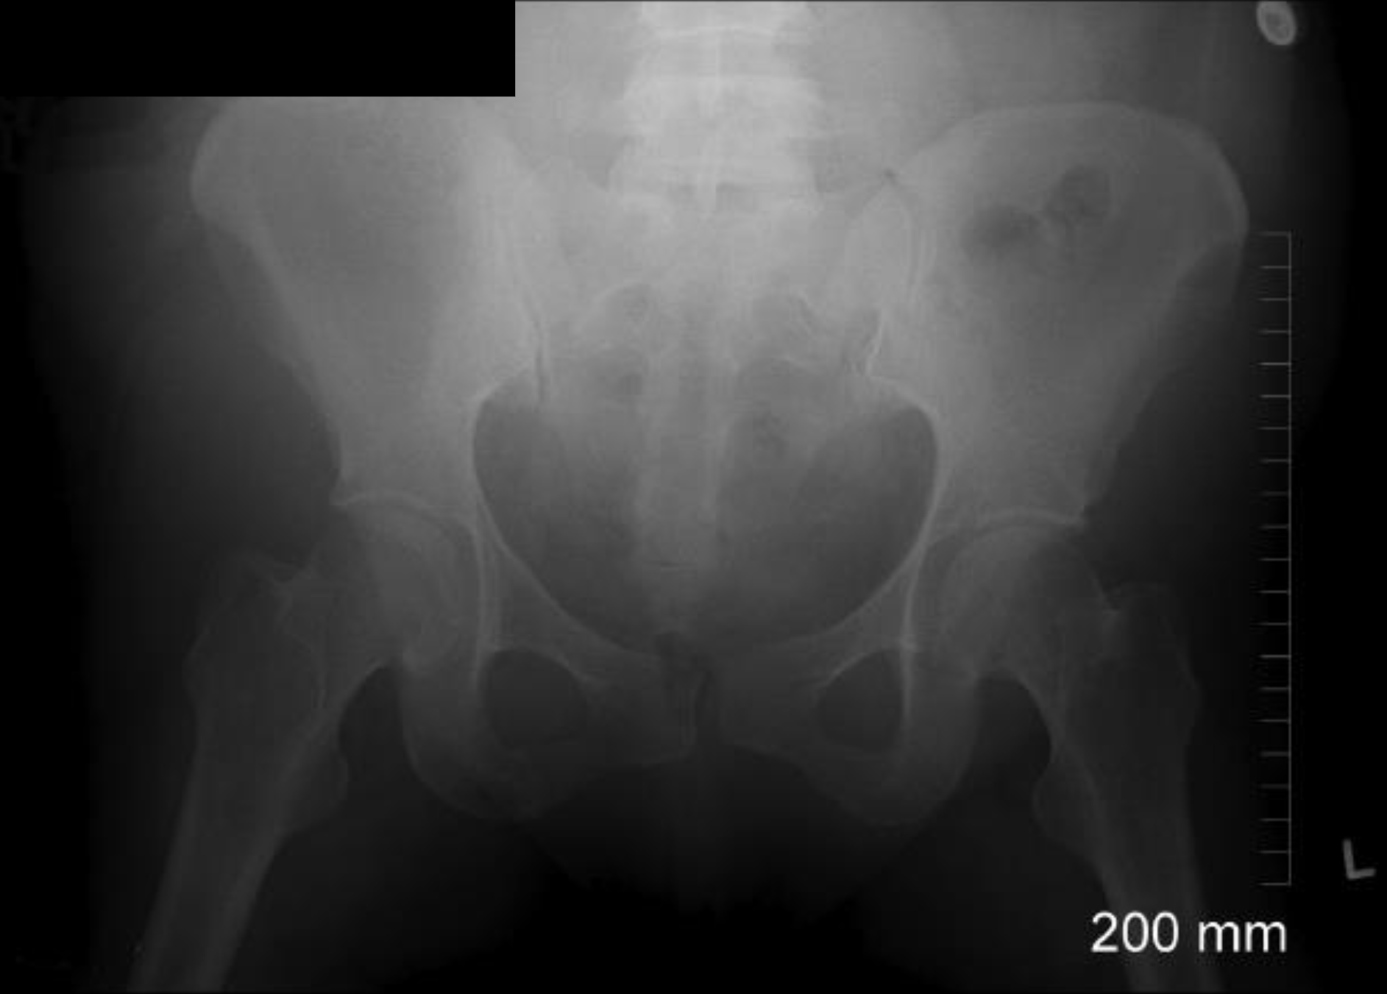
x-Ray / Bäcken
©ACS
Notes:
Pelvic x-ray - no pelvic fracture present

Slide 14
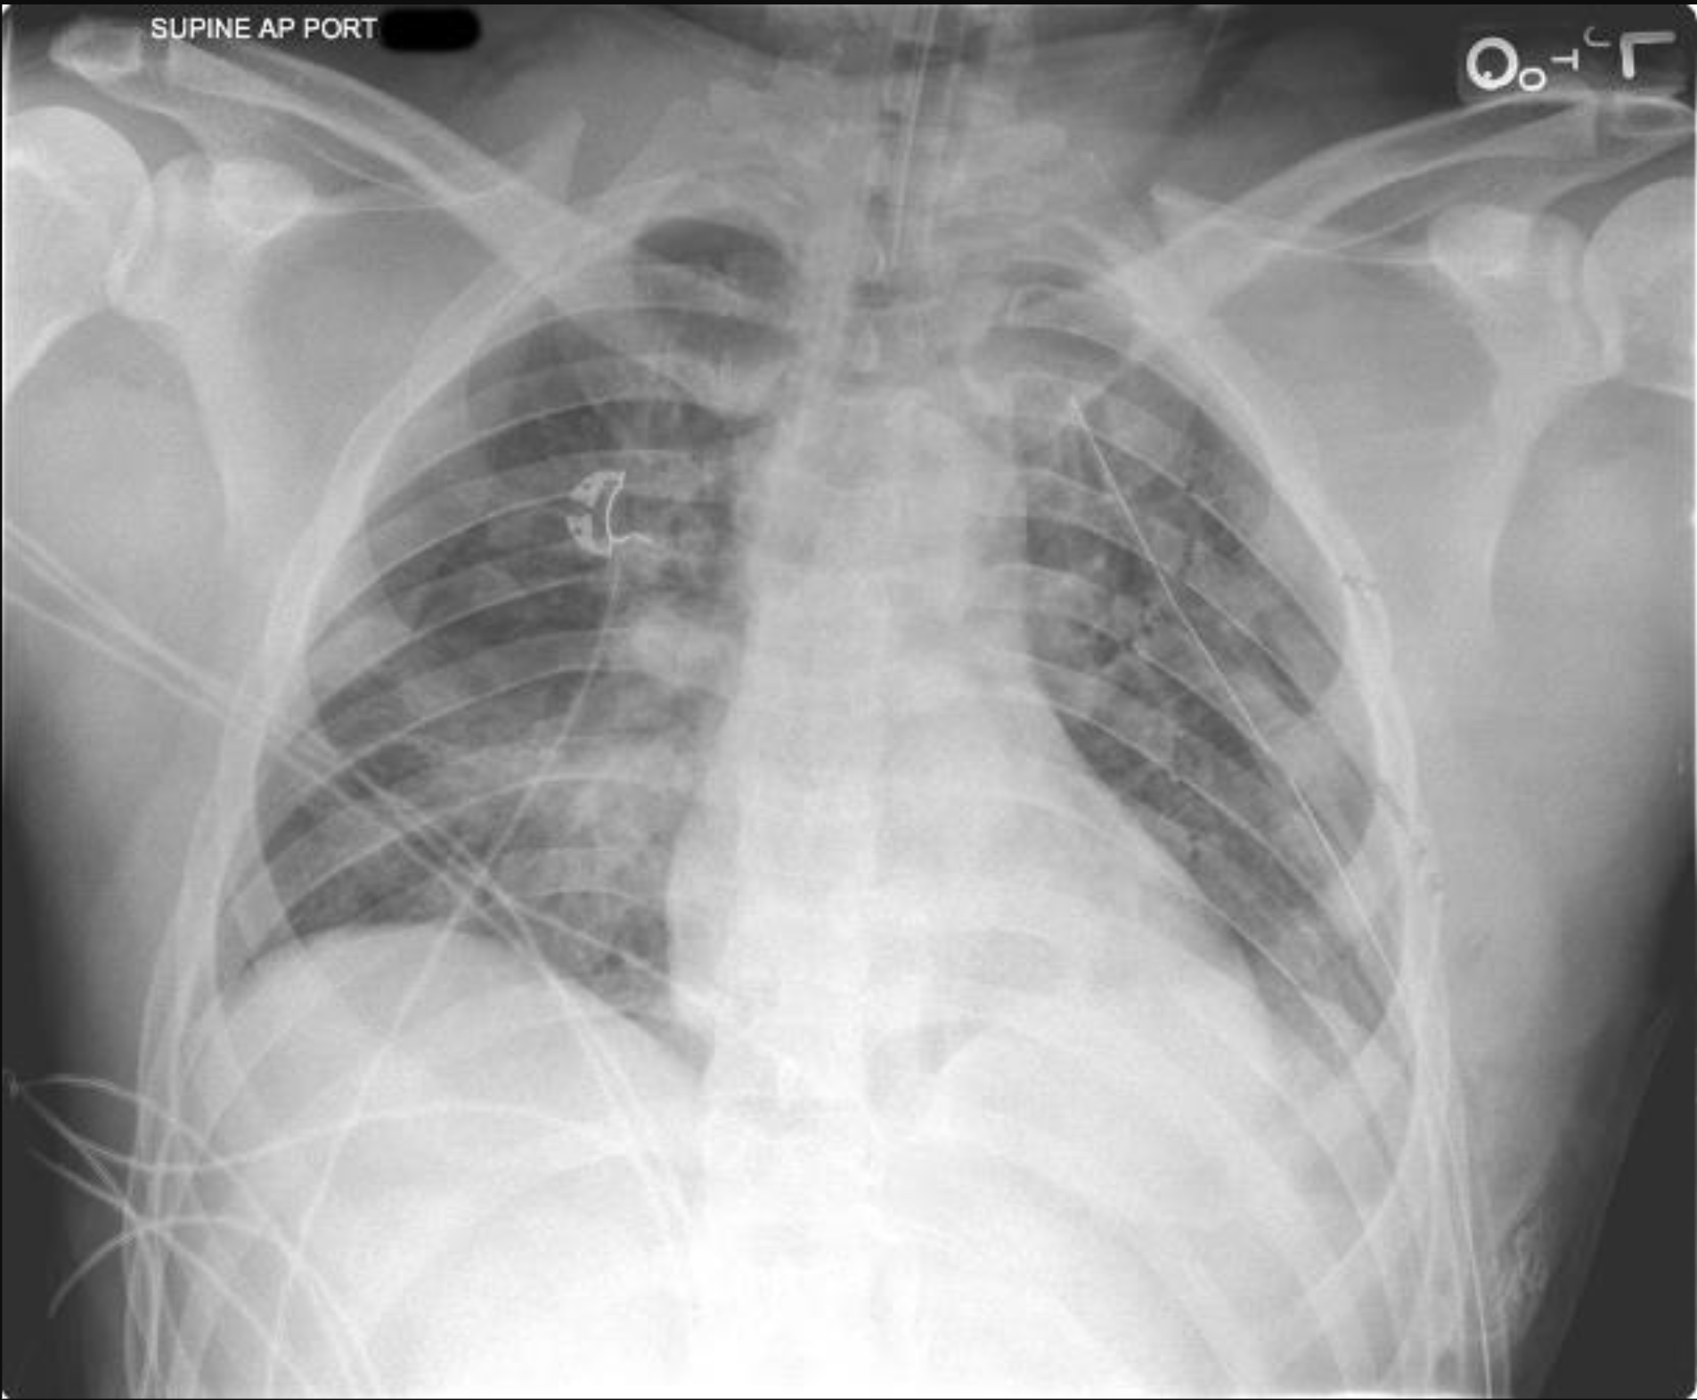
Akut behandling
©ACS
Notes:
Chest x-ray - definitive airway in appropriate position, multiple left rib fractures, left thoracostomy tube

Slide 15
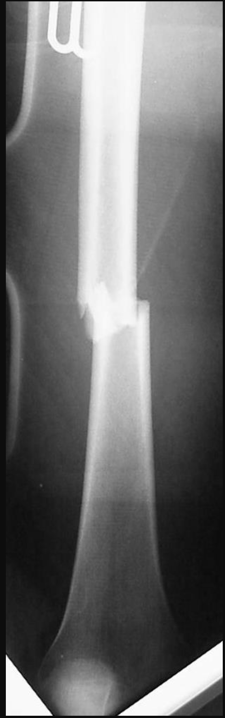
x-Ray / Extremitet
©ACS
Notes:
Left femur x-ray – midshaft fracture

Slide 16

©ACS
Notes:
CASE Progression

Slide 17

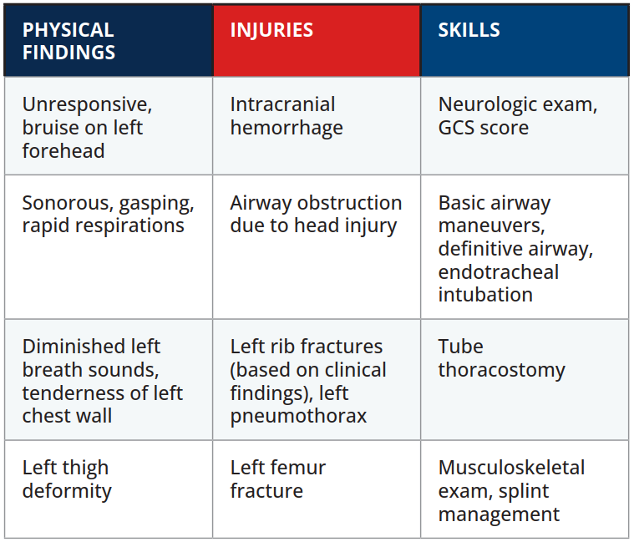

Scenario Sammanfattning
EXAMINATION
©ACS
Notes:
.

Slide 18


Tack
©ACS

