Slide 1

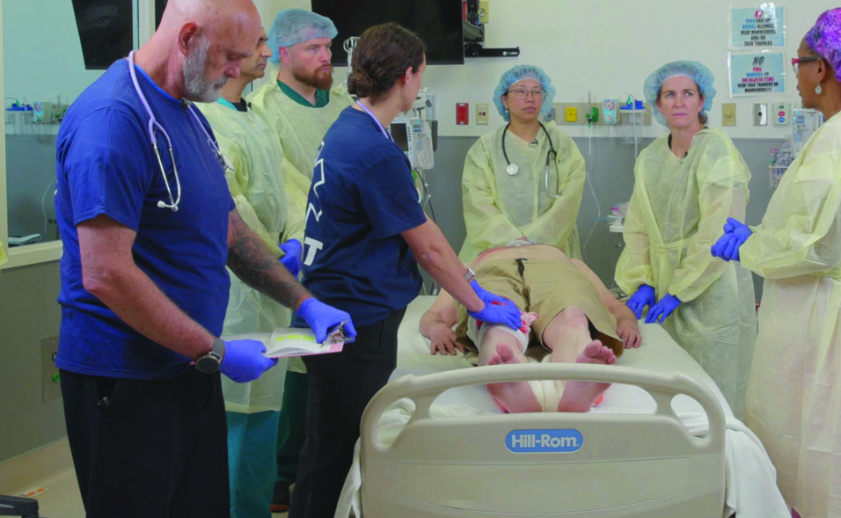

Examination
Patientfall M
Notes:
Välkommen

Slide 2
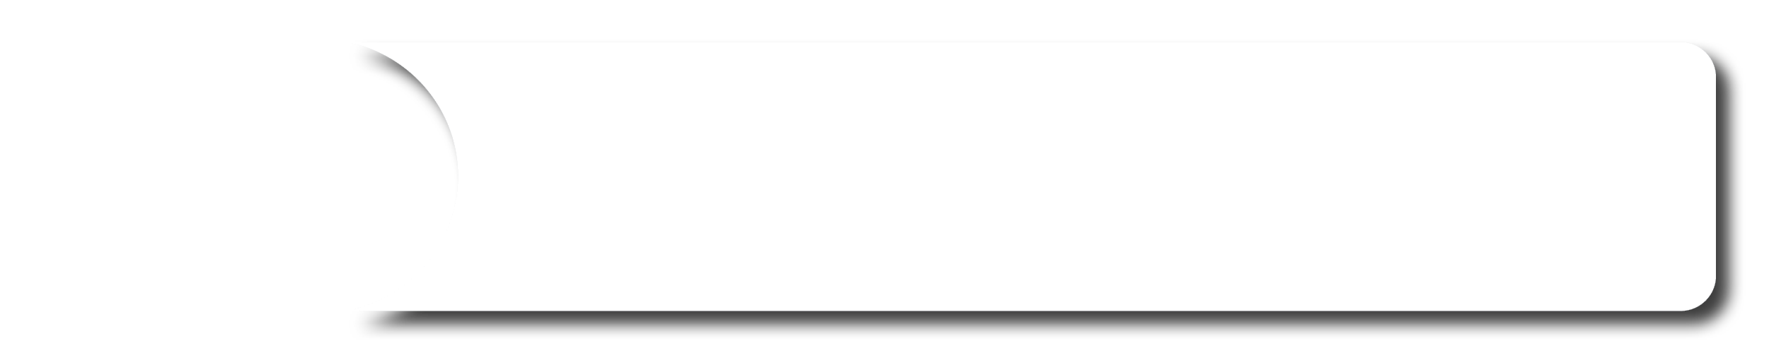





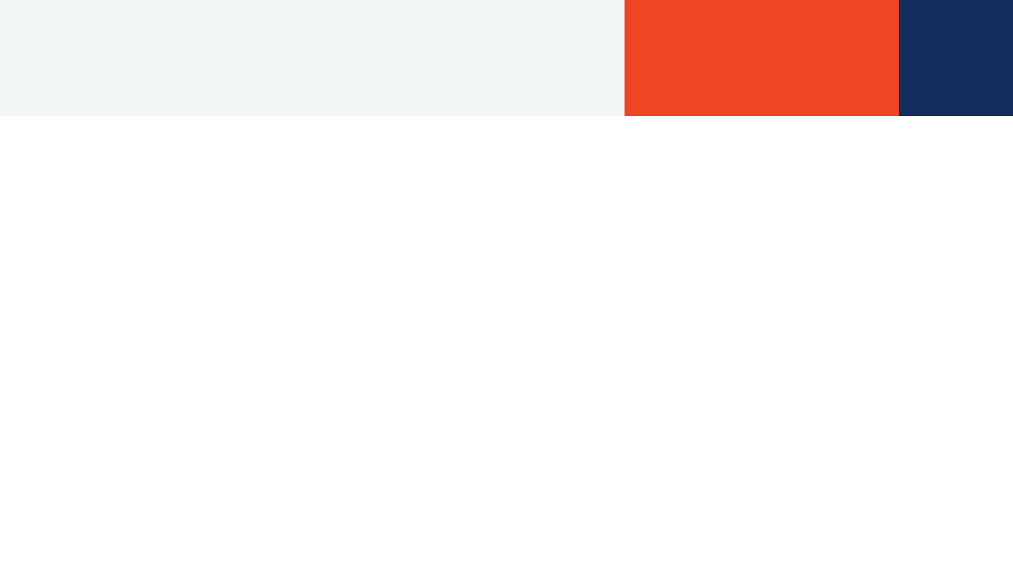
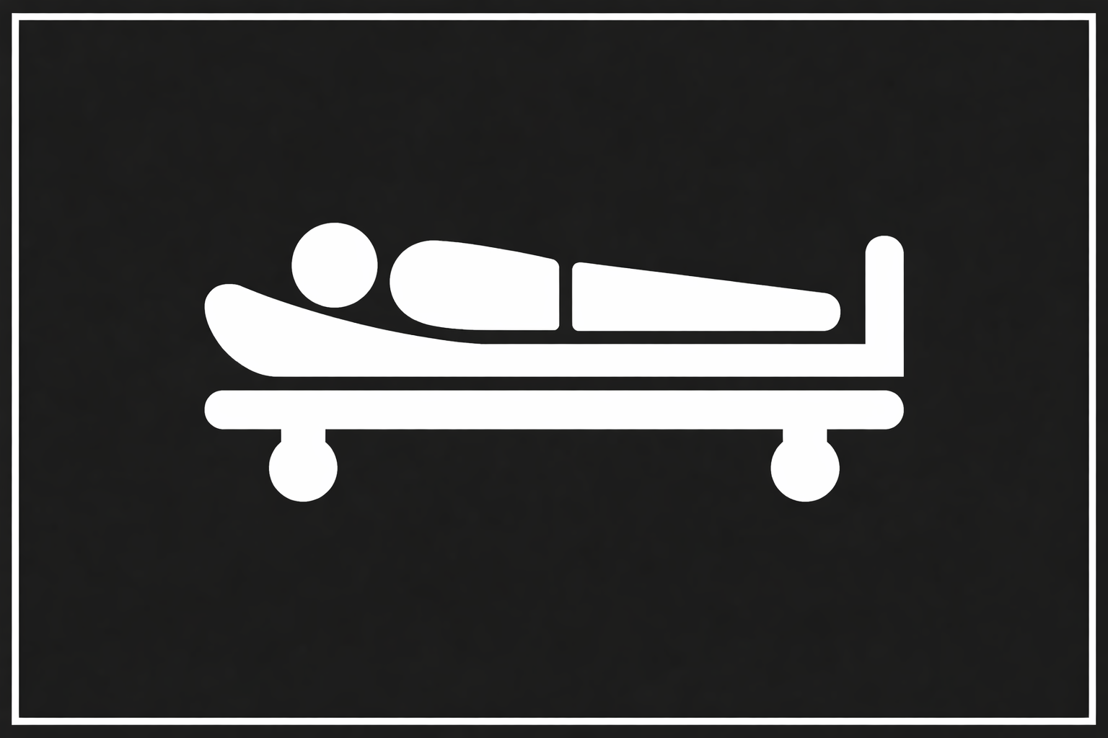
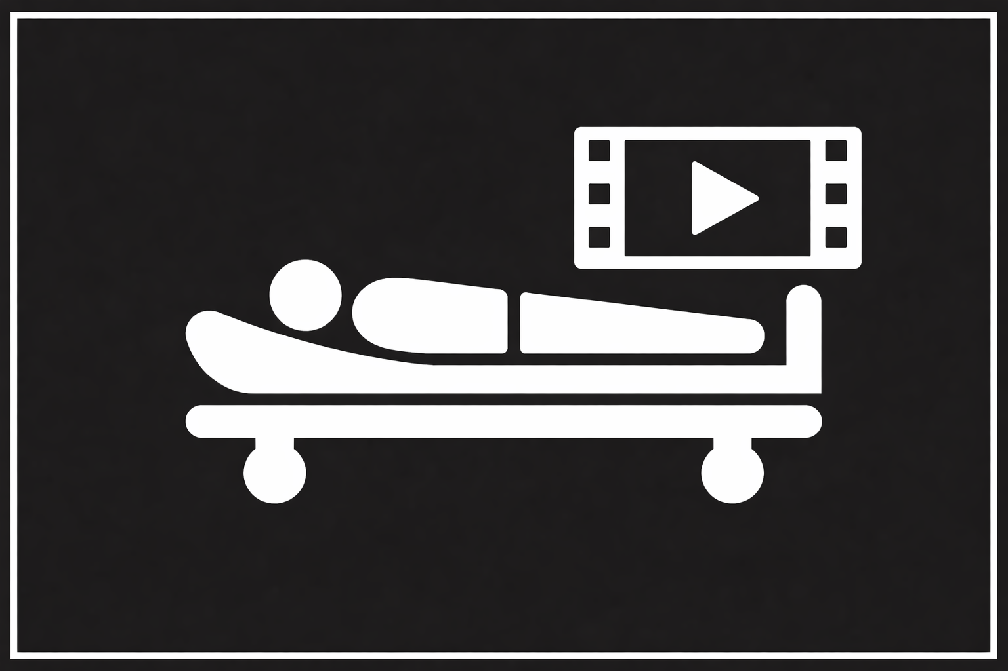




A 42-year-old climbed an electrical pole to free kite and contacted a high-voltage wire with the left forearm. He fell 5m and landed on the back. 5min unconscious and no pulse. After 5min CPR - ROSC
Scenario
M
A burn is present on the left forearm. The patient reports difficulty breathing and pain in the back, lower left chest, and left upper arm.
ED of a community hospital with surgical capabilities but not available for another 2 hours.
S
RR 24, Sat 90%, BP 90/60, HR 120
T
Oxygen at 6 L/min via mask, one IV Right arm, SMR
©ACS
Notes:
CASE Scenario

Slide 3
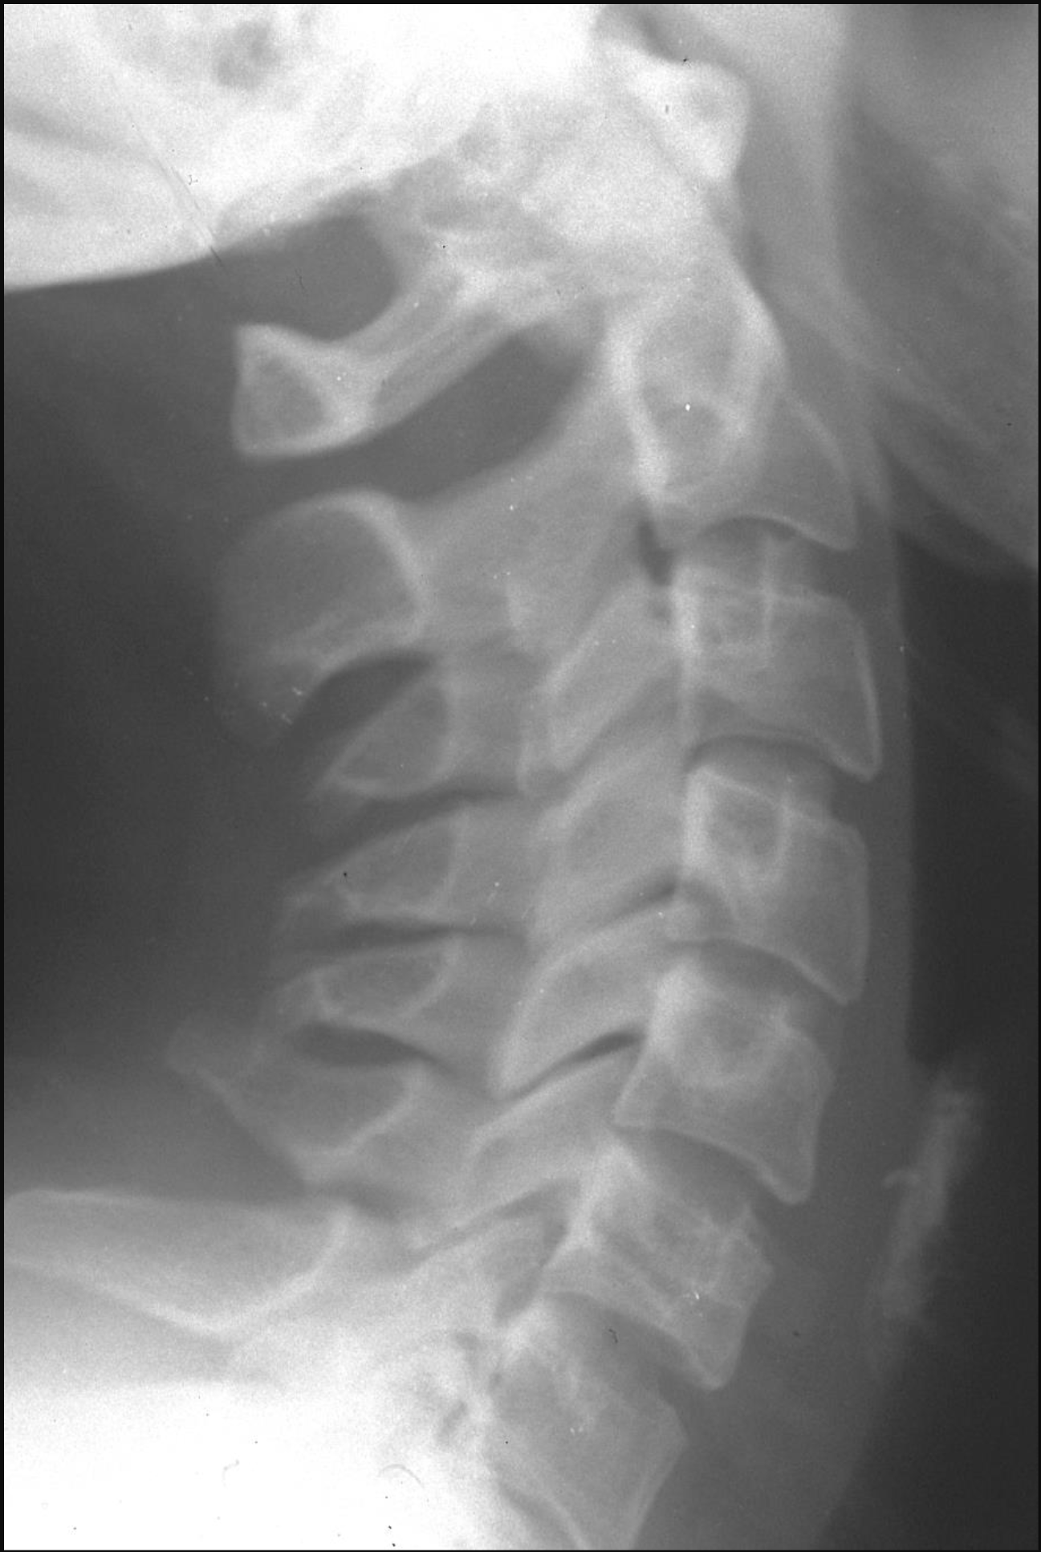

x-Ray / Halsrygg
©ACS
Notes:
Lateral cervical spine x-ray – without abnormalities

Slide 4
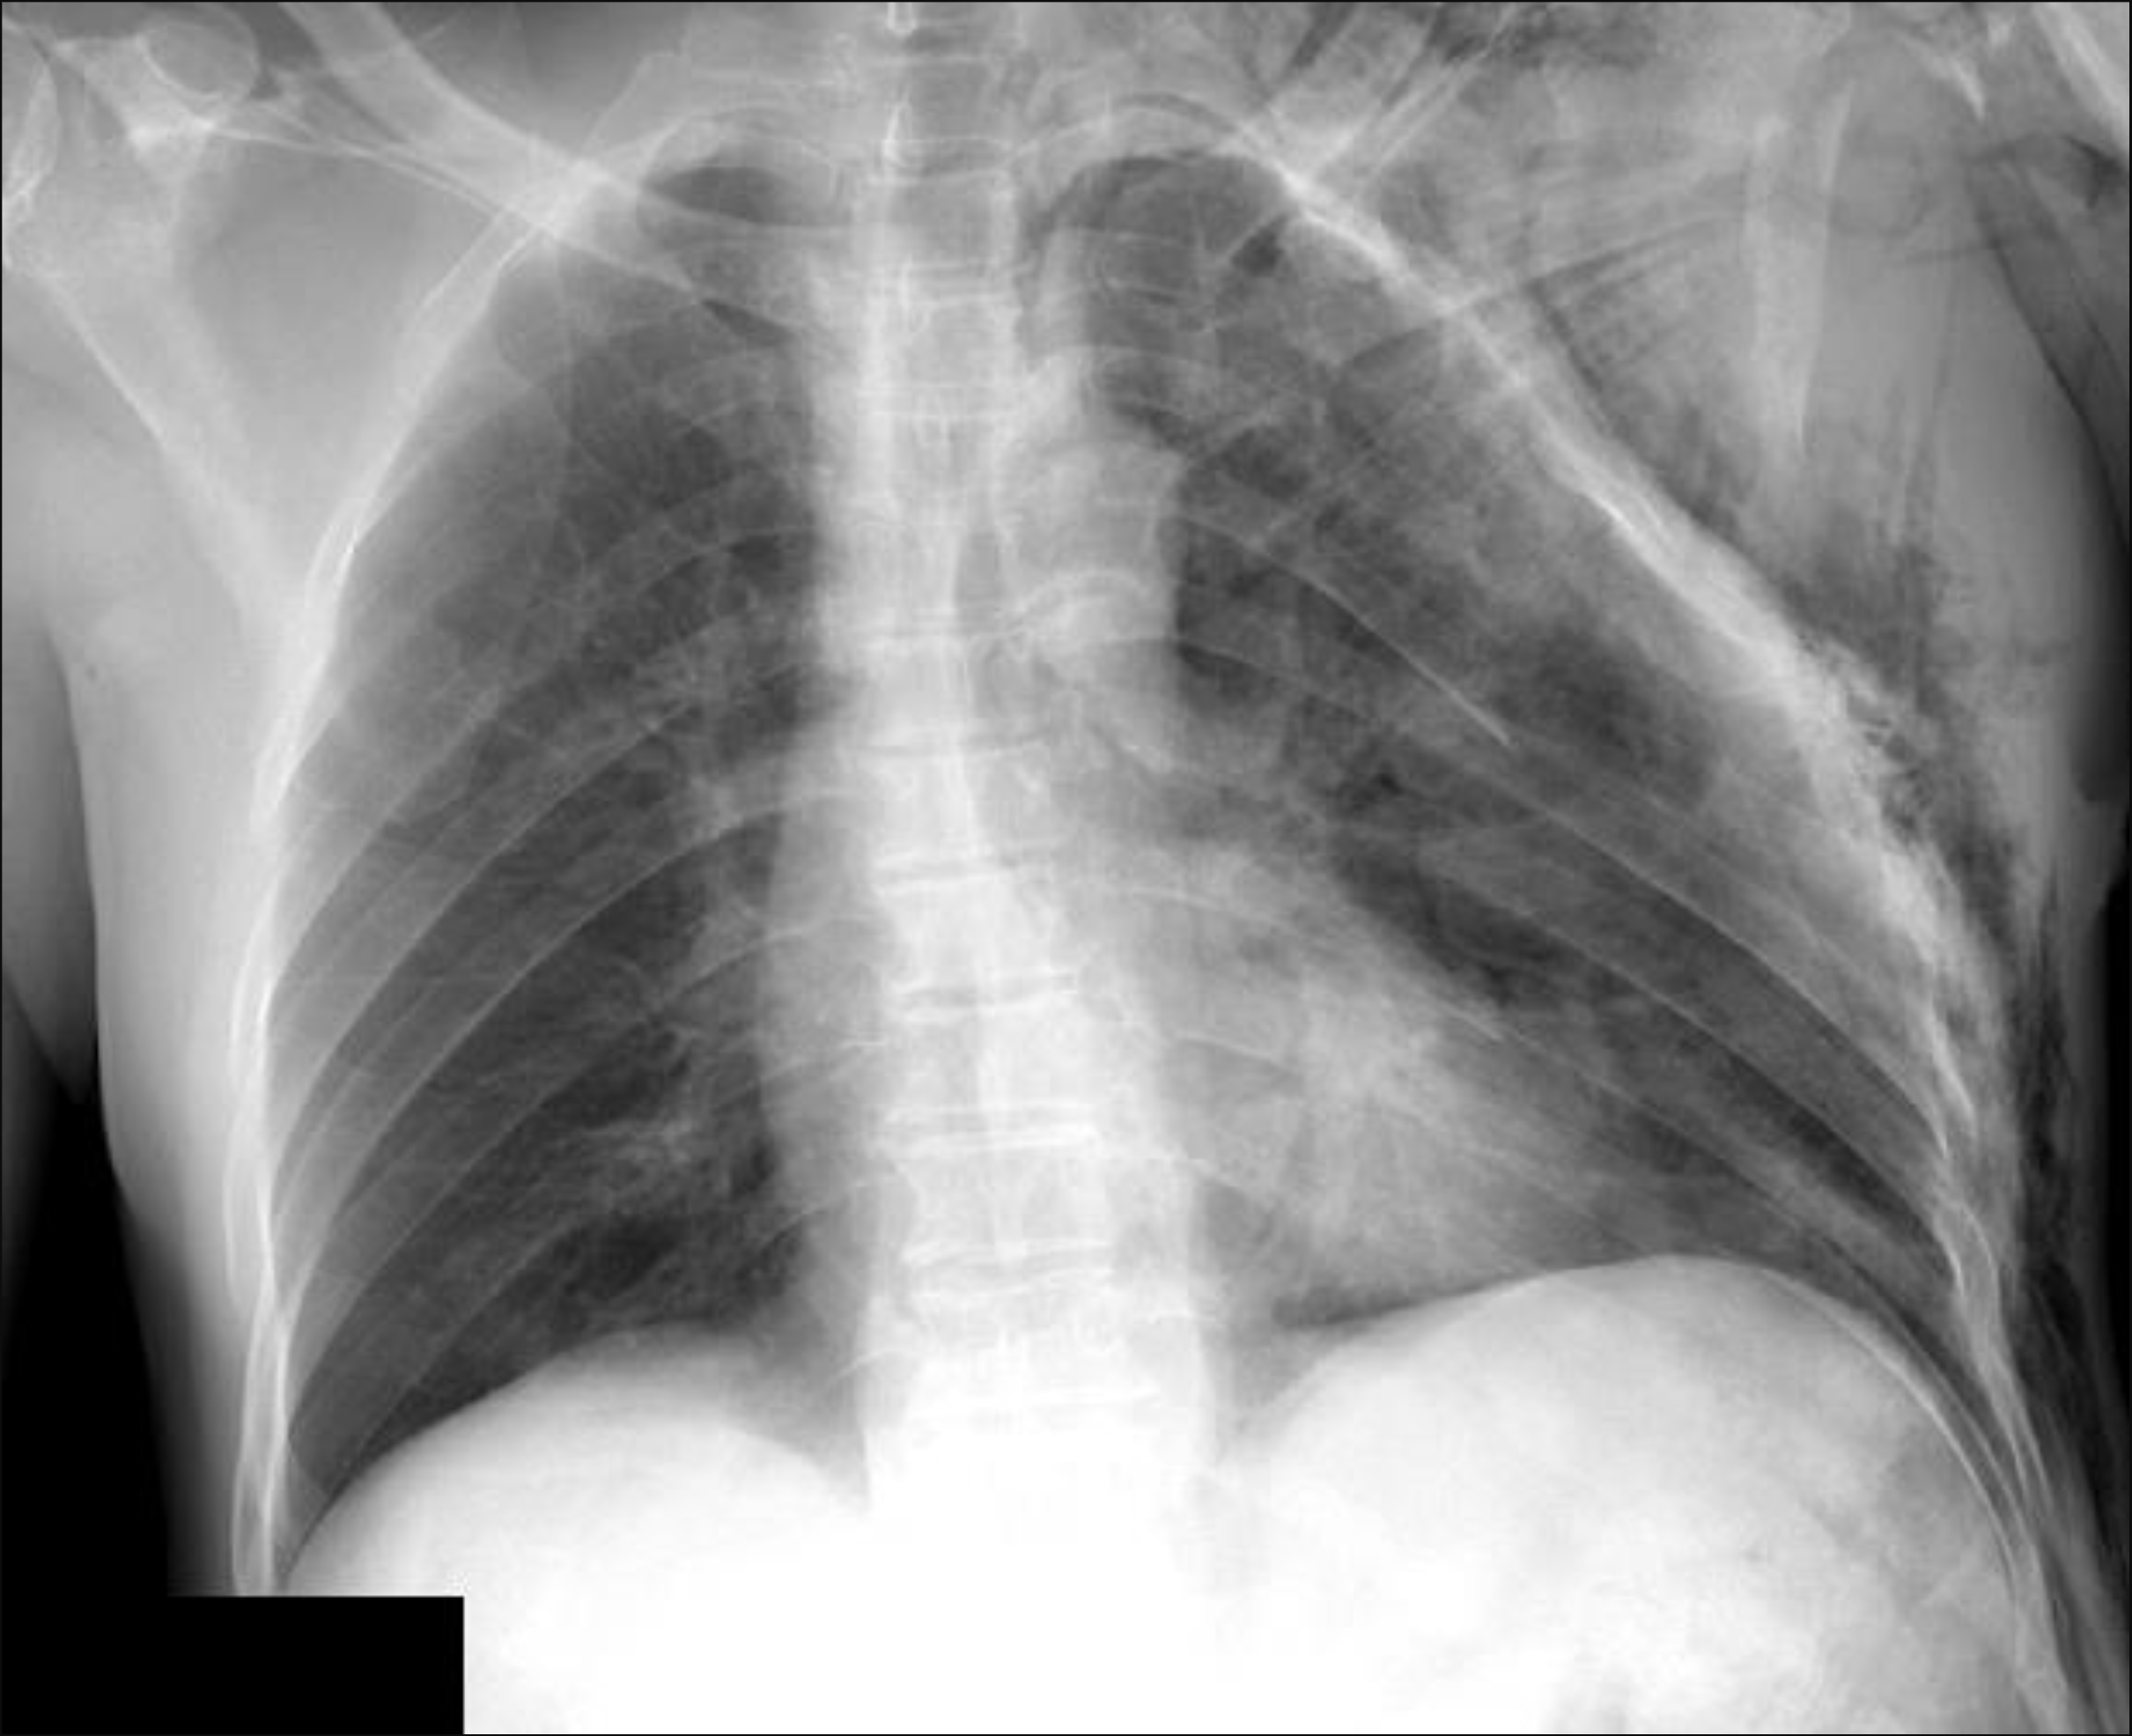
x-Ray / Thorax
©ACS
Notes:
Chest x-ray – left pneumothorax, multiple left rib fractures, subcutaneous emphysema

Slide 5


FAST
©ACS
Notes:
CASE Progression

Slide 6

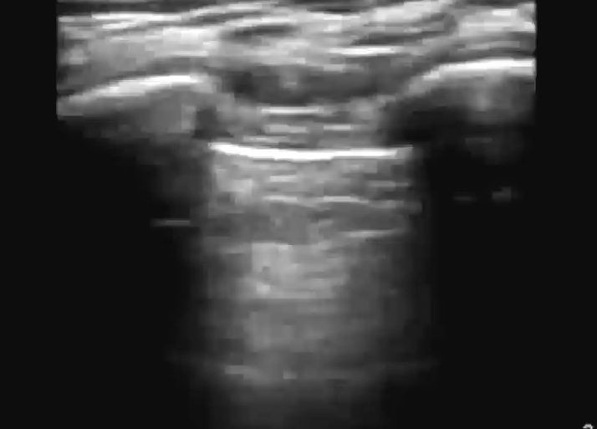
e-FAST / Vänster Lunga
M-Mode
©ACS
Notes:
No Lung Sliding

Slide 7
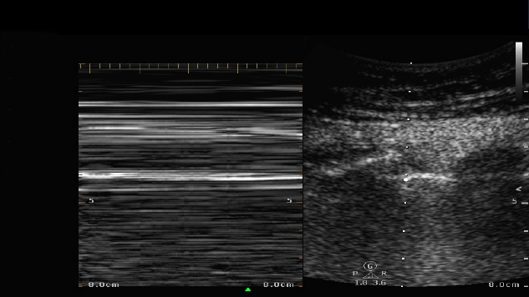
e-FAST / Vänster Lunga / M-Mode
©ACS
Notes:
Barcode sign

Slide 8

e-FAST / Höger Lunga
M-Mode
©ACS
Notes:
CASE Progression

Slide 9

e-FAST / Höger Lunga / M-Mode
©ACS
Notes:
CASE Progression

Slide 10

FAST / Subxiphoidalt
©ACS
Notes:
CASE Progression

Slide 11

FAST / RUQ
©ACS
Notes:
CASE Progression

Slide 12
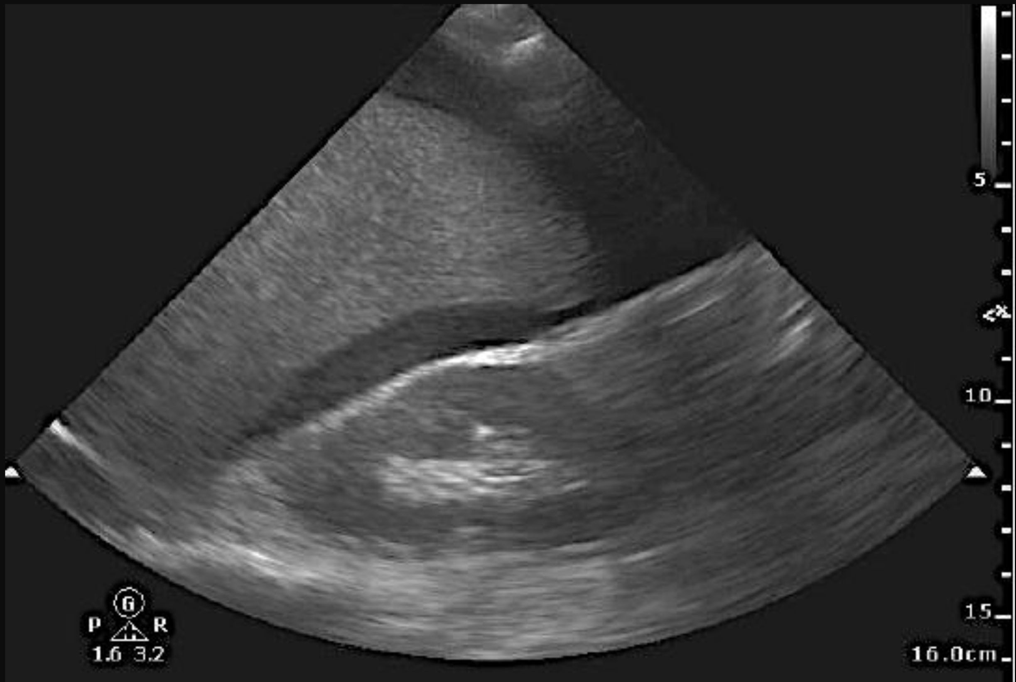
FAST / LUQ
©ACS
Notes:
FAST (left upper quadrant) – intra-abdominal fluid is present

Slide 13
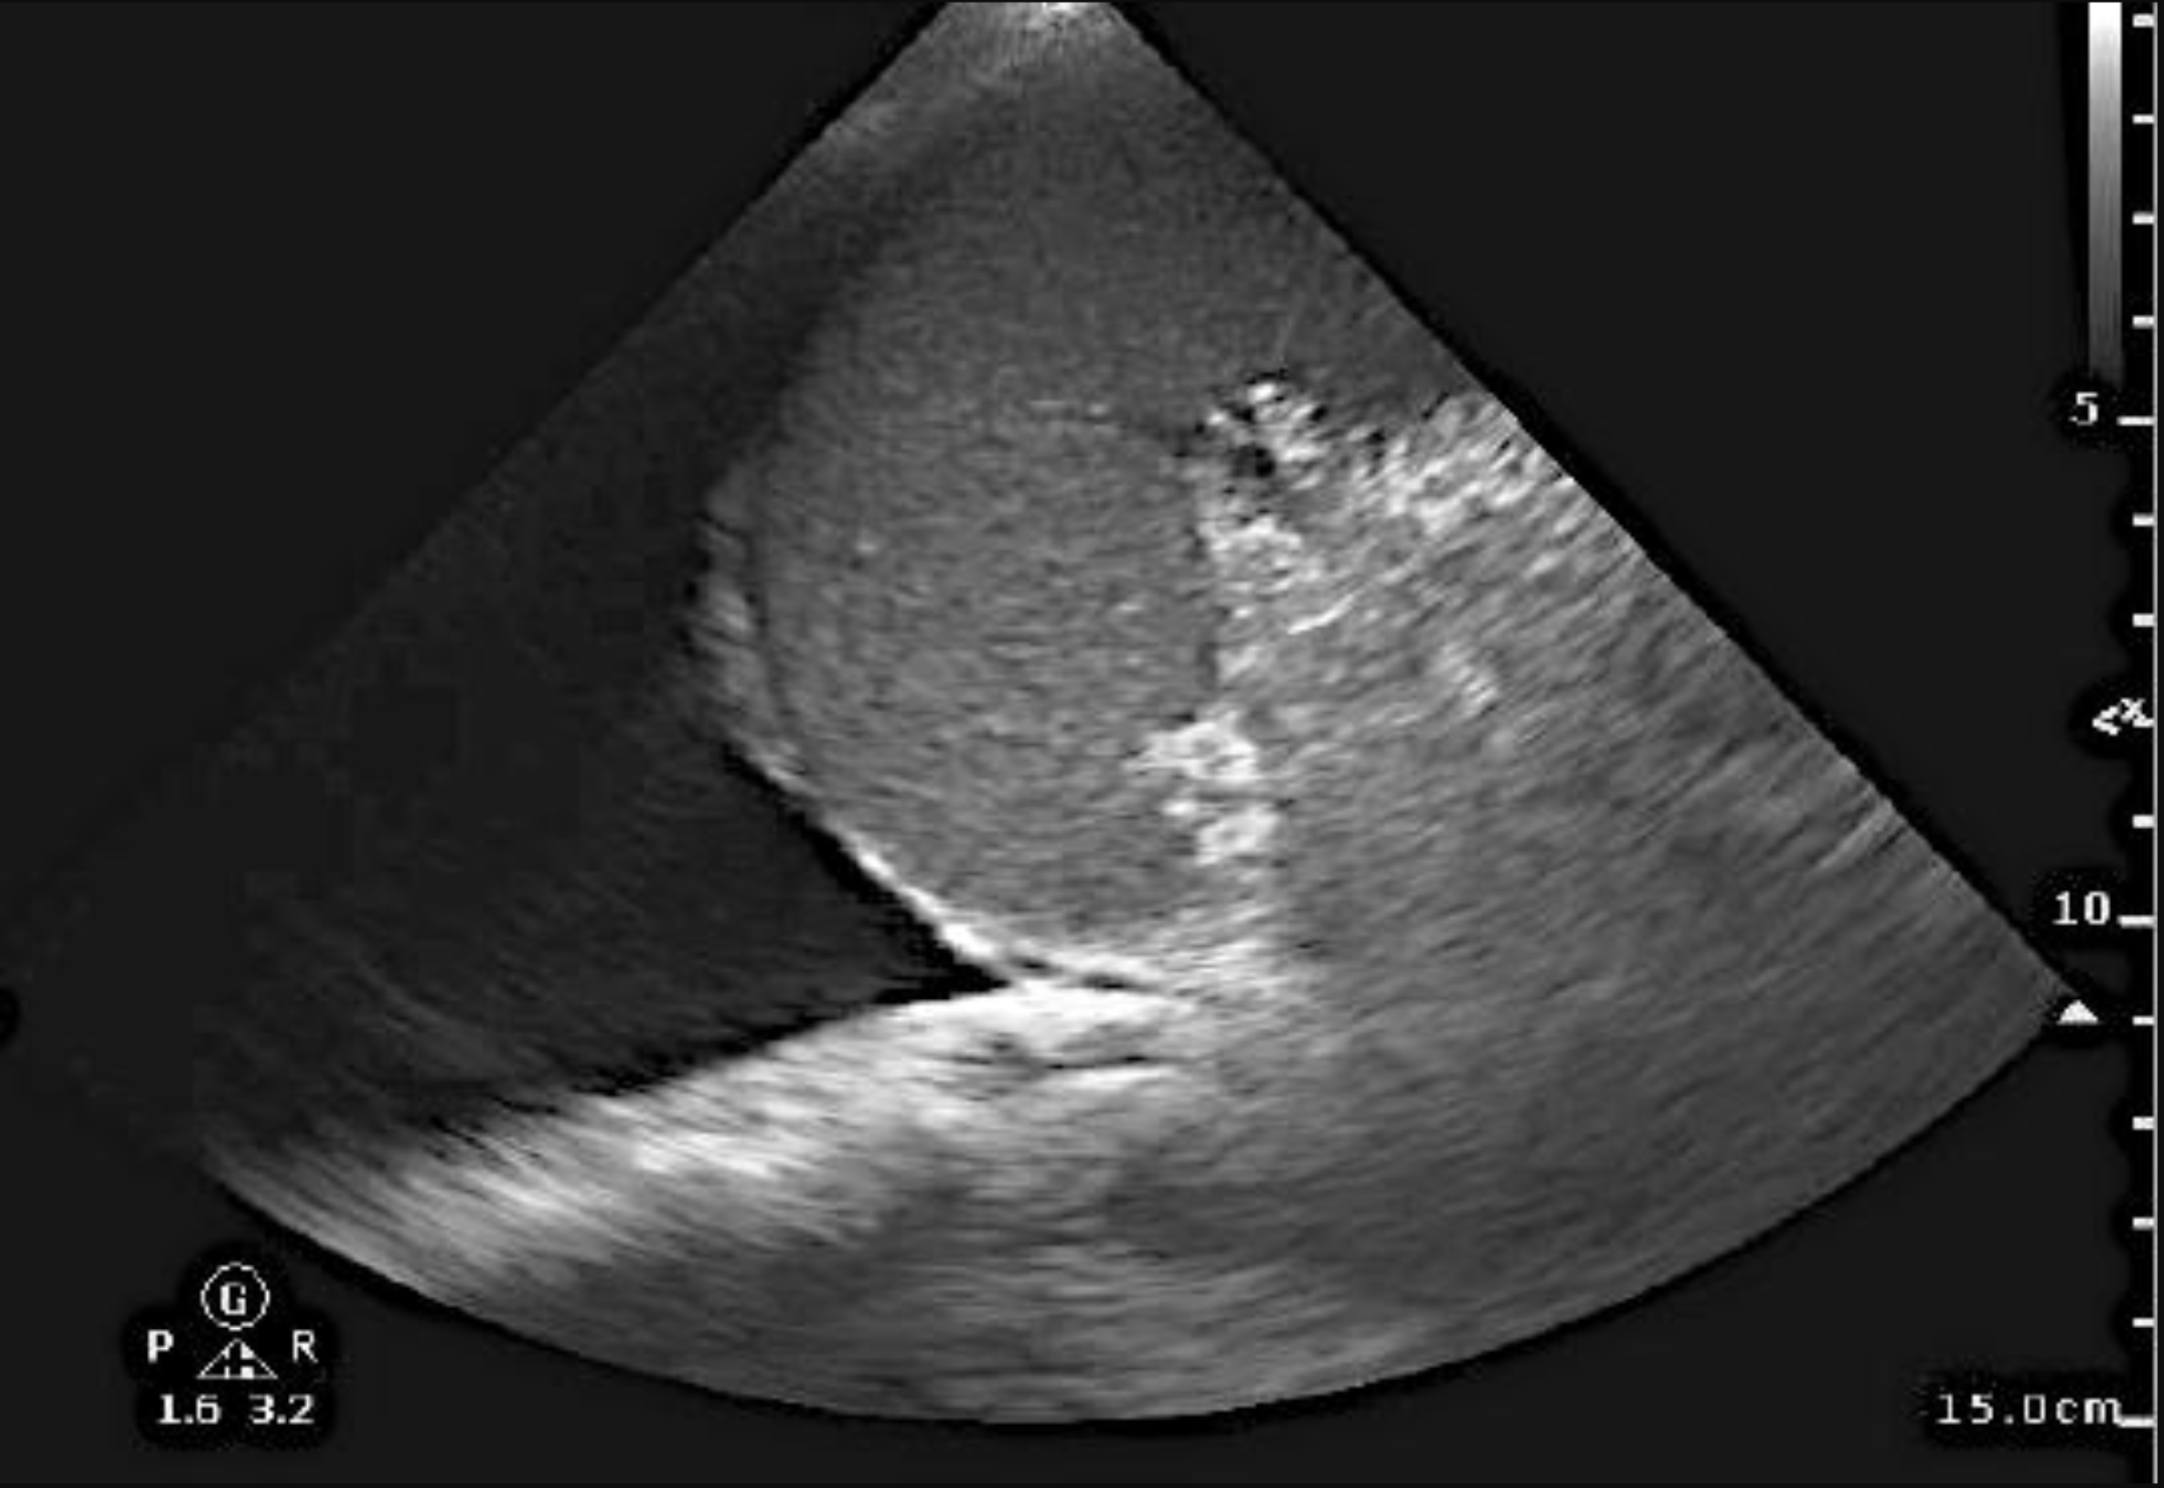
FAST / LUQ
©ACS
Notes:
eFAST (left chest and left upper quadrant) – intra-abdominal fluid is present

Slide 14

FAST / Pelvis
Dålig insyn
©ACS

Slide 15
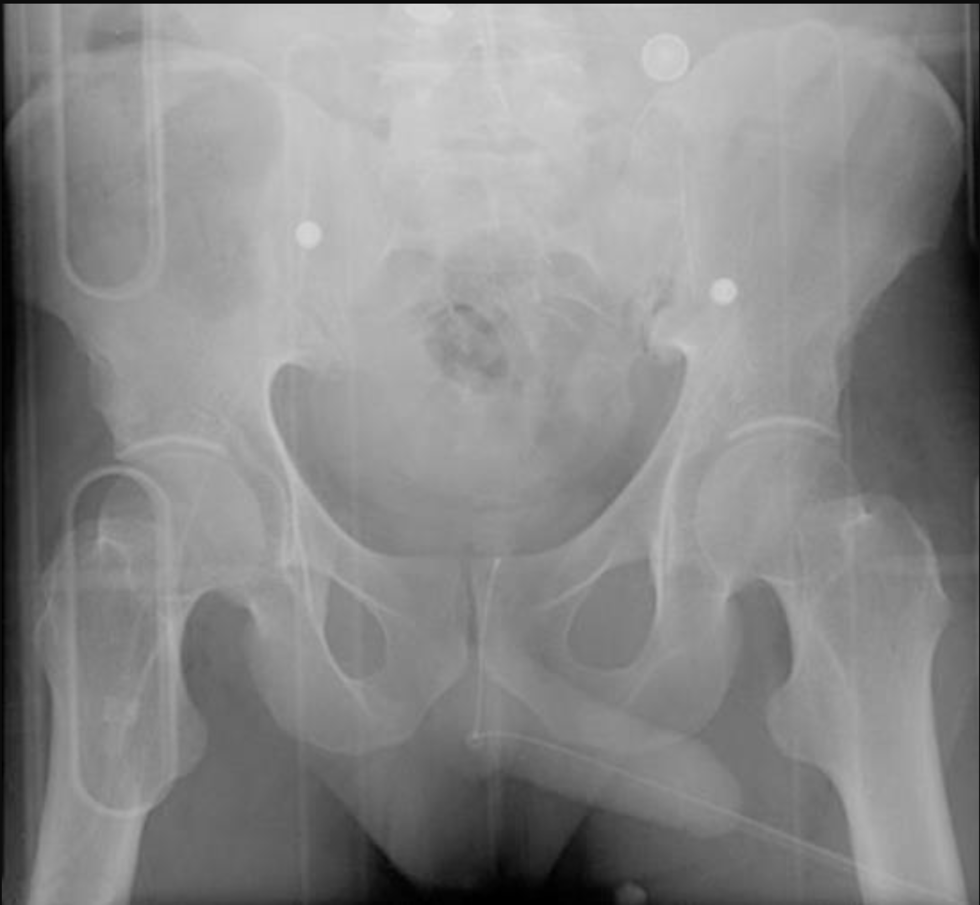
x-Ray / Bäcken
©ACS
Notes:
Pelvic x-ray - no pelvic fractures present

Slide 16
x-Ray / Extremitet
©ACS
Notes:
CASE Progression

Slide 17
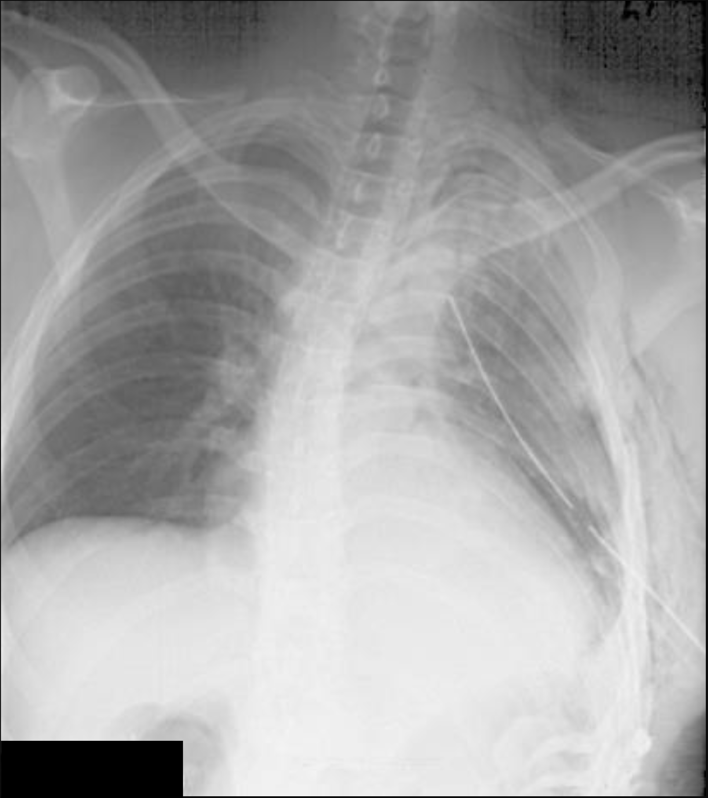
Akut behandling
©ACS
Notes:
Chest x-ray – left tube thoracostomy, resolution of pneumothorax, multiple left rib fractures, subcutaneous emphysema.

Slide 18

©ACS
Notes:
CASE Progression

Slide 19

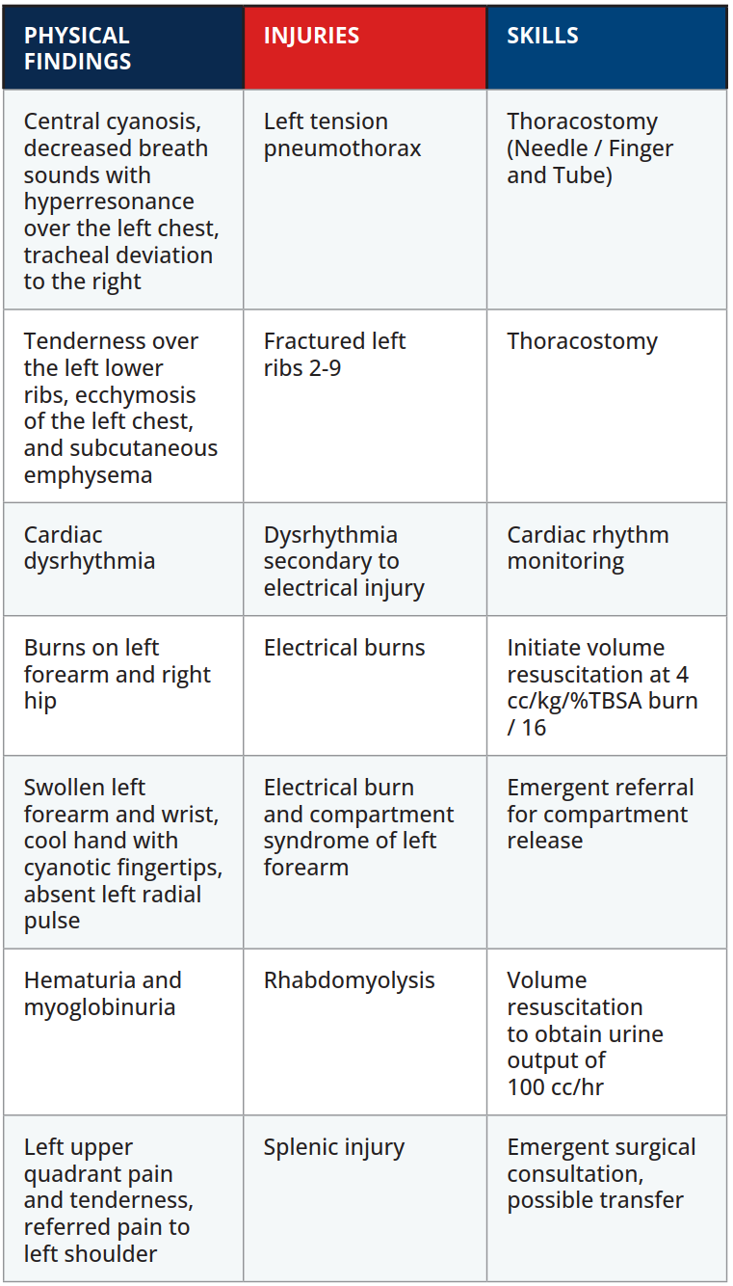

Scenario Sammanfattning
EXAMINATION
©ACS
Notes:
.

Slide 20

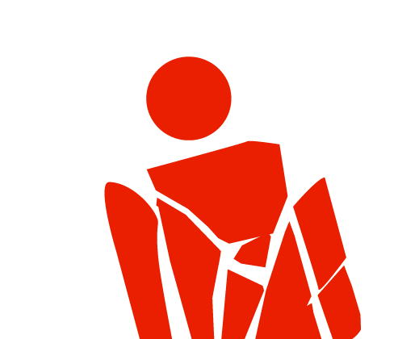
Tack
©ACS

