Slide 1

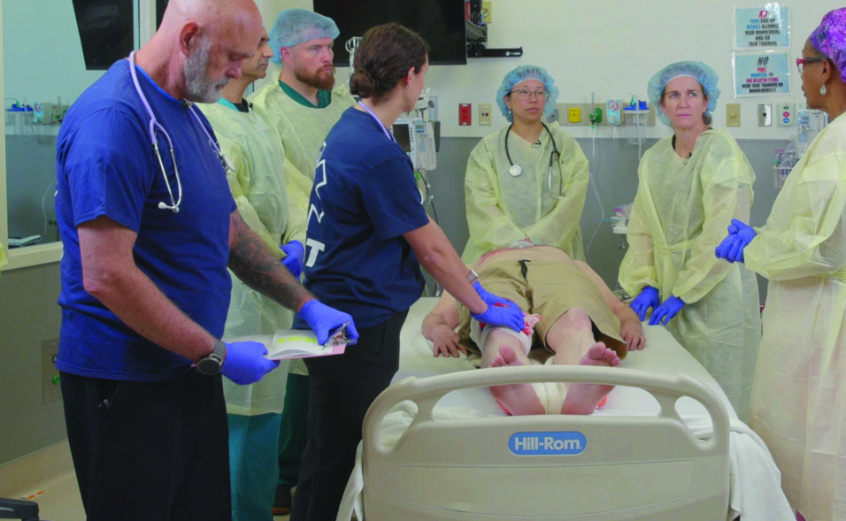

Examination
Patientfall L
Notes:
Välkommen

Slide 2







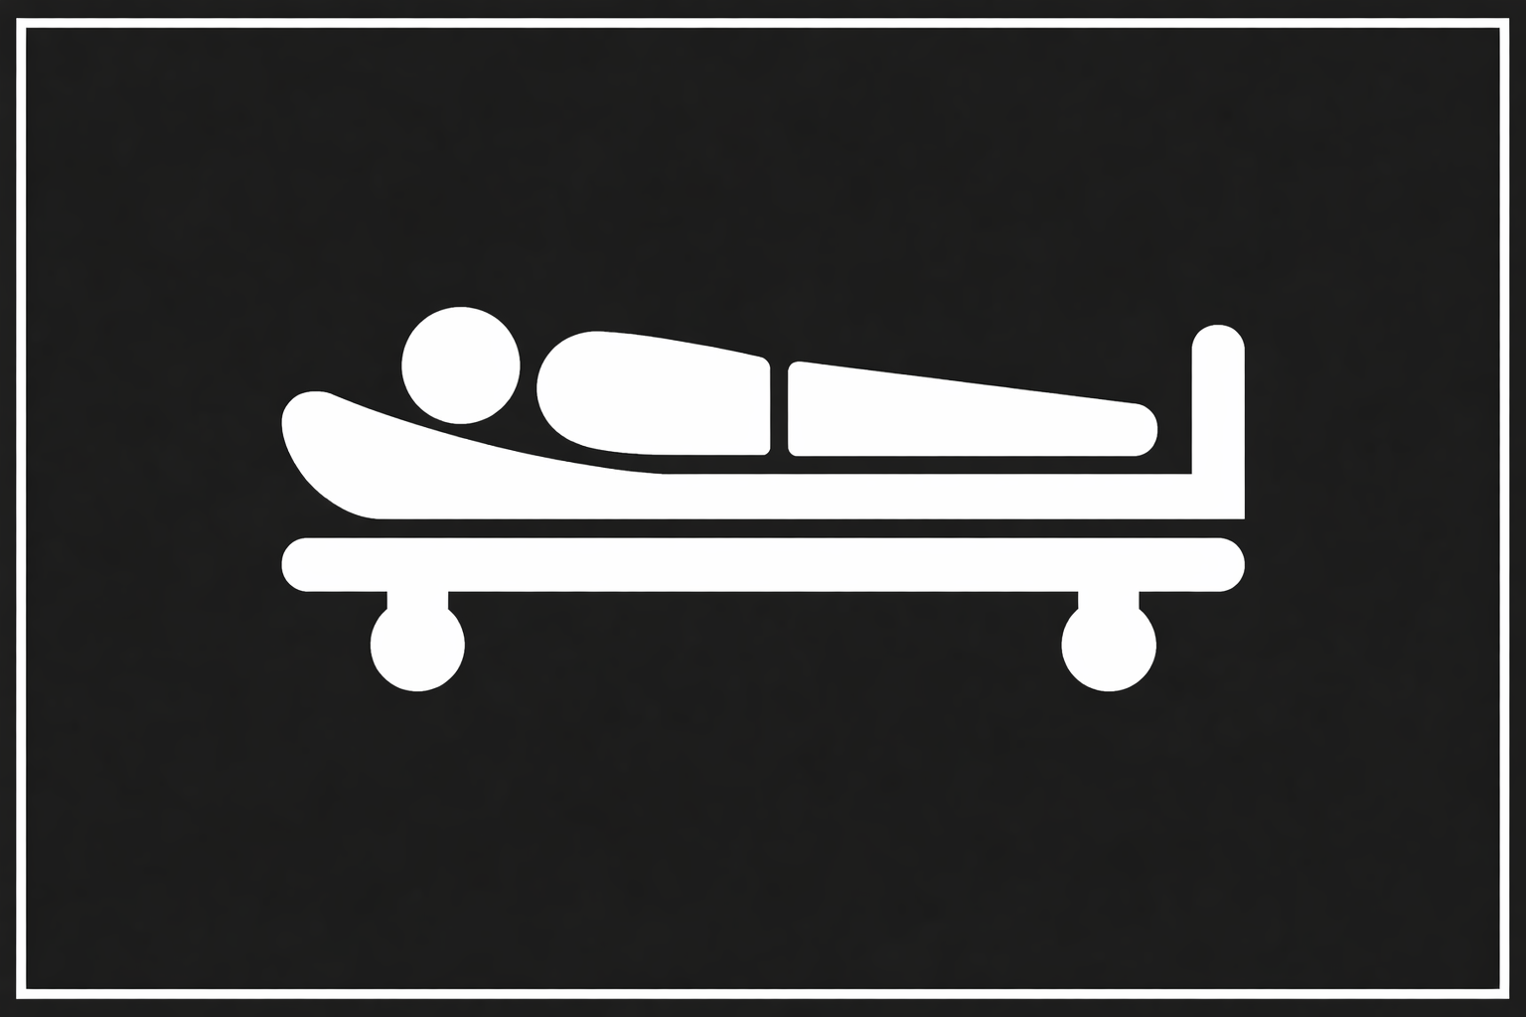
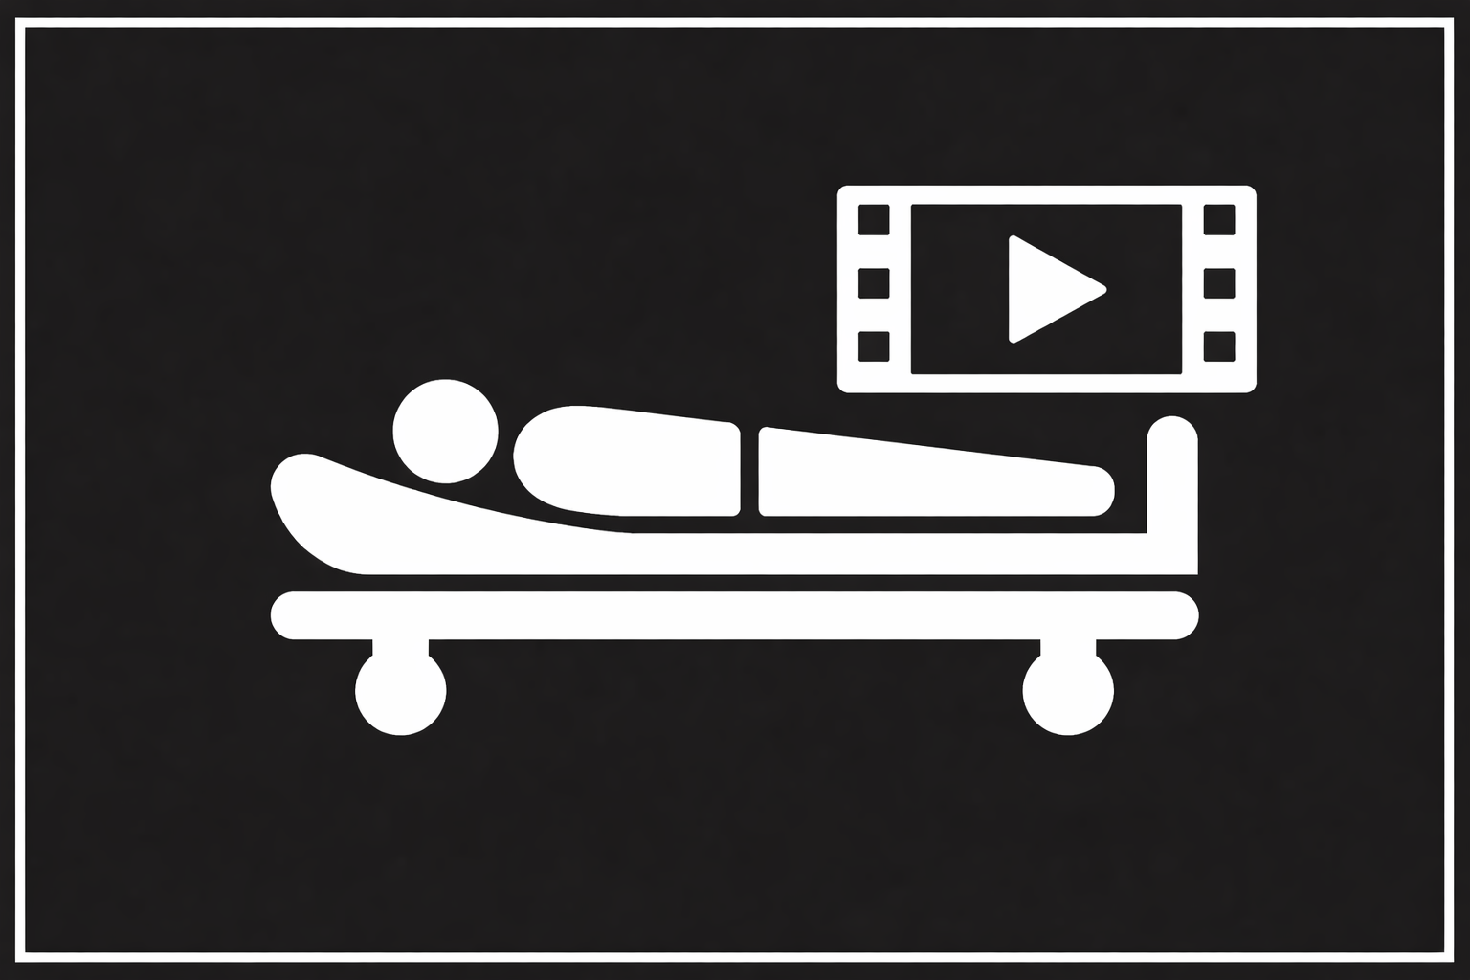




A 20-year-old presents by private vehicle to the ER reporting several stab wounds to the right arm, chest, and abdomen.
Scenario
M
Profuse bleeding coming from the right arm despite local pressure. Reported stab wounds to the right arm, chest, and upper abdomen.
ED of a community hospital with surgical capabilities.
S
Respirations are rapid and shallow. The patient speaks in short, gasping words, and is pale and anxious. Lips are cyanotic.
T
The patient is immediately transported to the emergency treatment bay.
©ACS
Notes:
CASE Scenario

Slide 3


x-Ray / Thorax
Radiographer is on the way
©ACS

Slide 4


FAST
©ACS
Notes:
CASE Progression

Slide 5


e-FAST / Vänster Lunga
M-Mode
©ACS
Notes:
CASE Progression

Slide 6

e-FAST / Vänster Lunga / M-Mode
©ACS
Notes:
CASE Progression

Slide 7
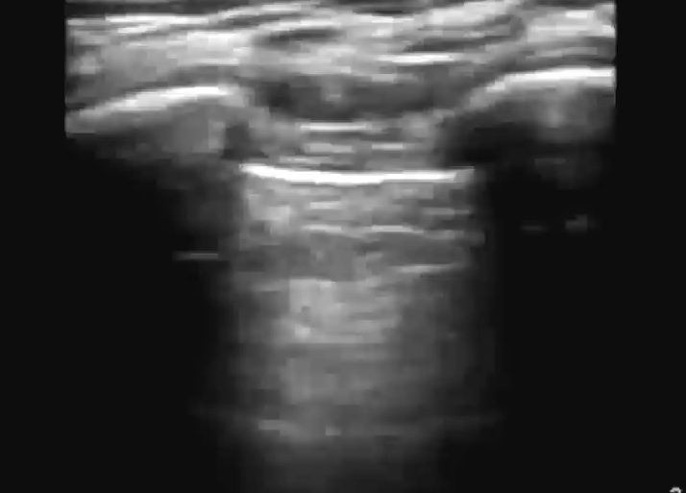
e-FAST / Höger Lunga
M-Mode
©ACS
Notes:
No Lung Sliding

Slide 8
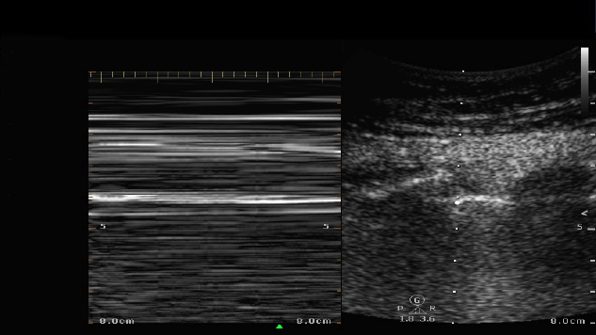
e-FAST / Höger Lunga / M-Mode
©ACS
Notes:
Barcode Sign

Slide 9

FAST / Subxiphoidalt
©ACS
Notes:
CASE Progression

Slide 10
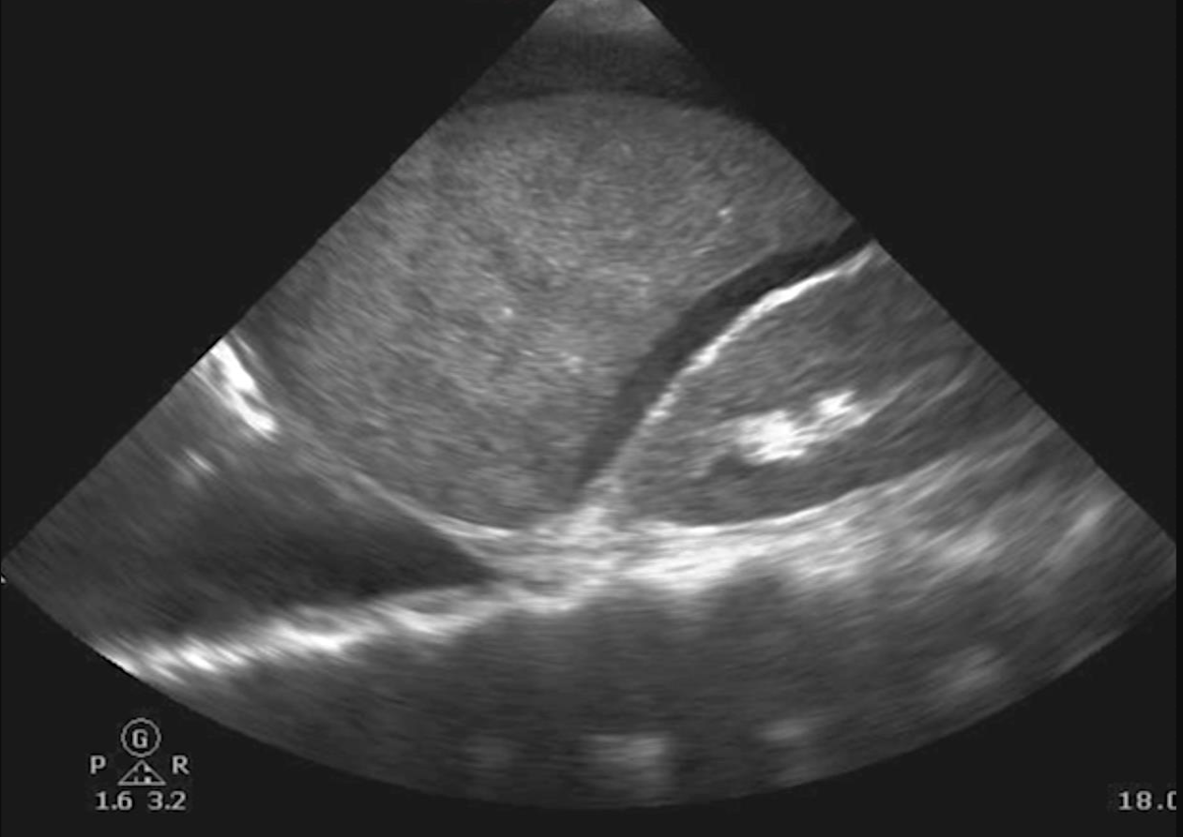
FAST / RUQ
©ACS
Notes:
FAST – (right upper quadrant) intra-abdominal fluid
Chest x-ray – right thoracostomy tube

Slide 11

FAST / LUQ
©ACS

Slide 12

FAST / Pelvis
Dålig insyn
©ACS

Slide 13
x-Ray / Bäcken
Radiographer is on the way
©ACS

Slide 14
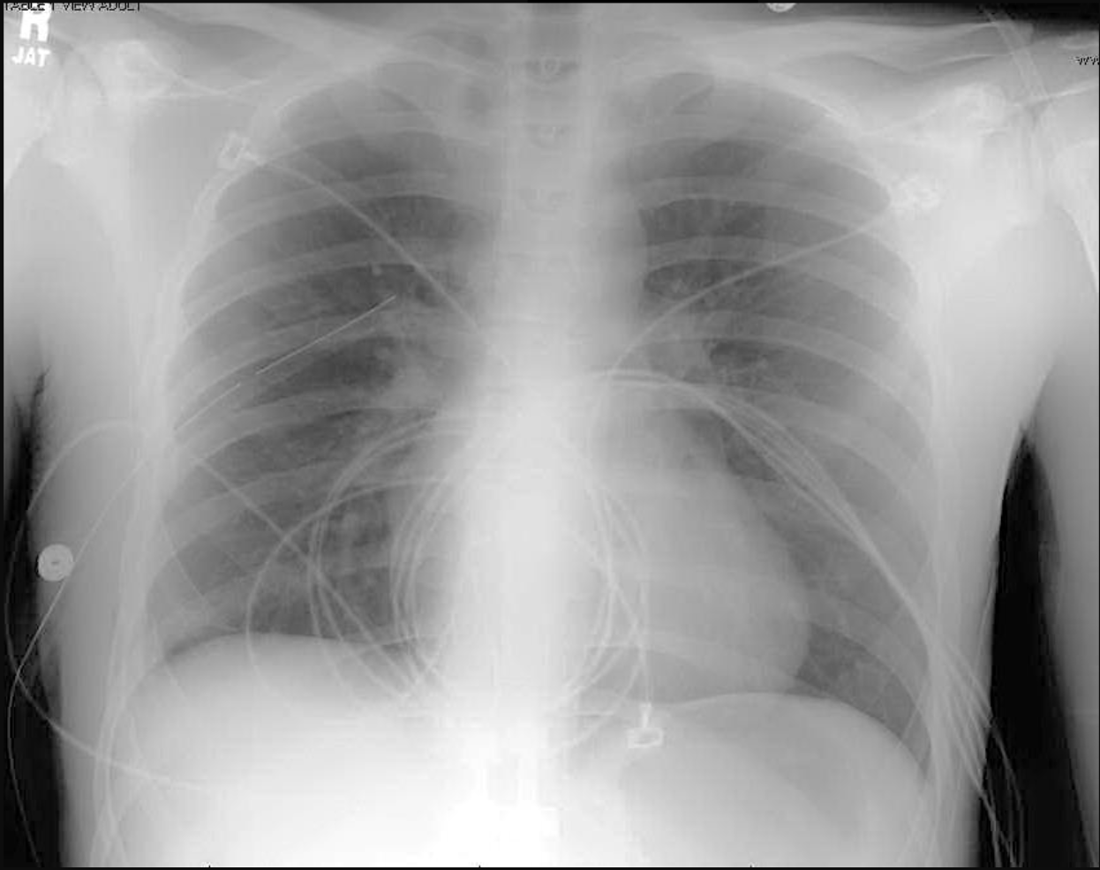
Akut behandling
©ACS
Notes:
Chest x-ray – right thoracostomy tube

Slide 15
©ACS
Notes:
CASE Progression

Slide 16

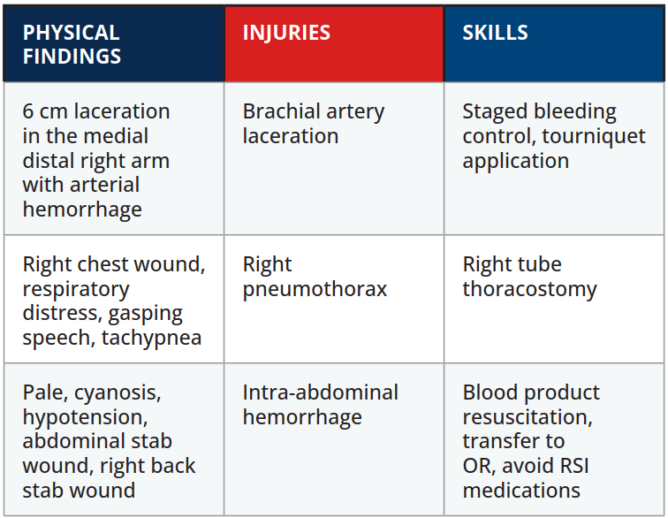

Scenario Sammanfattning
EXAMINATION
©ACS
Notes:
.

Slide 17


Tack
©ACS

