Slide 1

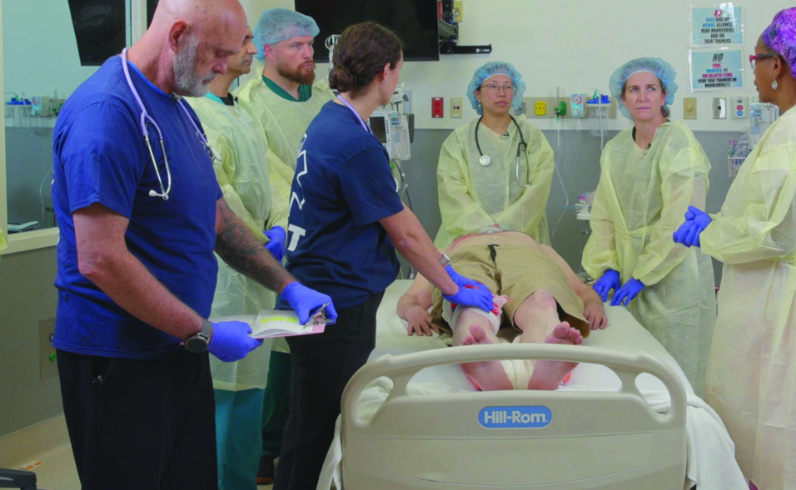

Examination
Patientfall I
Notes:
Välkommen

Slide 2






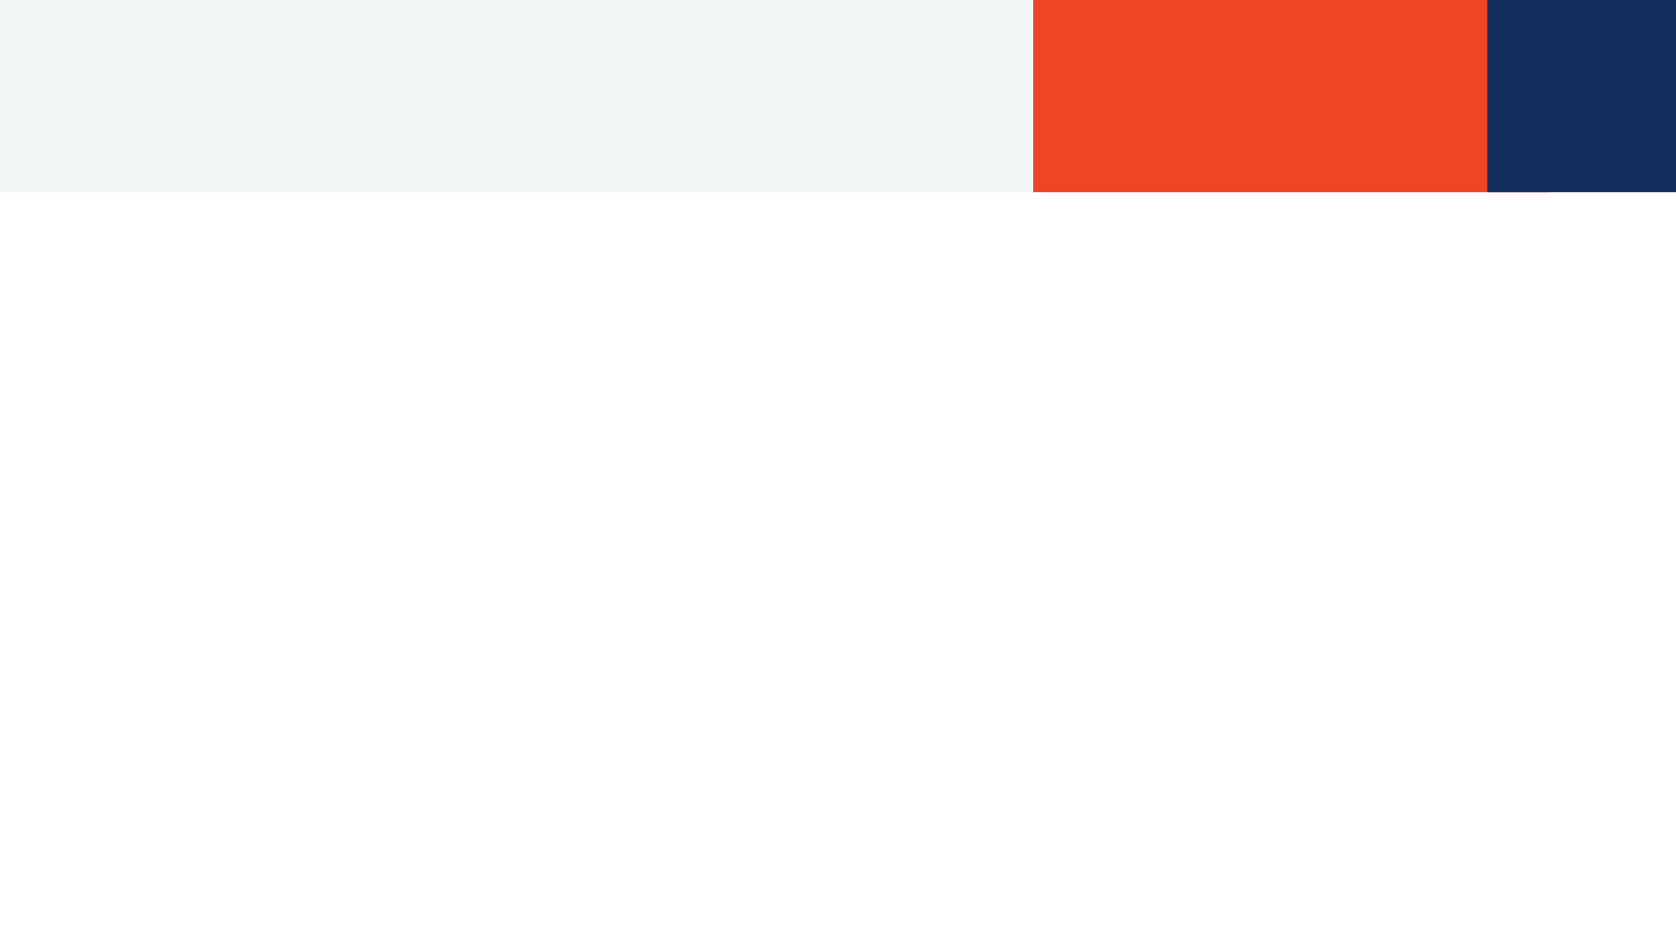






35-year-old sustained a knife injury to the left chest in a reported domestic dispute 5 minutes prior to ambulance arrival.
Scenario
M
A 2cm sucking stab wound left 3 ICS, just anterior to the midaxillary line. Left breath sounds are diminished. The skin is cool.
ED of a community hospital with surgical capabilities.
S
AF 32, SAT 80%, HF 140, BT 80/40, responds only to painful stimuli by moaning and groaning.
Gauze over the chest wound. Oxygen via mask 12 L/min. 1 IV was inserted and 500cc of crystalloid solution was infused.
T
©ACS
Notes:
CASE Scenario

Slide 3
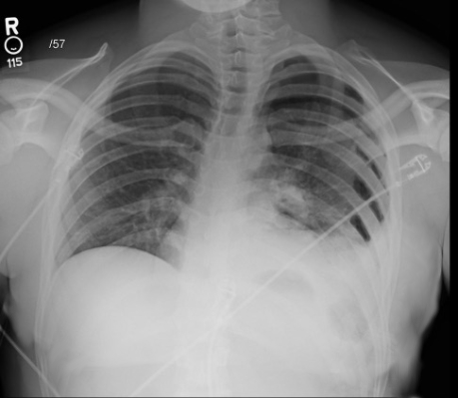

x-Ray / Thorax
Notes:
Chest x-ray - left pneumothorax

Slide 4


FAST
Notes:
CASE Progression

Slide 5

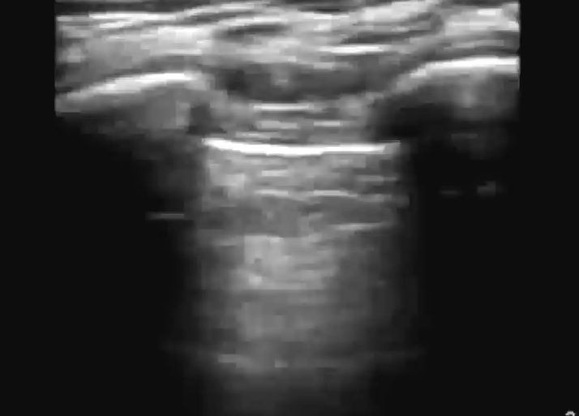
e-FAST / Vänster Lunga
M-Mode
Notes:
No Lung Sliding
eFAST (still images) – left “barcode sign” indicative
of pneumothorax, right normal “waves on a sandy beach” image

Slide 6
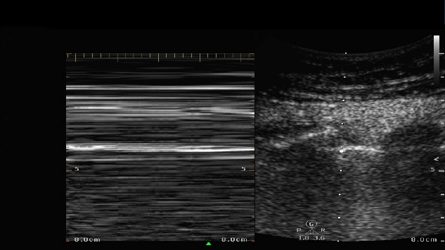
e-FAST / Vänster Lunga / M-Mode
Notes:
eFAST (still images) – left “barcode sign” indicative
of pneumothorax, right normal “waves on a sandy beach” image

Slide 7

e-FAST / Höger Lunga
M-Mode
Notes:
eFAST (still images) – left “barcode sign” indicative
of pneumothorax, right normal “waves on a sandy beach” image

Slide 8

e-FAST / Höger Lunga / M-Mode
Notes:
eFAST (still images) – left “barcode sign” indicative
of pneumothorax, right normal “waves on a sandy beach” image

Slide 9
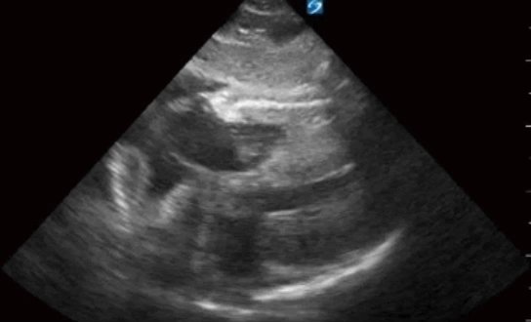
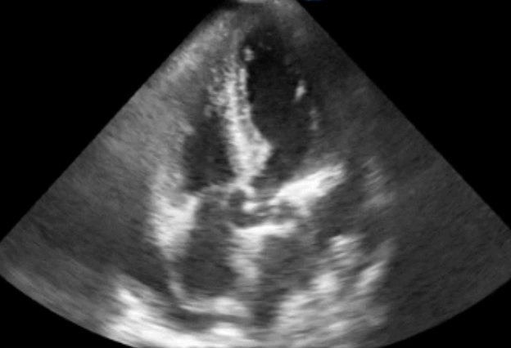
FAST / Subxiphoidalt
Notes:
Video above: FAST (pericardial window video) – pericardial fluid is present
Video below: FAST (pericardial window video) – pericardial fluid is present

Slide 10

FAST / RUQ
Notes:
CASE Progression

Slide 11

FAST / LUQ

Slide 12

FAST / Pelvis
Dålig insyn

Slide 13
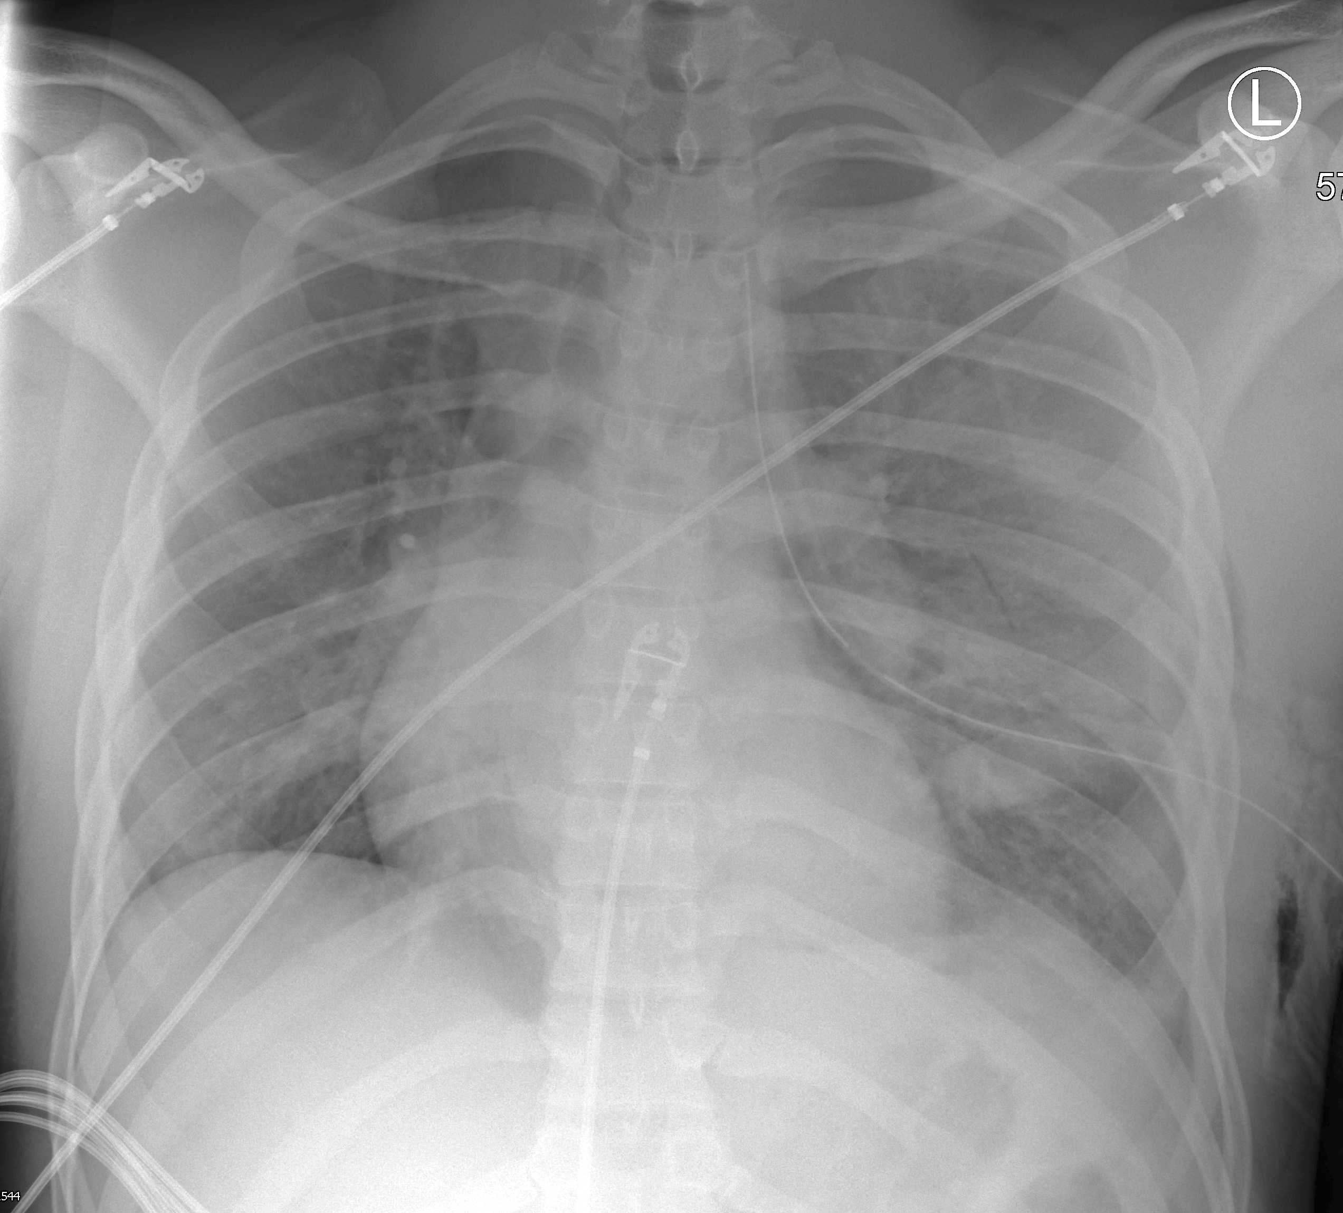
Akut behandling
Notes:
Chest x-ray – left thoracostomy tube, lung expanded

Slide 14

©ACS
Notes:
CASE Progression

Slide 15

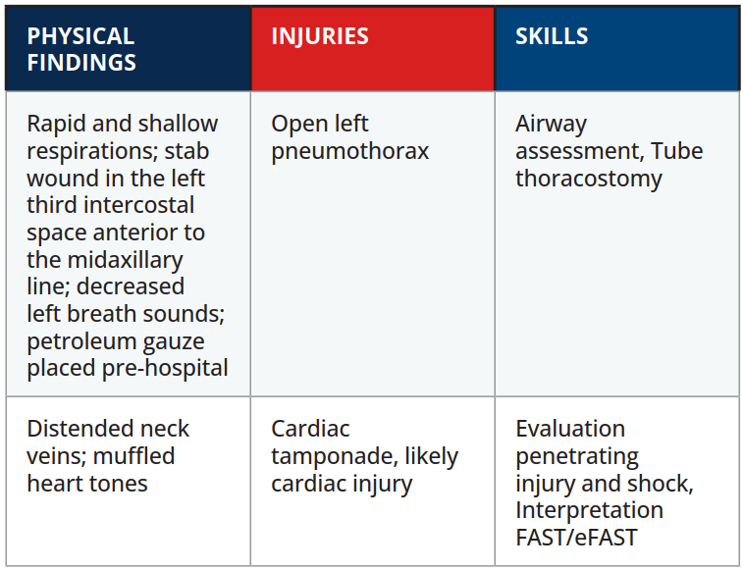

Scenario Sammanfattning
EXAMINATION
©ACS
Notes:
.

Slide 16


Tack
©ACS

