Slide 1

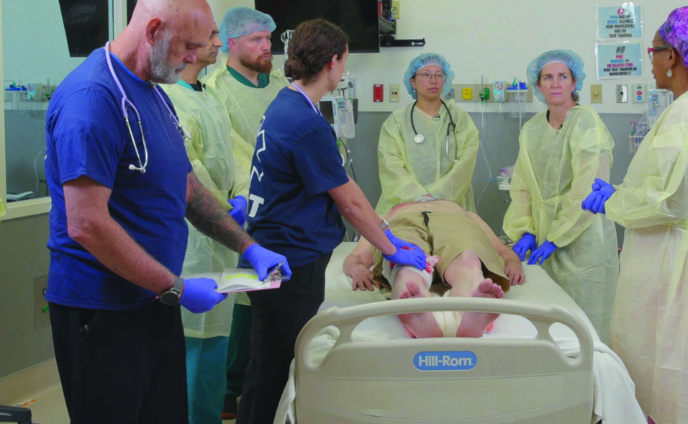

Examination
Patientfall E
Notes:
Välkommen

Slide 2
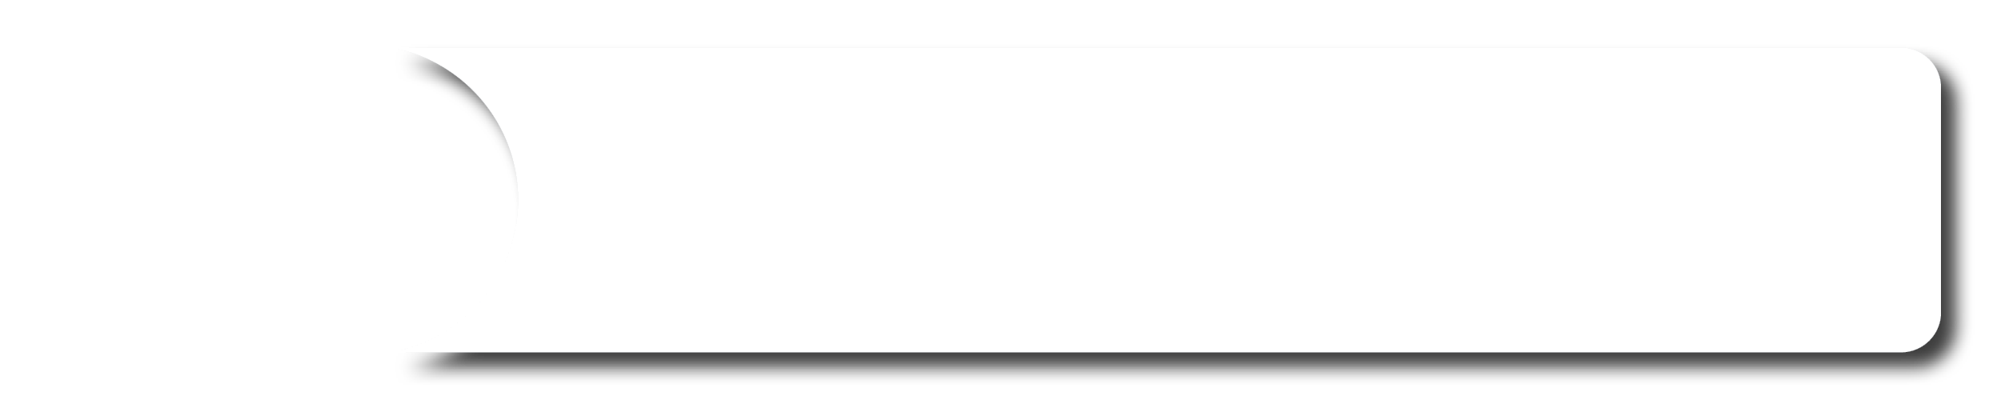






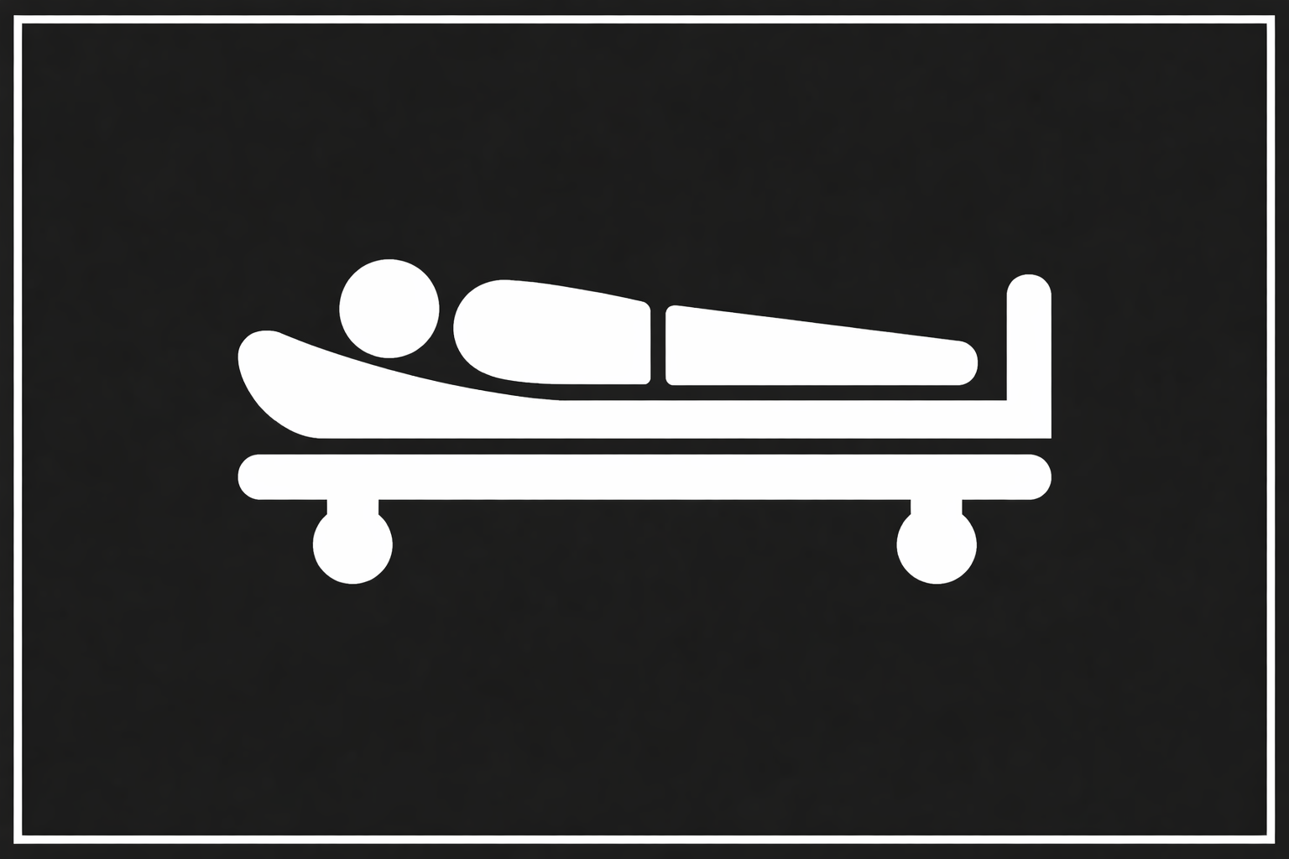
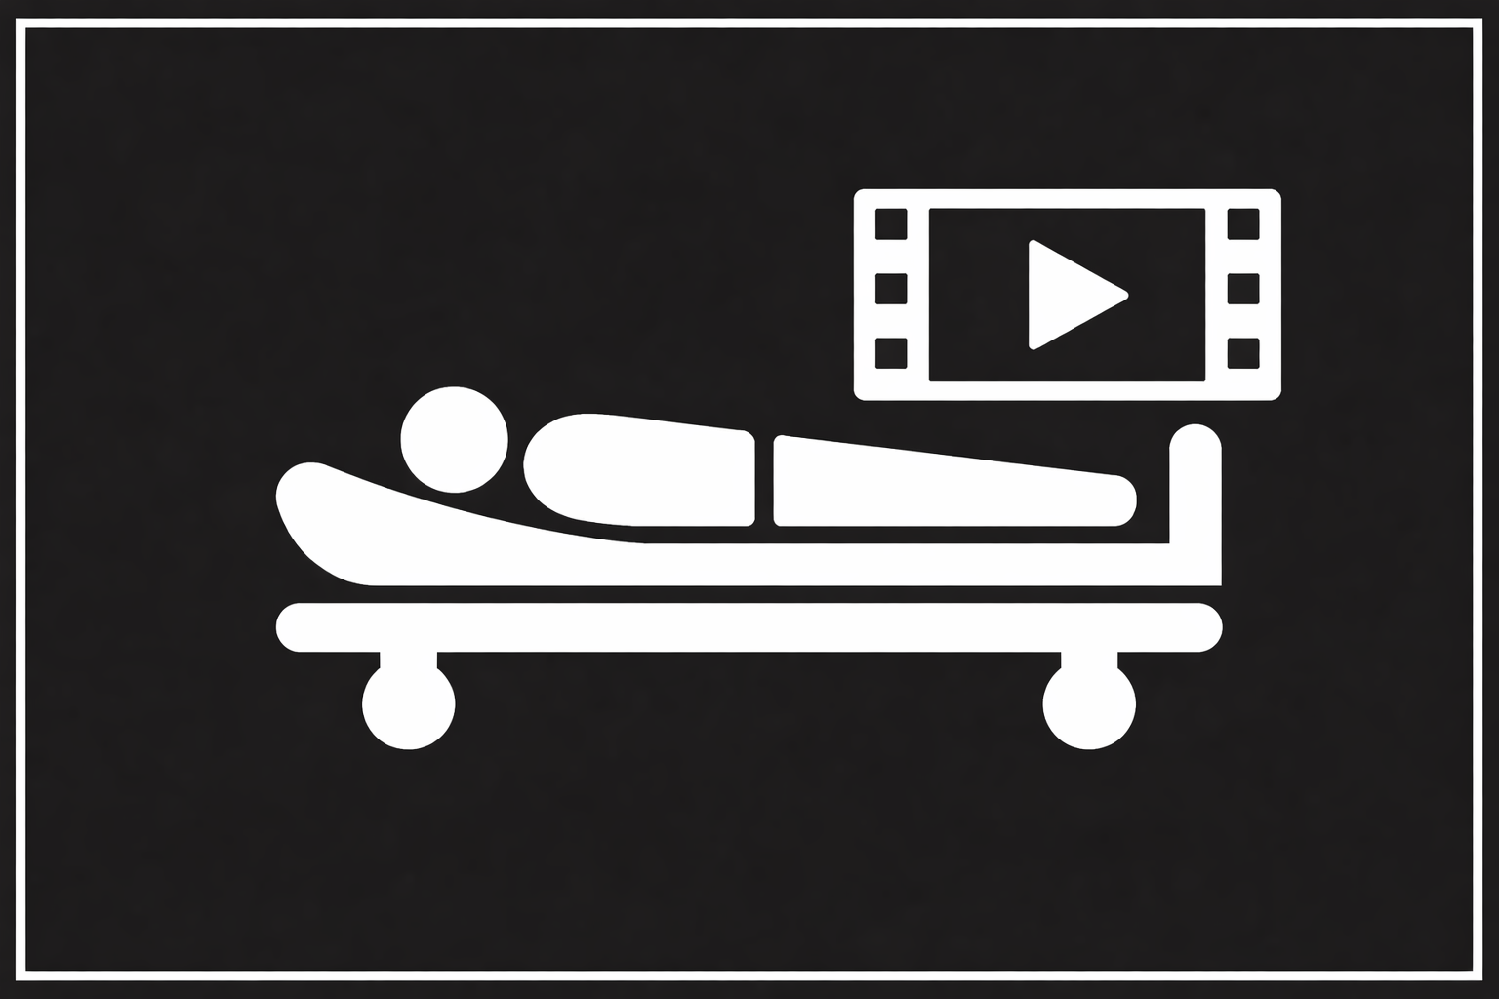




A 42-year-old male presents to the Emergency Area after being shot. A friend transported the patient by a private vehicle.
Scenario
M
The friend reports the patient has multiple bullet wounds and that injury occurred approximately 20min before arrival.
ED of a community hospital with surgical capabilities.
S
The friend reports the patient has become more ”sleepy”; the patient was able to walk to the car and was talking.
T
No treatments.
©ACS
Notes:
CASE Scenario

Slide 3
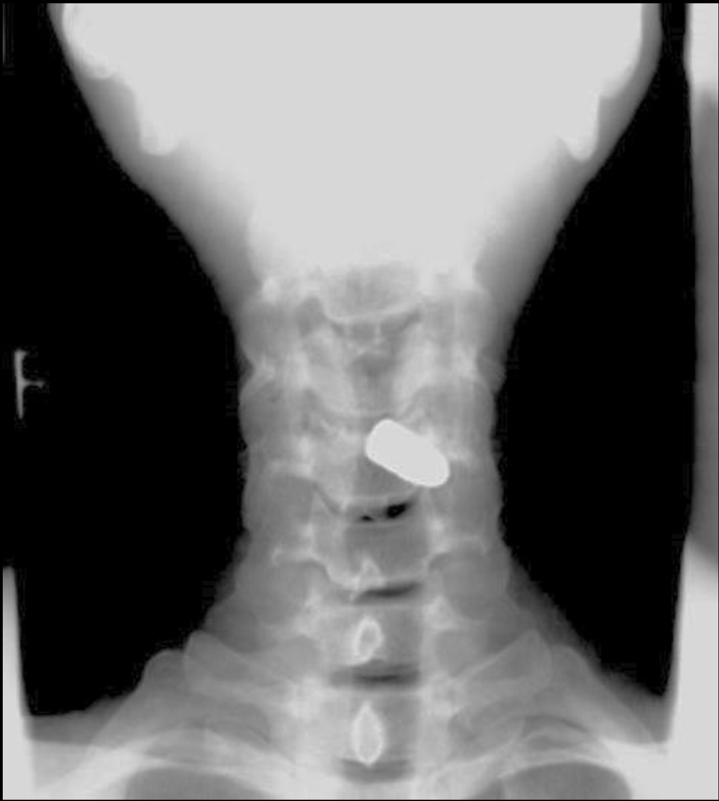
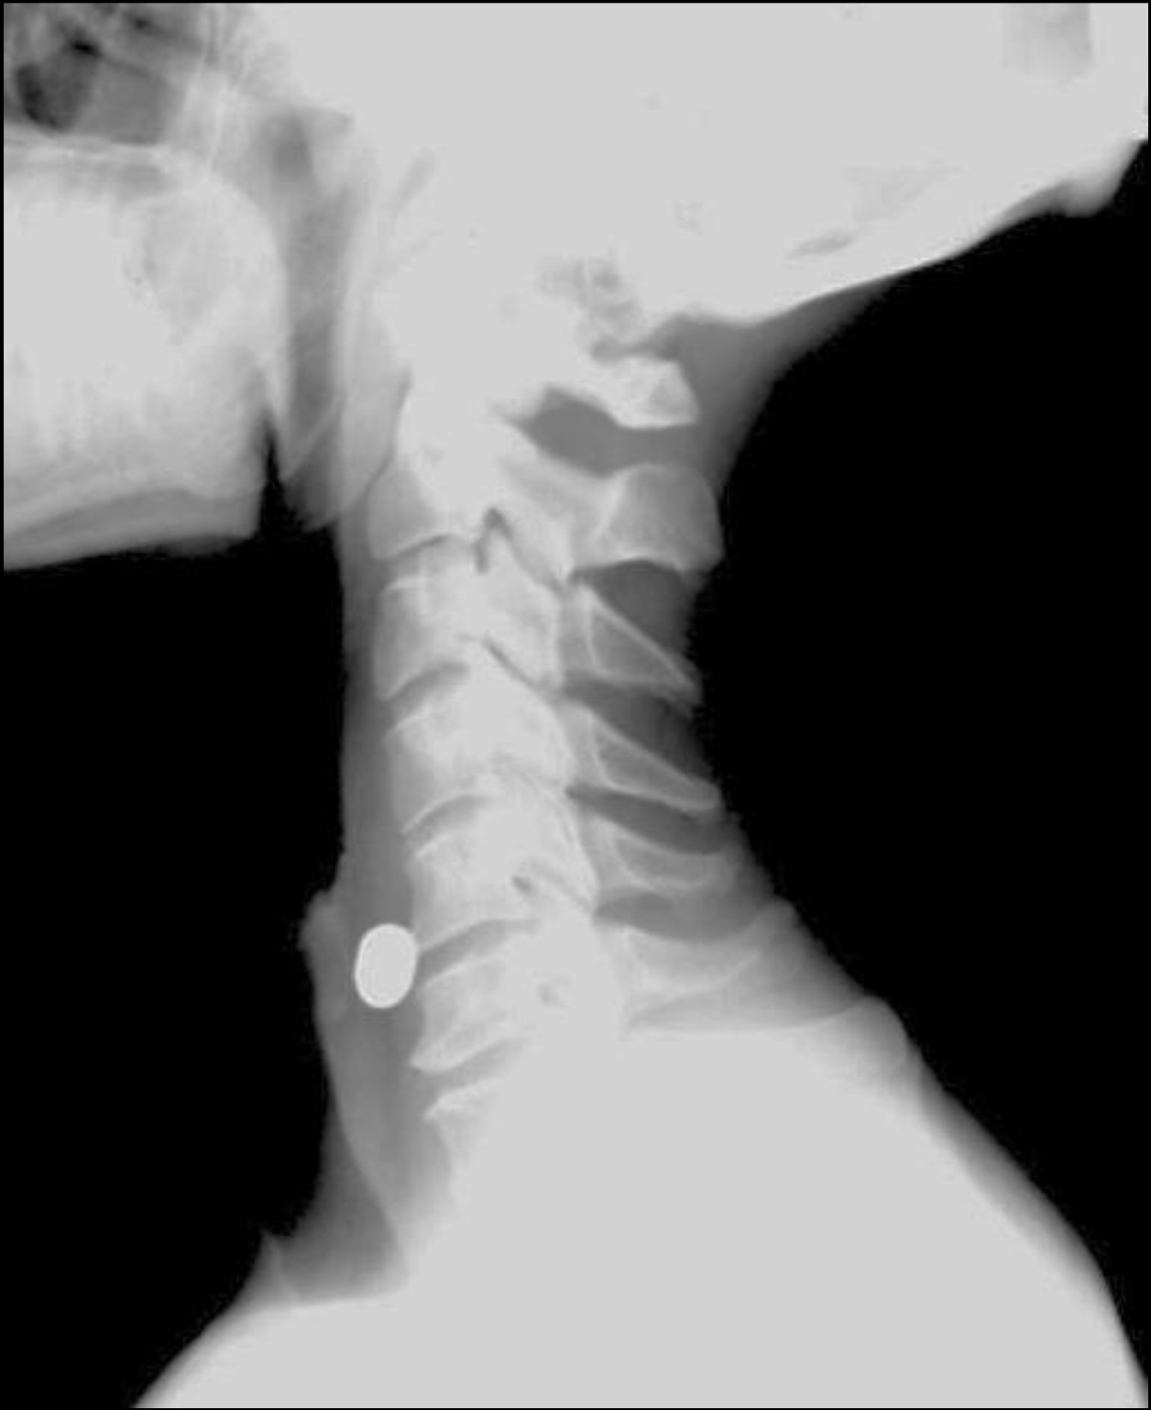

x-Ray / Halsrygg
©ACS
Notes:
AP cervical x-ray – metallic foreign body left of C5 body
Lateral cervical x-ray – metallic foreign body anterior to C5/6

Slide 4

x-Ray / Thorax
Radiographer is on the way
©ACS

Slide 5


FAST
©ACS
Notes:
CASE Progression

Slide 6


e-FAST / Vänster Lunga
M-Mode
©ACS
Notes:
CASE Progression

Slide 7

e-FAST / Vänster Lunga / M-Mode
©ACS
Notes:
CASE Progression

Slide 8
e-FAST / Höger Lunga
M-Mode
©ACS
Notes:
CASE Progression

Slide 9
e-FAST / Höger Lunga / M-Mode
©ACS
Notes:
CASE Progression

Slide 10

FAST / Subxiphoidalt
©ACS
Notes:
CASE Progression

Slide 11
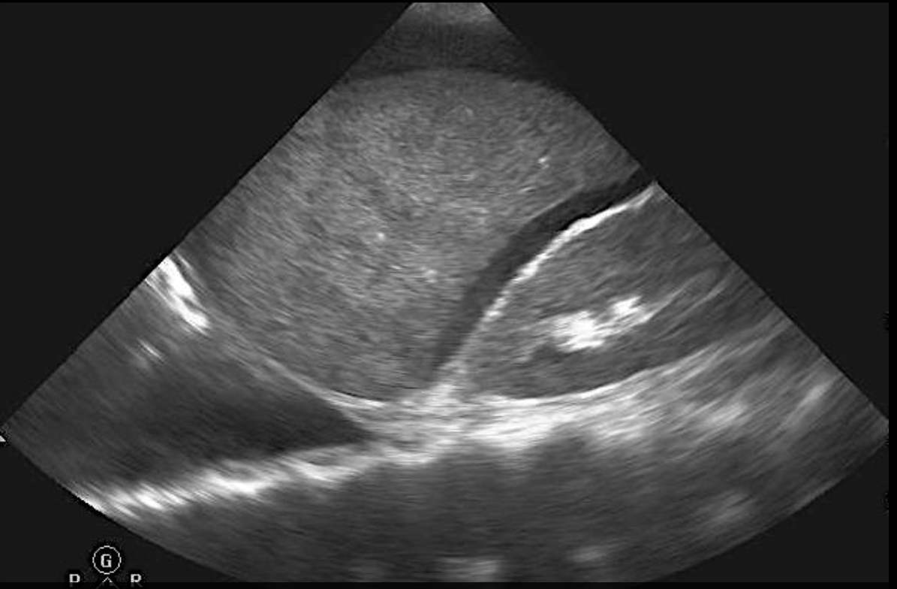
FAST / RUQ
©ACS
Notes:
FAST RUQ – fluid is present between the liver and kidney

Slide 12

FAST / LUQ
©ACS

Slide 13
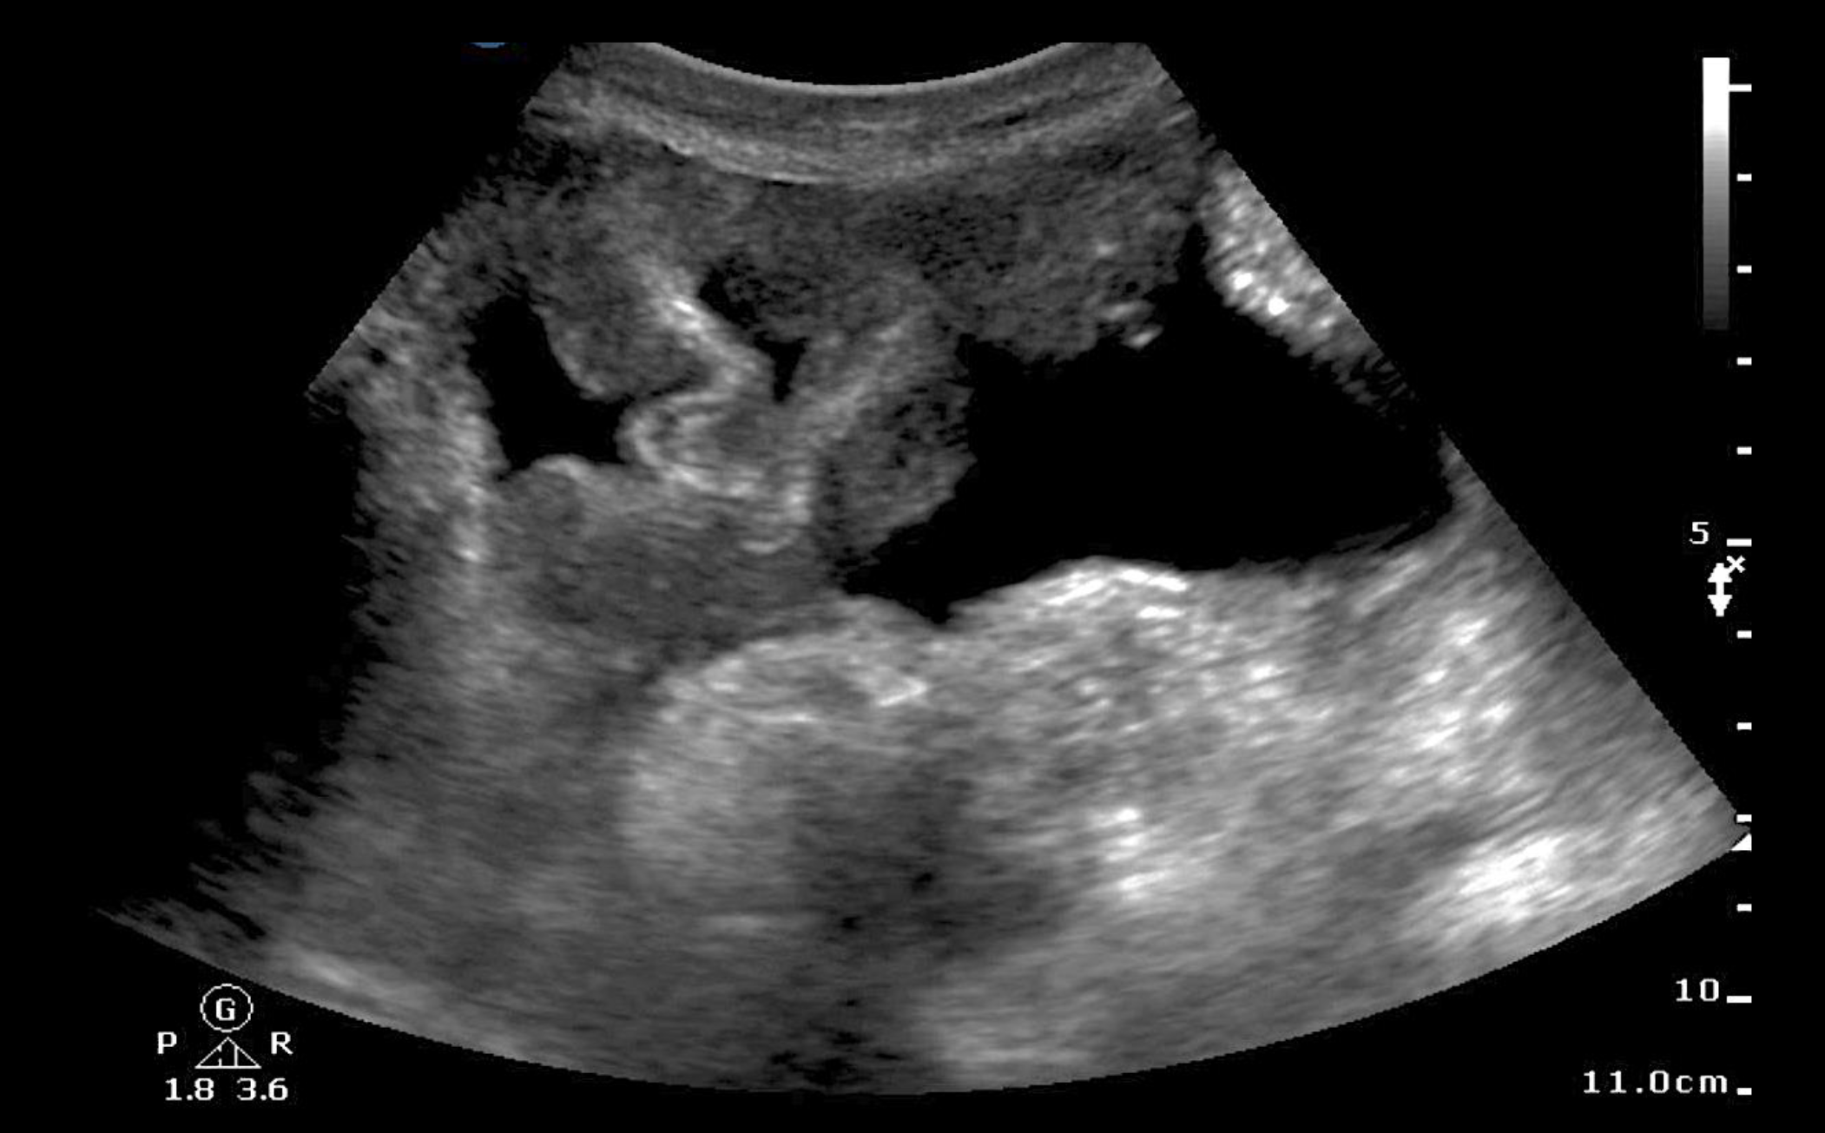
FAST / Pelvis
©ACS
Notes:
FAST pelvis – fluid in pelvis

Slide 14
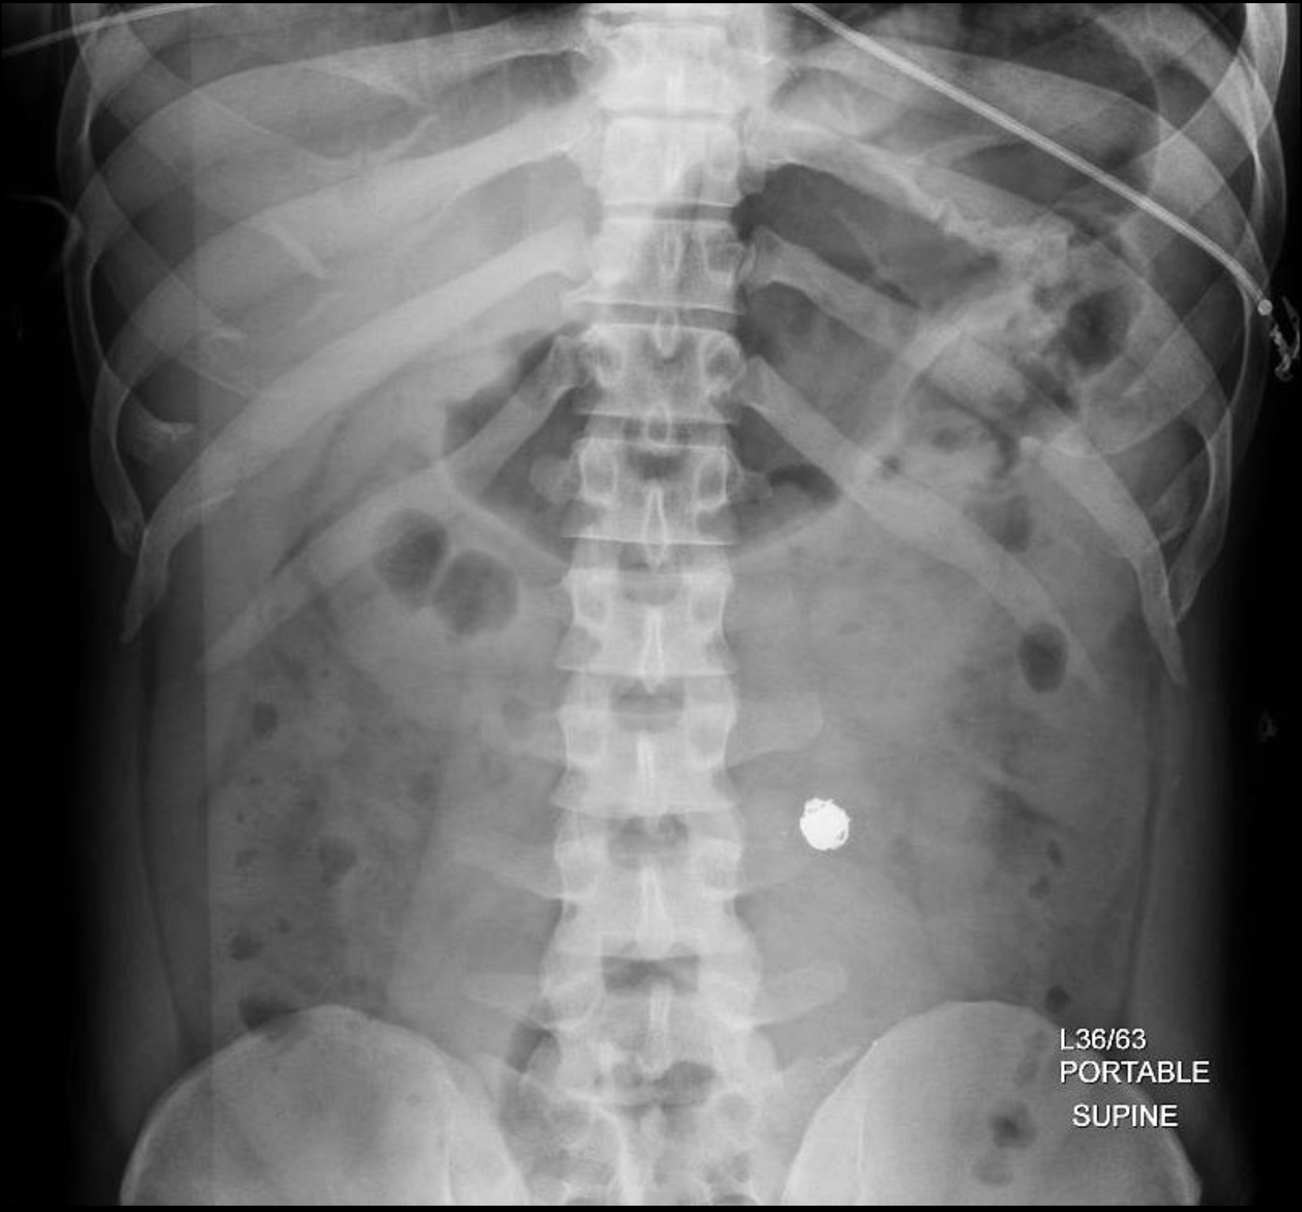
x-Ray / Bäcken
Notes:
Pelvis x-ray taken to high – became an abdominal x-ray – metallic foreign body in the left midabdomen

Slide 15
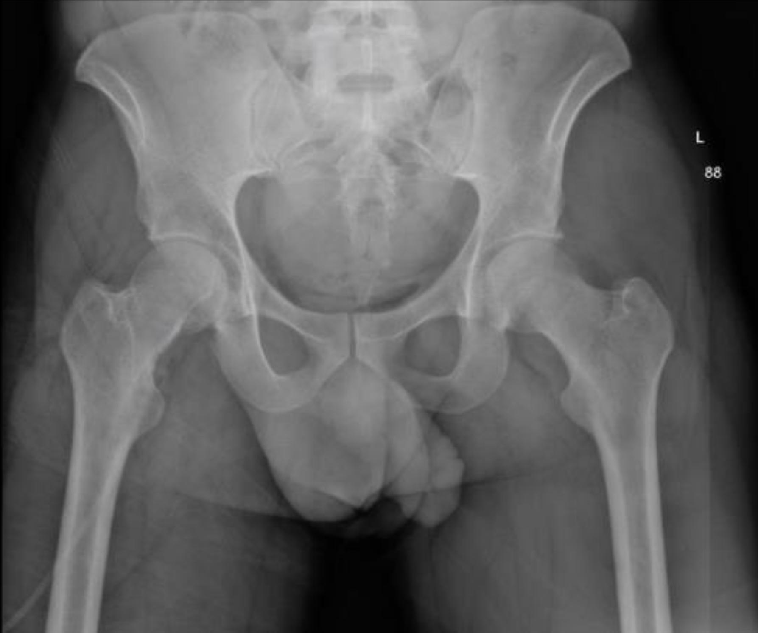
x-Ray / Bäcken
©ACS
©ACS
Notes:
Pelvis x-ray – no abnormality

Slide 16
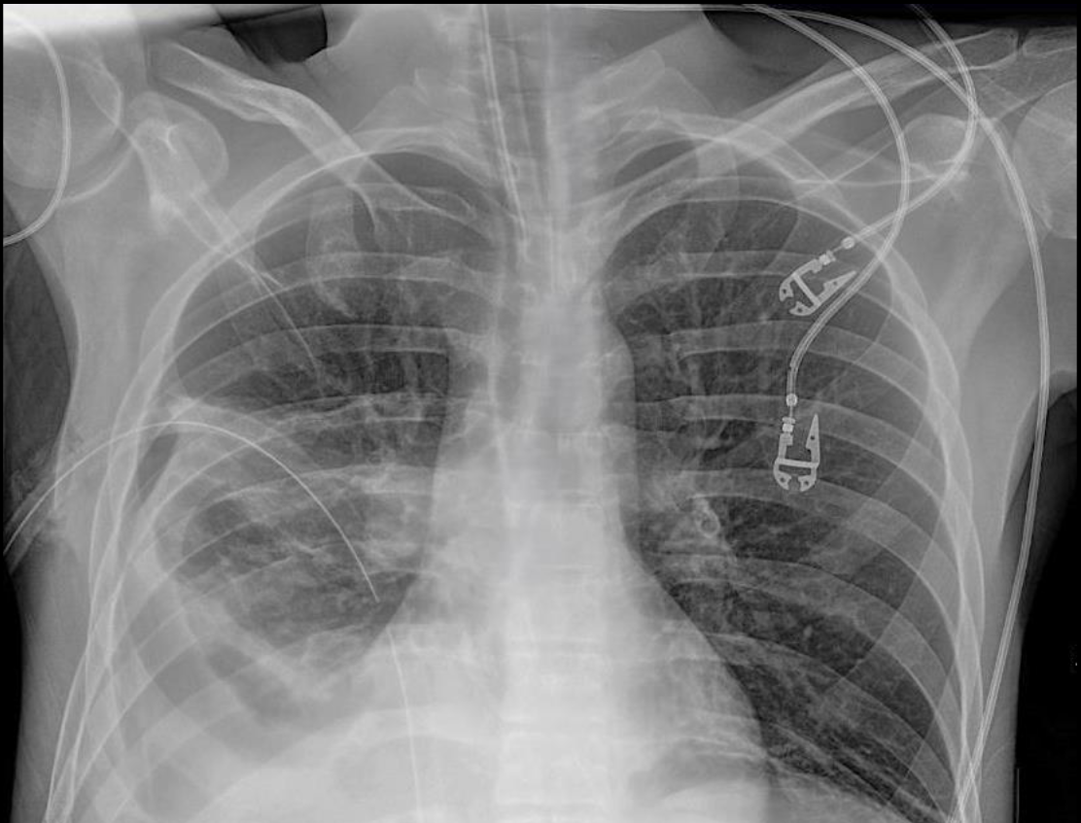
Akut behandling
©ACS
Notes:
Chest x-ray – endotracheal and right thoracostomy tubes are in appropriate positions, no metallic foreign body; residual right hemothorax

Slide 17
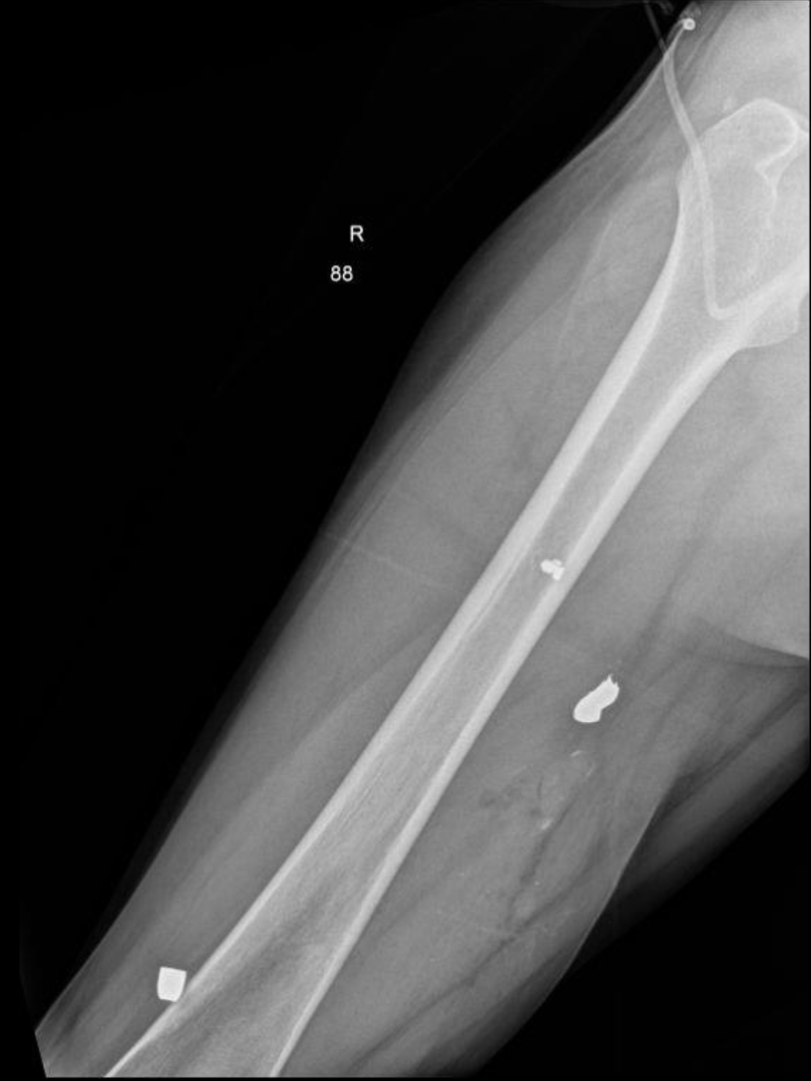
x-Ray / Extremitet
©ACS
Notes:
Right femur x-ray – two metallic foreign bodies without fracture

Slide 18
©ACS
Notes:
CASE Progression

Slide 19

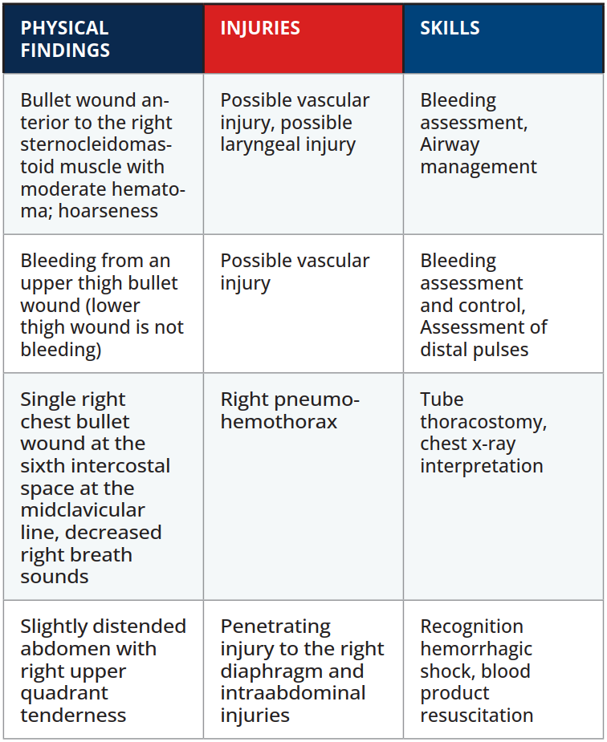

Scenario Sammanfattning
EXAMINATION
©ACS
Notes:
.

Slide 20


Tack
©ACS

