Slide 1

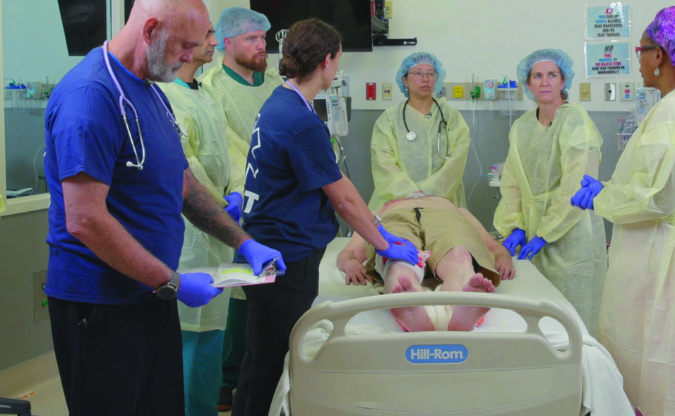

Examination
Patientfall B
Notes:
Välkommen

Slide 2













A 24-year-old unhelmeted motorcycle driver collided into the side of a truck and then slid approximately 12m on the road.
Scenario
M
Open left femoral fracture with profuse bleeding, left wrist deformity, and left temporal laceration with arterial bleeding.
ED of a community hospital with surgical capabilities.
S
AF 40 shallow and very noisy, HF 150, BT 80/50, responds only to painful stimuli. Lips are cyanotic.
Oral airway inserted, Oxygen at 6-8 L/min via mask, pressure dressing on the left thigh and head wound. SMR, splint left wrist
T
©ACS
Notes:
CASE Scenario

Slide 3


x-Ray / Thorax
Radiographer is on the way
©ACS

Slide 4


FAST
©ACS
Notes:
CASE Progression

Slide 5

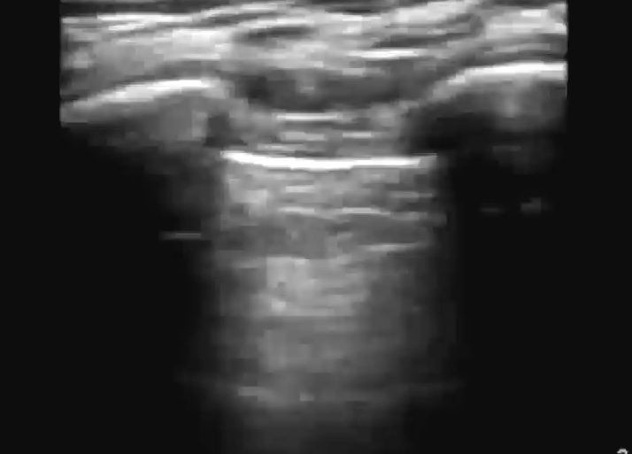
e-FAST / Vänster Lunga
M-Mode
©ACS
Notes:
No Lung Sliding

Slide 6
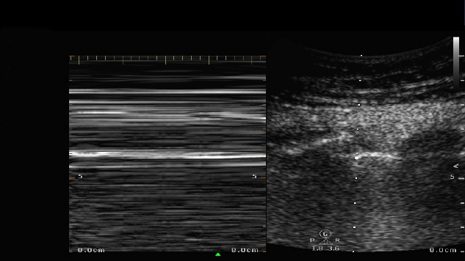
e-FAST / Vänster Lunga / M-Mode
©ACS
Notes:
Barcode Sign

Slide 7

e-FAST / Höger Lunga
M-Mode
©ACS
Notes:
CASE Progression

Slide 8

e-FAST / Höger Lunga / M-Mode
©ACS
Notes:
CASE Progression

Slide 9

FAST / Subxiphoidalt
©ACS
Notes:
CASE Progression

Slide 10

FAST / RUQ
©ACS
Notes:
CASE Progression

Slide 11

FAST / LUQ
©ACS

Slide 12

FAST / Pelvis
Dålig insyn
©ACS

Slide 13
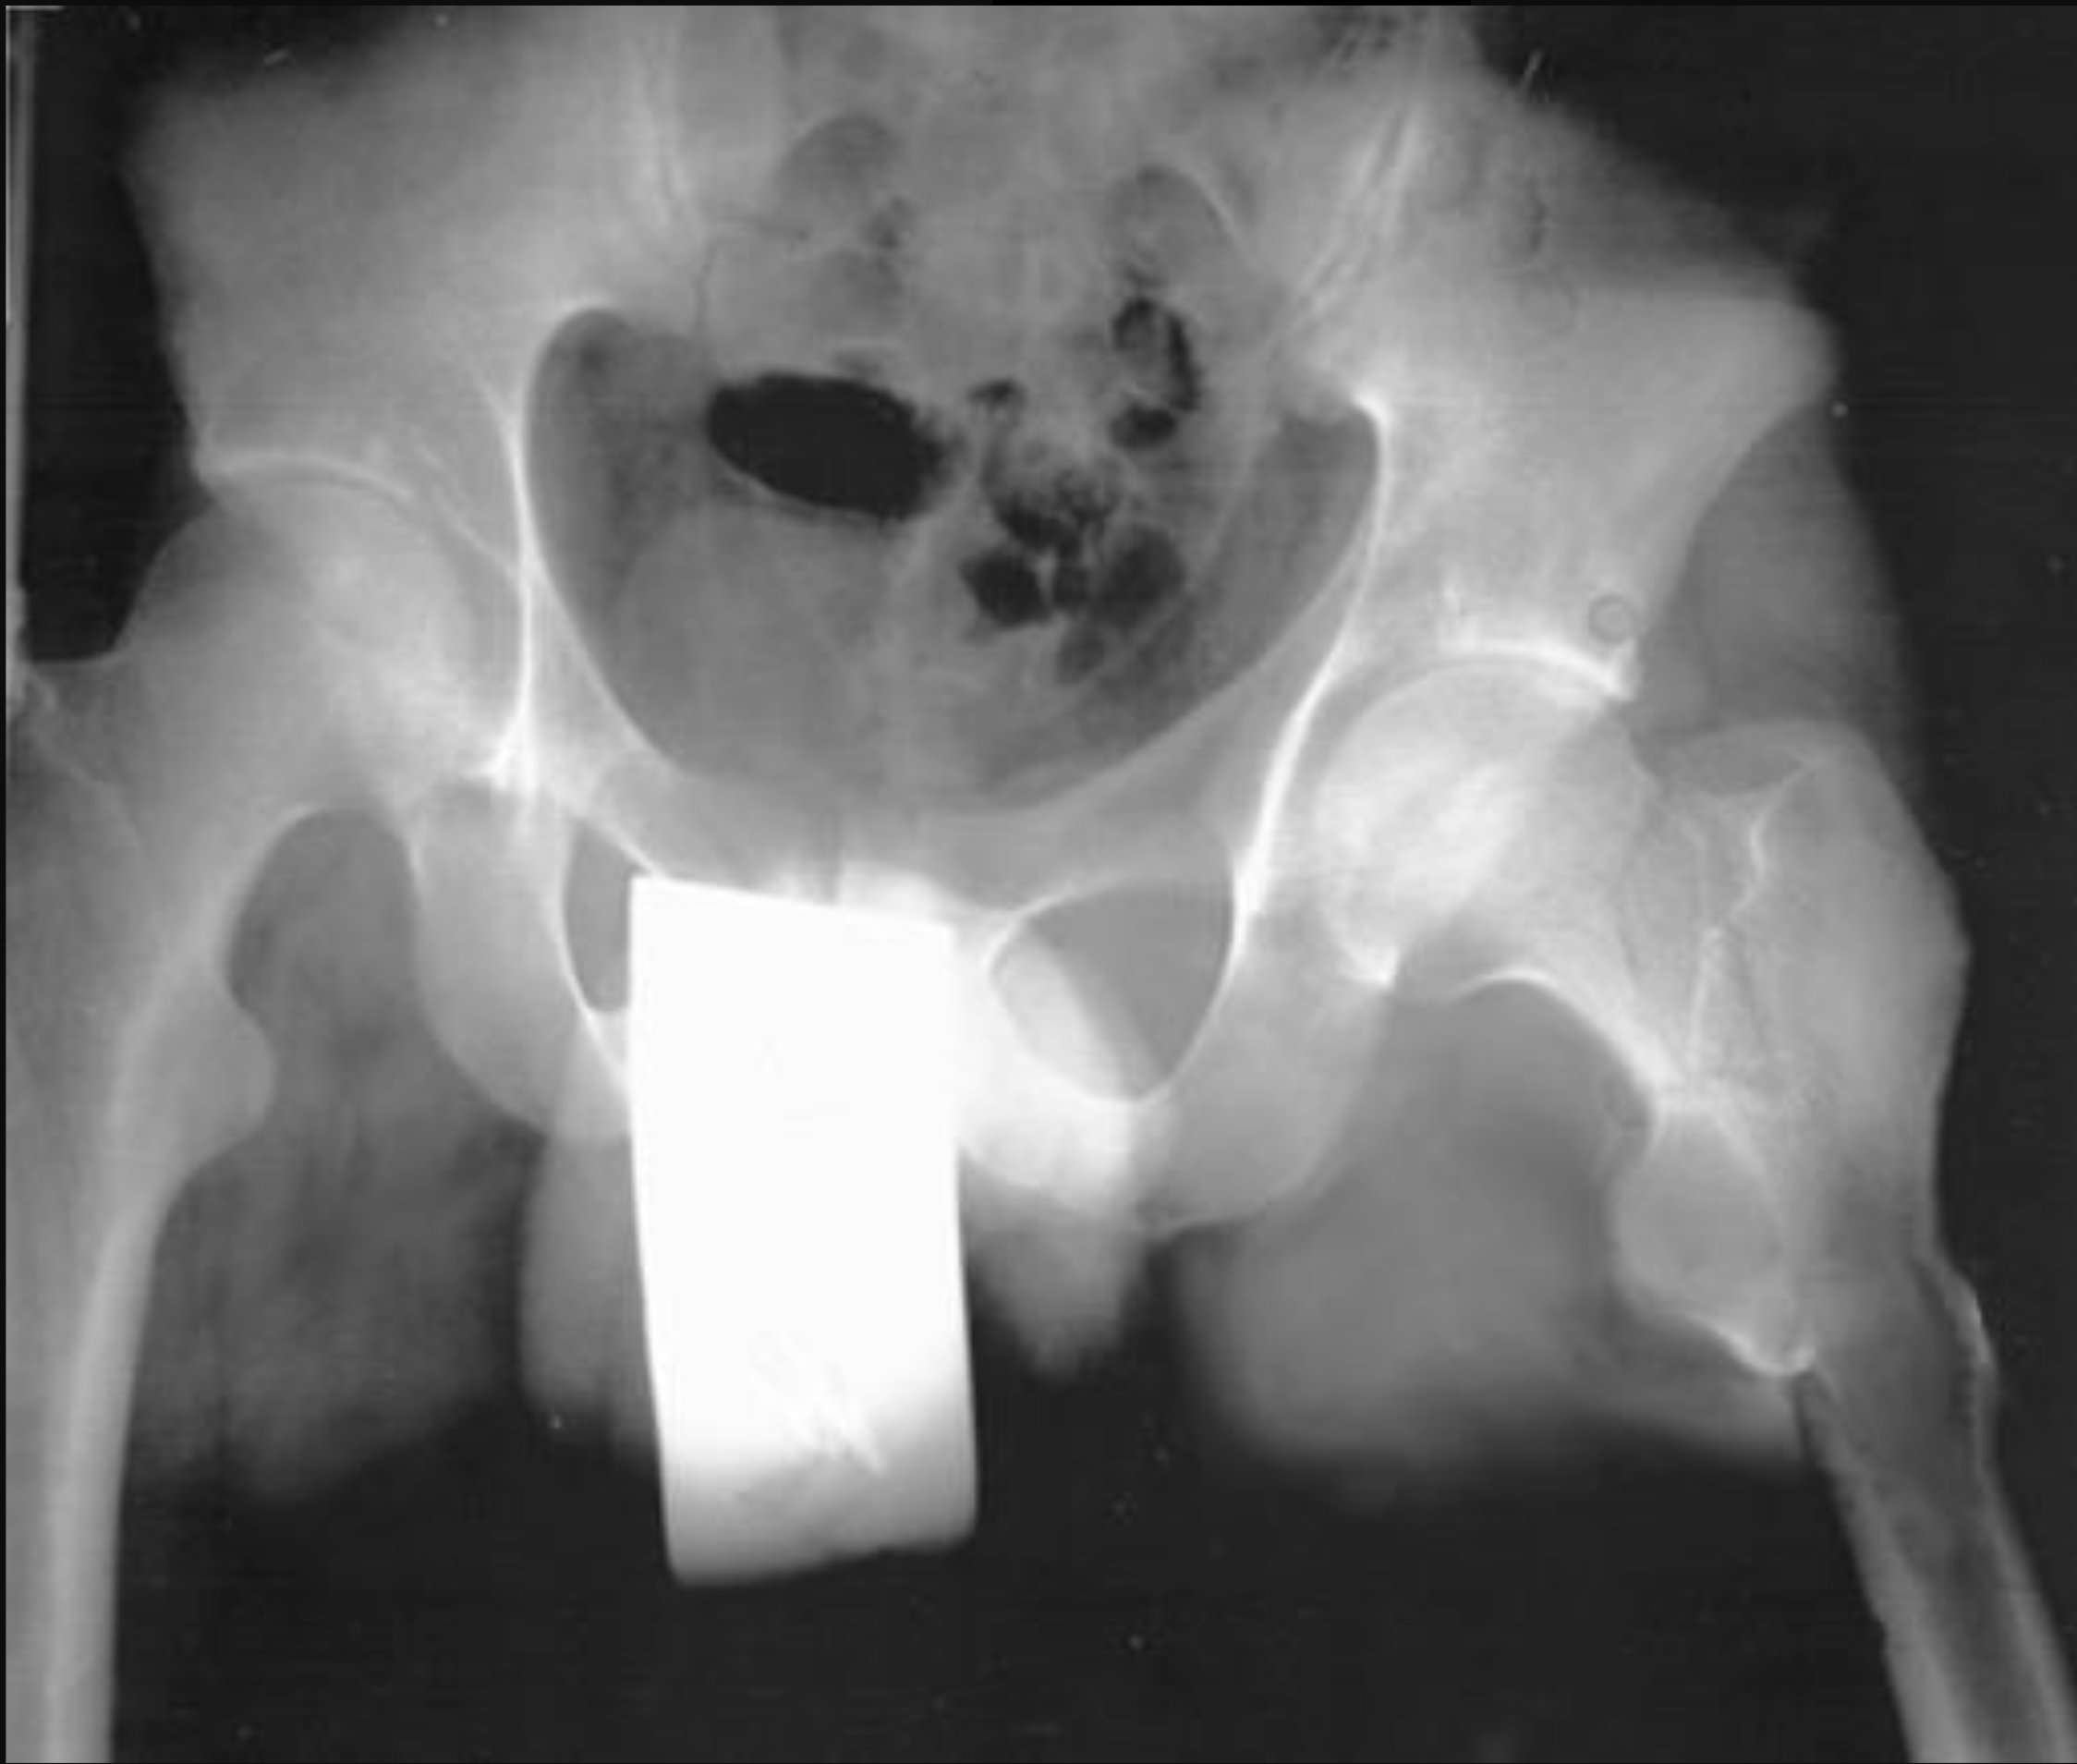
x-Ray / Bäcken
©ACS
Notes:
Left femoral neck fracture, metallic object removed on repeat x-ray and no pelvic fracture present

Slide 14
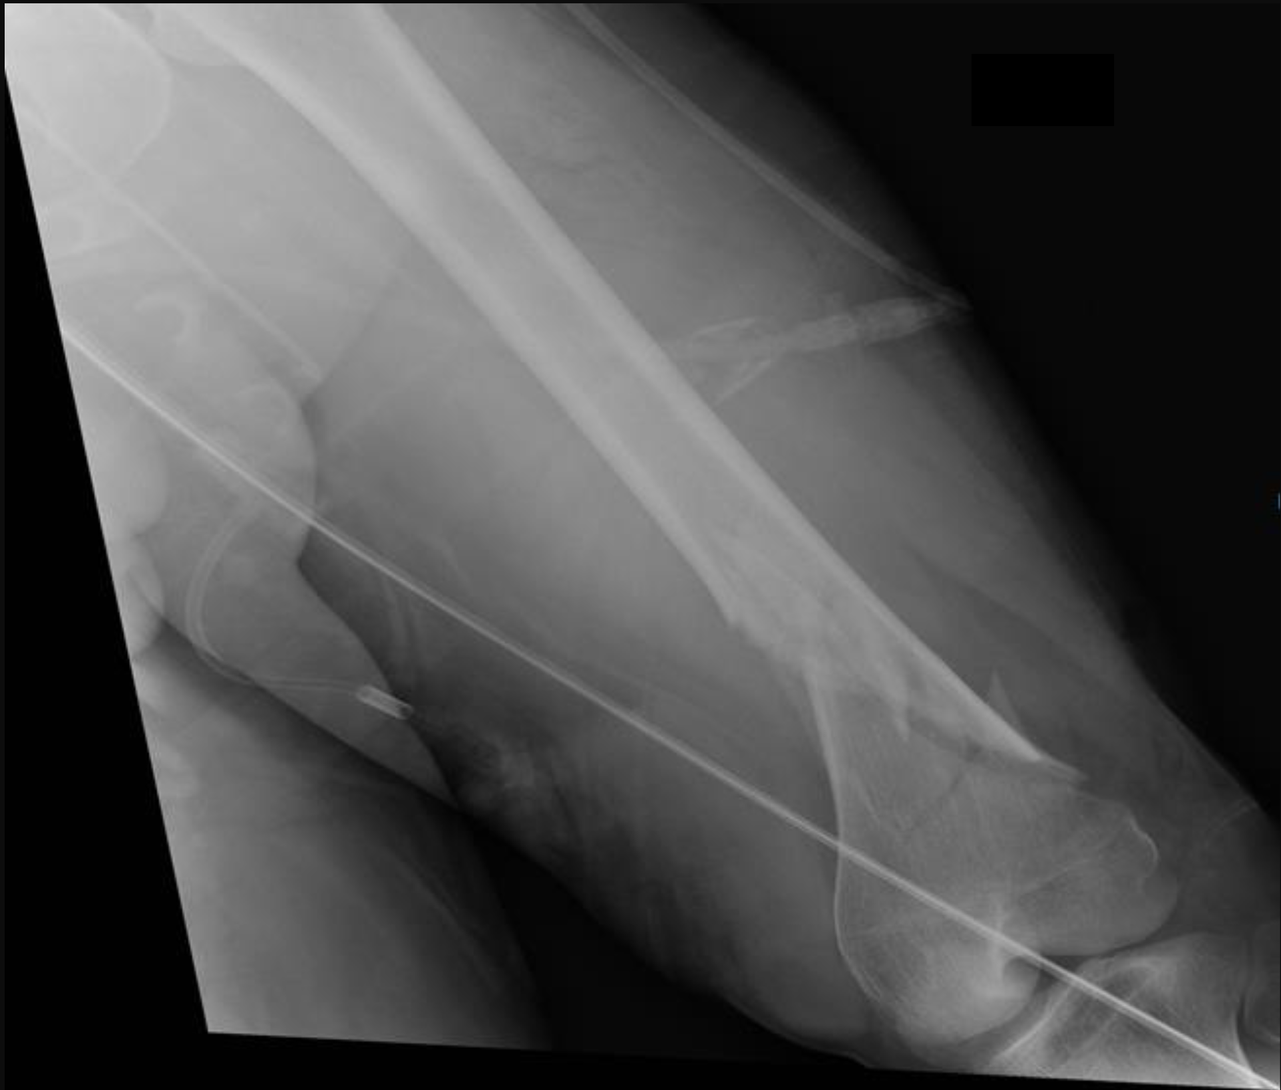
x-Ray / Extremitet
©ACS
Notes:
Left femur x-ray – distal displaced fracture

Slide 15
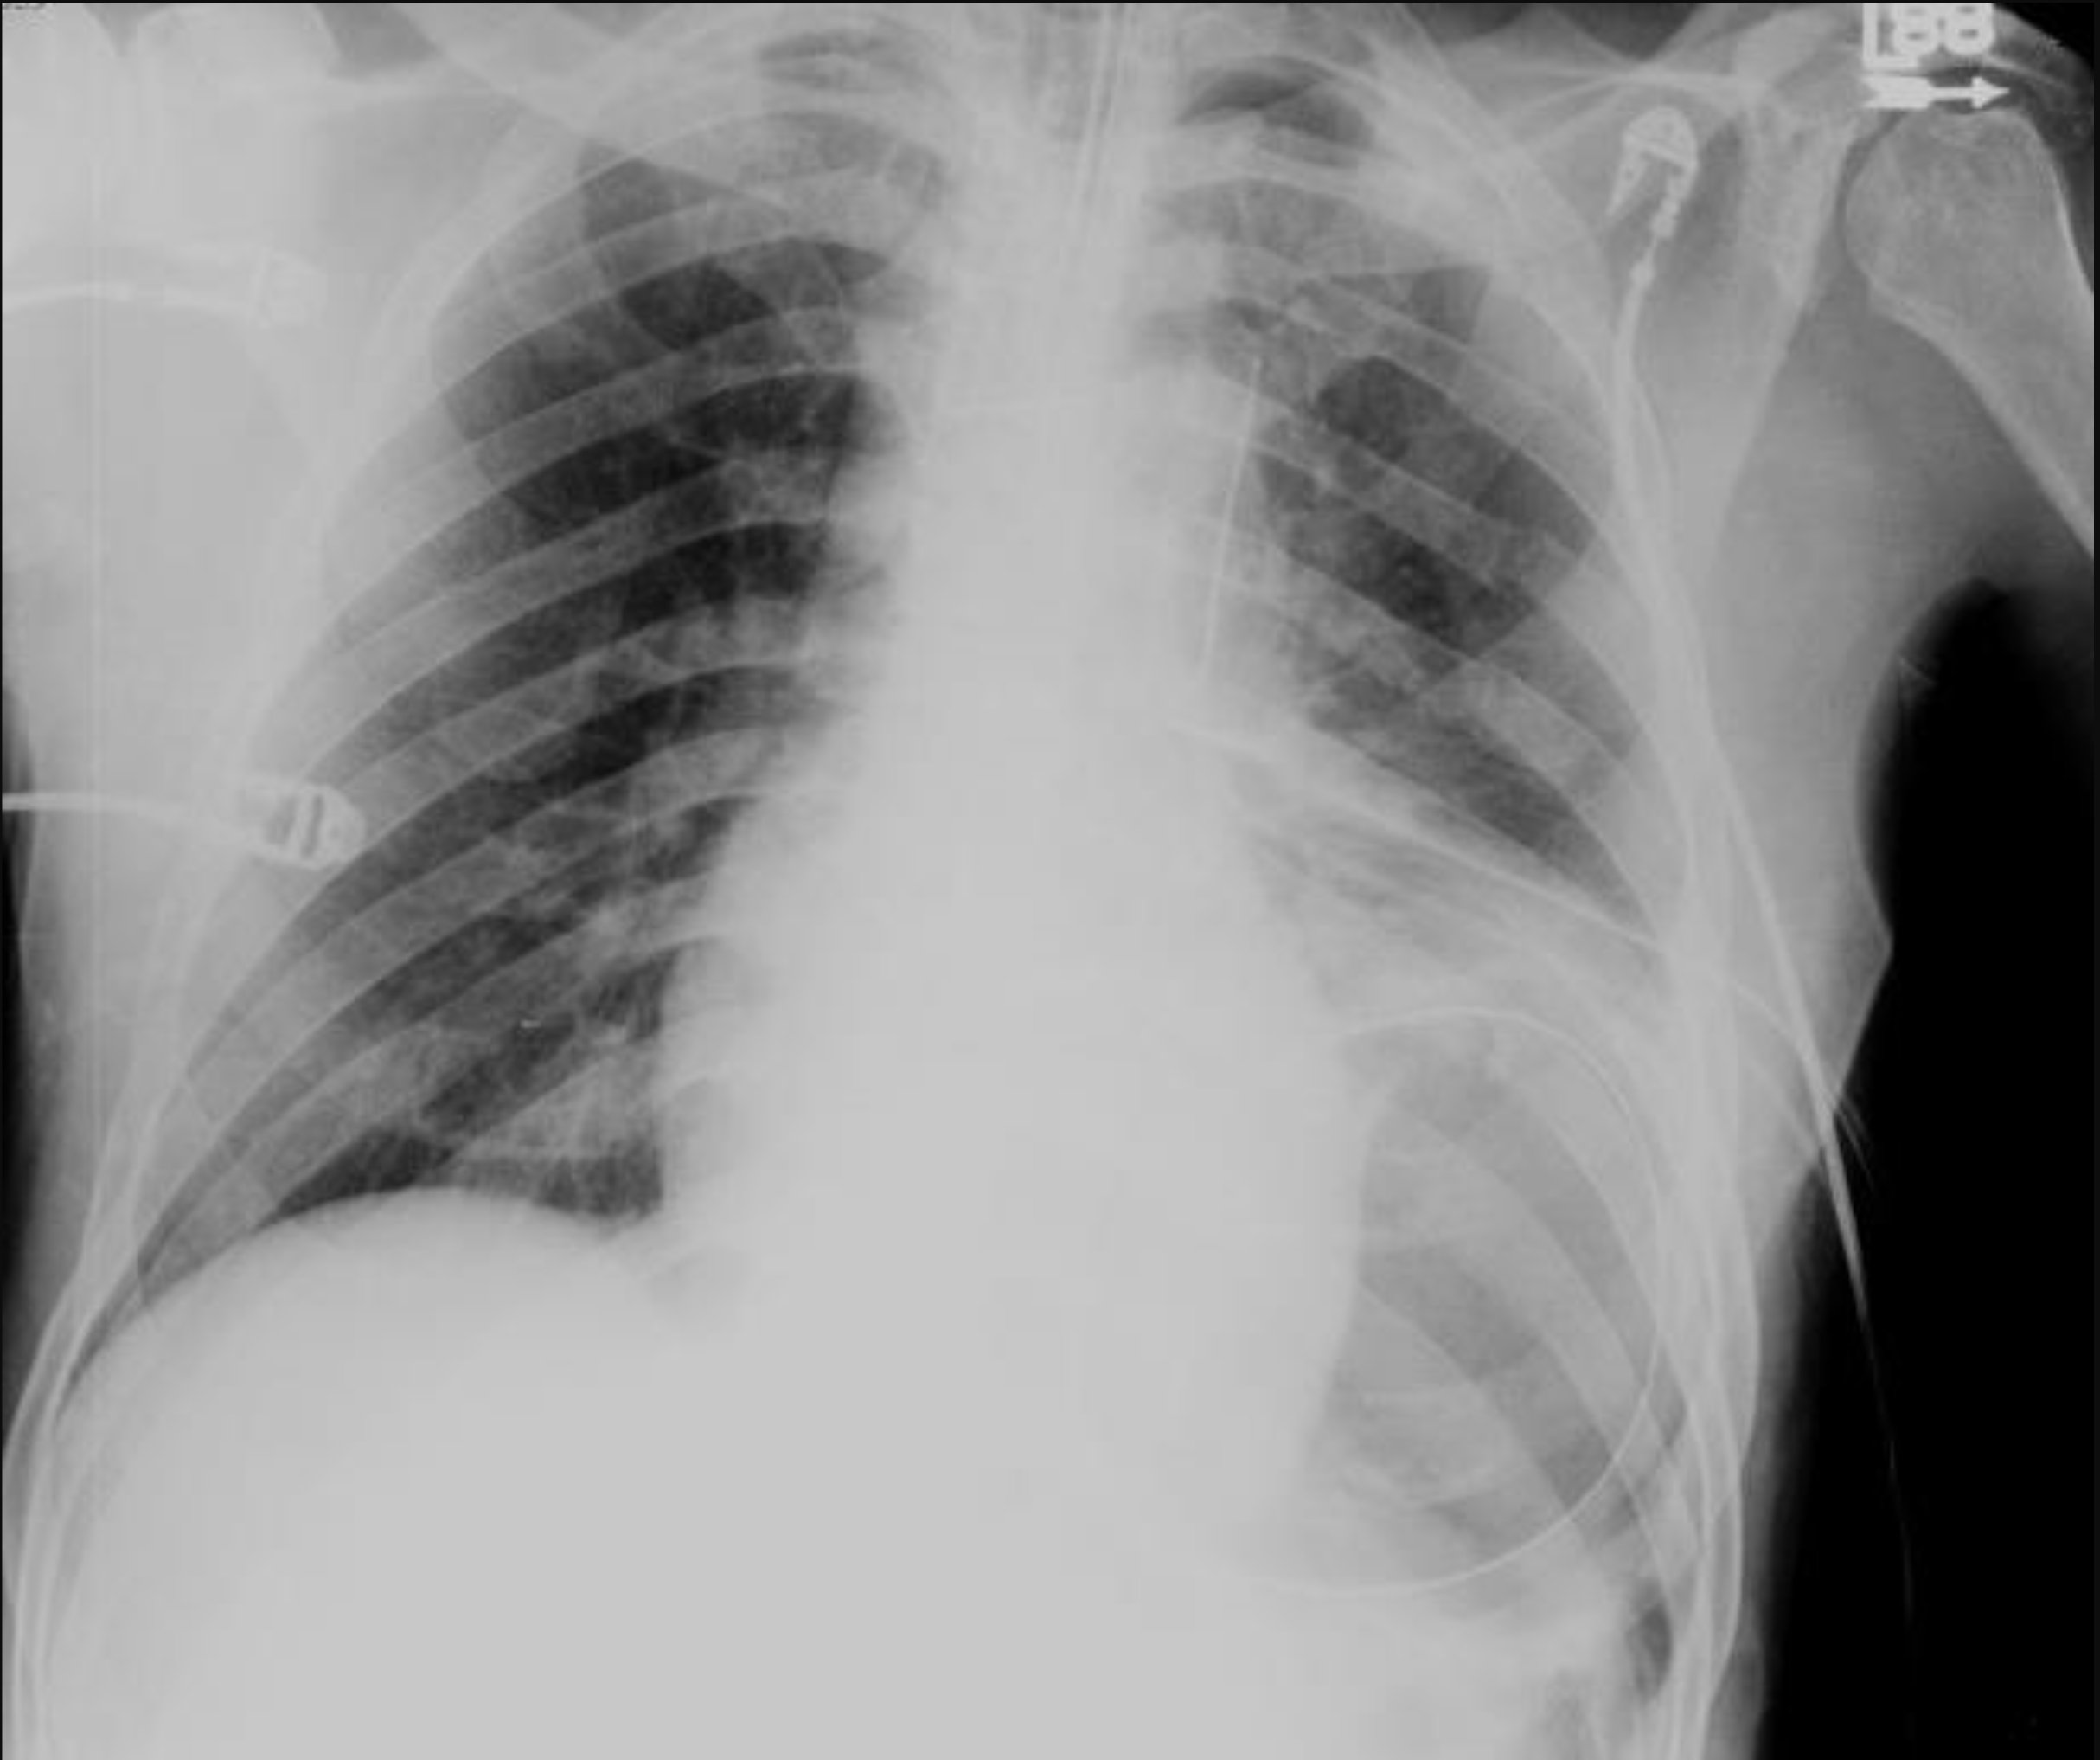
Akut behandling
©ACS
Notes:
Chest x-ray- definitive airway in appropriate position, multiple left rib fractures, potential left pulmonary contusion, left chest thoracostomy tube, and an obscured left hemidiaphragm with a dislocated gastric tube (consistent with ruptured diaphragm)

Slide 16
©ACS
Notes:
CASE Progression

Slide 17

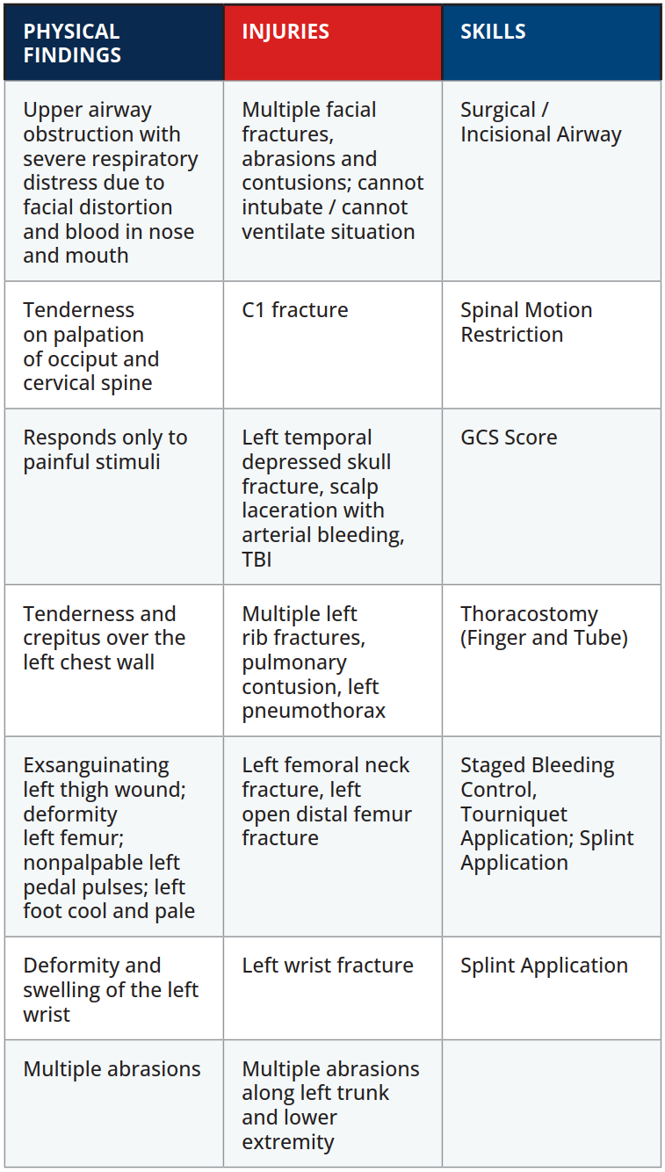

Scenario Sammanfattning
EXAMINATION
©ACS
Notes:
.

Slide 18


Tack
©ACS

