Slide 1

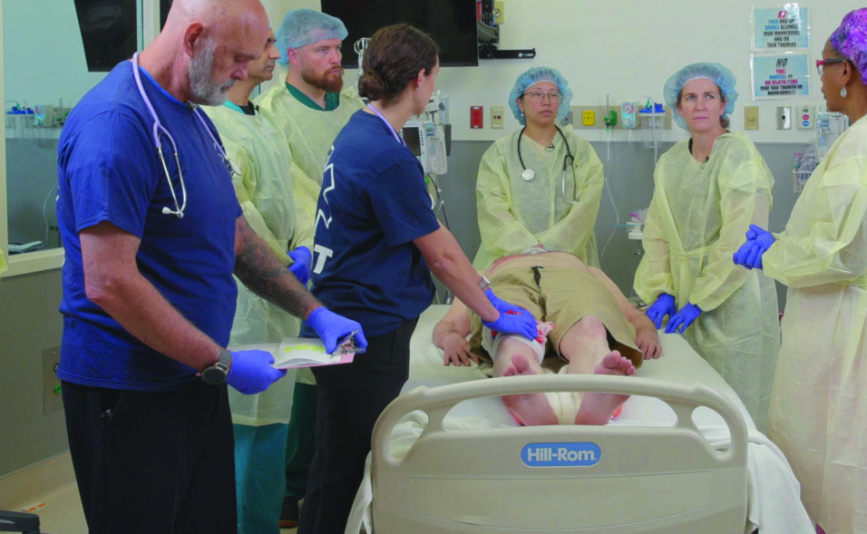

WELCOME
to the
ATLS
Refresher Course
Notes:
Välkommen

Slide 2

Course Director Namn Jobb Ort
Course Coordinator XXX XXX XXX
t.ex. Robert Zürner KIRURG UMEÅ
Instructors
  NAMN Specialitet ORT
  tex. Henrik Lund Narkos Östersund
Faculty
26-27/05
©ACS

Slide 3
Today 07.45 - 17.15
Training 09.15 - 12.35
Examination 13.30 - 16.45
Program
26-27/05
©ACS

Slide 4
Course Certificate
For course approval, the following are required
Physical attendance throughout the entire course (mobile)
Approved performance during station-based training
Approved practical and written examination
Course Certificate
Issued upon successful completion of the course
Certificate
26-27/05
©ACS

Slide 5
Welcome and Introductions
We would like you to introduce yourselves now:
  Who are you?
  What is your professional background?
  What is your experience with trauma?
  What do you hope to gain from this course?
Welcome
26-27/05
©ACS

Slide 6
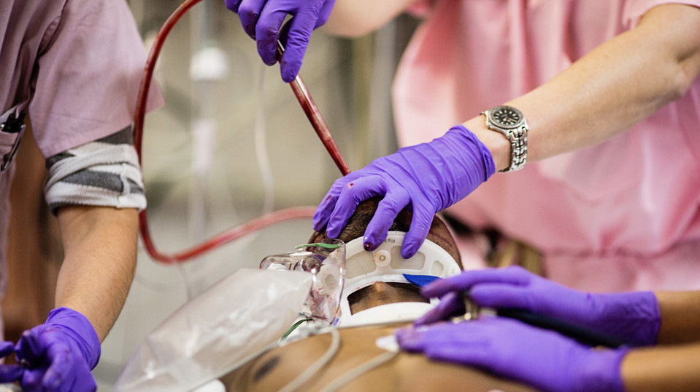
The ATLS course provides one acceptable method for the safe, immediate management of trauma patients.
ATLS PROVIDES A COMMON LANGUAGE.
©ACS
Notes:
As mentioned, ATLS describes one safe approach to the initial care of trauma patients. It also provides a common language for trauma care clinicians to communicate with each other.

Slide 7
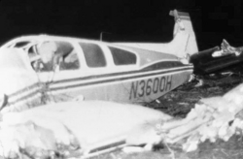
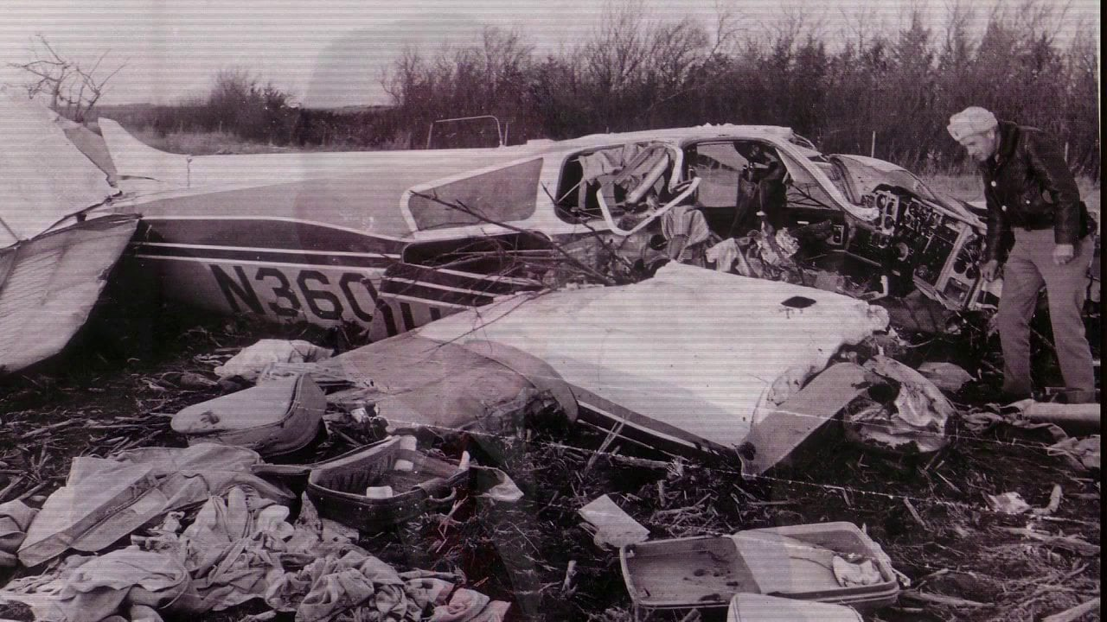
The Beginning:
Tragedy and Challenge
©ACS
Notes:
The idea for ATLS began in 1976, when Dr. Styner, an orthopedic surgeon, crashed his plane in rural Nebraska. Dr. Styner and his three children were seriously injured, and his wife was killed instantly. Dr. Styner sustained serious injuries, and three of his four children sustained critical injuries. The surviving family members were taken to a rural hospital, that was unfortunately unable to provide comprehensive care. This occurred in part because the available staff had not received optimal training in the care of injured patients.
Dr. Styner and his colleagues decided to do something about that.

Slide 8
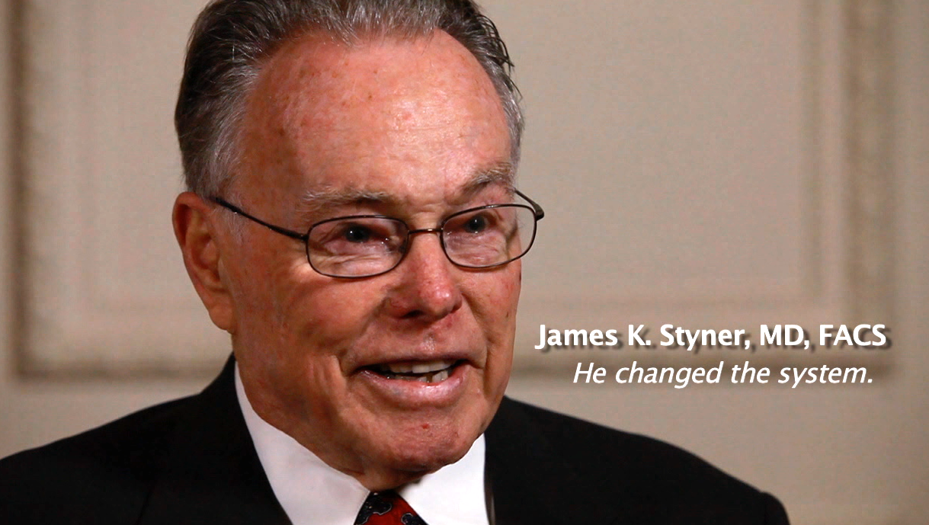
“When I can provide better care in the field with limited resources than what my children and I received at the primary care facility, there is something wrong with the system, and the system has to be changed.”
James Styner, MD, FACS (1977)
Surgeons and physicians in Nebraska
Lincoln Medical Education Foundation
Lincoln Area Mobile Heart Team nurses
University of Nebraska Medical Center
Nebraska State Committee on Trauma of the American College of Surgeons
Southeast Nebraska Emergency Medical Services
©ACS
Notes:
Dr. Styner recognized that better and more consistent trauma care training was required for all clinicians assessing and managing injured patients. The people and organizations listed on the slide developed what became the ATLS course.
This occurred around the same time the Advanced Cardiac Life Support, or ACLS, course was developed in Nebraska; ATLS was modeled after that course.

Slide 9
A New Way to Think
1
Treat the greatest threat to life first.
2
Lack of a definitive diagnosis should not delay the application of indicated treatment.
3
A detailed history is not essential to begin the evaluation of a patient with acute injuries.
©ACS
Notes:
ATLS incorporated three revolutionary underlying concepts which have stood the tests of time, practical application, and medical advances.
The first of these was to treat the greatest threat to life first. Secondly, it was understood that the lack of a definitive diagnosis should not delay the application of indicated treatment. And third, a detailed history is not essential to begin the evaluation of a patient with acute injuries.
For example, consider the management of a patient who presents in hemorrhagic shock. The clinician may look for sources of bleeding but may initiate treatment without knowing the exact cause. External bleeding in an extremity is controlled even if the specific vascular injury is not known. Resuscitation and management proceeds regardless.
COURSE DIRECTORS: CAN SUBSTITUTE OTHER EXAMPLES TO ILLUSTRATE THESE POINTS THAT REPRESENT TYPES OF INJURIES SEEN FREQUENTLY IN THEIR PRACTICE ENVIRONMENT.

Slide 10

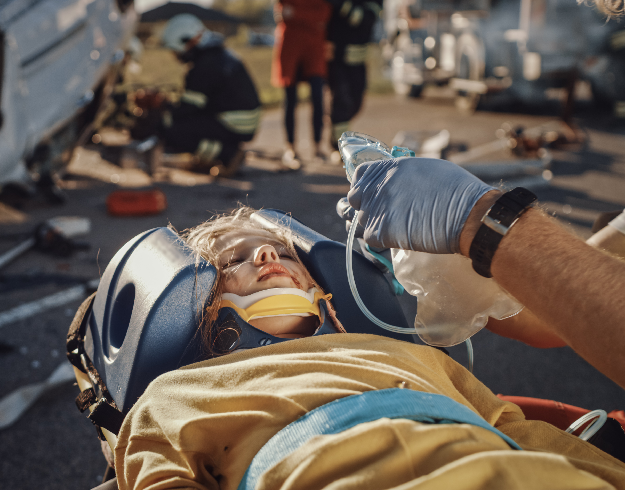

©ACS
Notes:
Another concept central to ATLS is that the sequence of care for is the same for all injured patients, whether they are adults, young children, older adult patients, or pregnant patients. Special considerations may be present in certain populations, but the overall approach is the same.

Slide 11
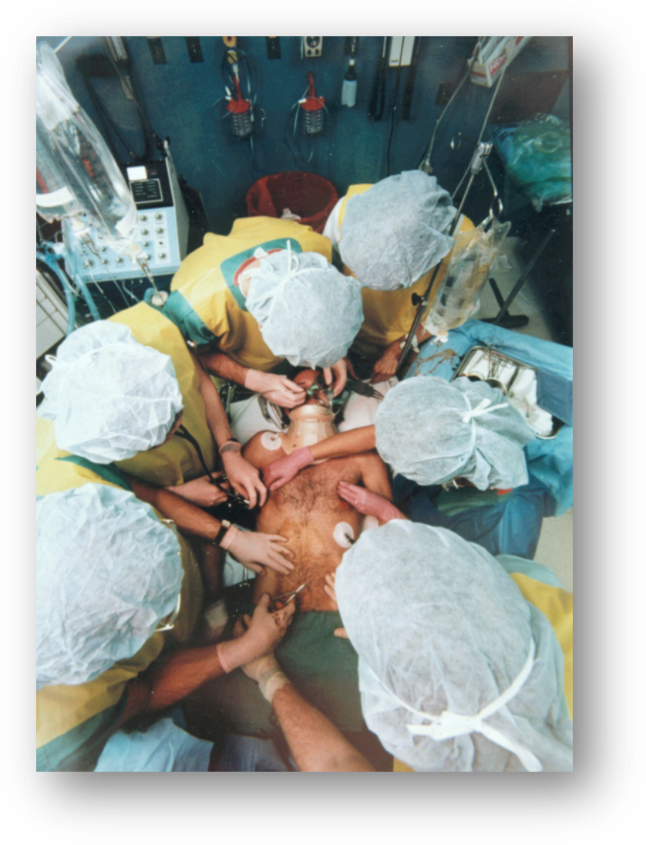
ATLS Concept
Follow ABCDE algorithmic approach to evaluation and treatment.
Recognize that time is of the essence.
Treat the greatest threat to life first.
Recognize the definitive diagnosis is not immediately important.
Do no further harm.
©ACS
Notes:
Using these principles, the ATLS concept employs the xABCDE algorithm as its universal language for the primary survey. The definitive diagnosis and an in-depth history are not required initially. By following the algorithm in sequence, the clinician is less likely to miss an immediate life threat; however, in many circumstances, several aspects of the algorithm may be applied simultaneously.
It is important to recognize that time is of the essence. ATLS is primarily directed at providing initial care in what used to be called the “golden hour.” The “golden hour” is not actually a fixed time period, but rather the window of opportunity during which clinicians can have a positive impact on the morbidity and mortality associated with injury.

Slide 12
Chapter
Statement
The Primary Survey (xABCDE) with simultaneous resuscitation is the cornerstone of the initial assessment of the trauma patient.
The primary survey is repeated frequently to identify any deterioration in patient status and indication for additional intervention.
©ACS

Slide 13
Initial Assessment and Management
Preparation
Triage
Primary Survey with Simultaneous Resuscitation
Secondary Survey
Re-evaluation
Definitive Care
Adjuncts
Adjuncts
Consider Transfer
Re-evaluation
©ACS
Notes:
The initial assessment and management of injured patients consists of the primary survey with simultaneous resuscitation and adjuncts; the secondary survey with associated adjuncts; frequent re-evaluation; and transfer of the patient to definitive care, if indicated. If the initial treating facility does not have the resources to manage all the patient’s injuries, transfer to a different facility may be indicated. However, definitive care could also involve transfer of the patient to a different team within the same facility.
Differences in healthcare systems, resources, and regional needs may dictate when and how patients are transferred. Also, in some austere environments, transfer may not be possible in the immediate or short term.

Slide 14
Primary Survey

Slide 15



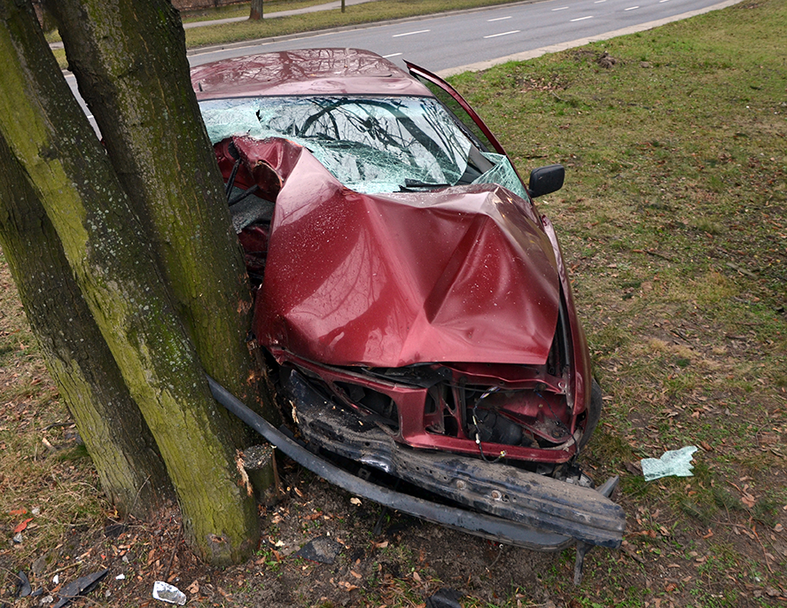


Case
Scenario
18-year-old male, unrestrained driver in MVC vs. tree
M
None reported
S
Vitals not reported
Prolonged extrication; transported to ED by ambulance; O₂ by mask; fluids via single IV; spinal motion restricted on long spine board.
T
©ACS
Notes:
The Instructor should review the information on the slide, adding that the hospital receiving the patient is a community hospital with no surgical specialty capabilities (not a trauma center).

Slide 16

Case Scenario
Emergency Department team consists of Lead Physician, two nurses, one Senior Level EM resident, and one Advanced Practice Provider
18-year-old male , unrestrained driver in MVC vs. tree.
M
Discussion Questions
  How would you prepare for this patient’s arrival?
  Based on the mechanism and history, what potential injuries may be present and what interventions may be indicated?
  What Team Dynamics concepts will be important while providing care for this patient?
I
None reported.
S
Vitals not reported.
Prolonged extrication; transported to ED by ambulance; O₂ by mask; fluids via single IV; spinal motion restricted on long spine board.
T
©ACS
Notes:
NOTE: If the participants do not provide the information, ask additional questions to elicit the information from the participants, rather than providing it yourself. ​
​
THE LEARNERS SHOULD PROVIDE THE FOLLOWING ANSWERS TO THE QUESTIONS ON THE SLIDE:
1. How would you prepare for this patient’s arrival?
Learners should indicate that they will use the xABCDE algorithm when preparing for the patient. They should make certain that oxygen, suction, and equipment for supporting the airway are available and functioning, and that equipment and personnel are available to manage the airway. Blood bank should be alerted for the possible need for blood products; warmed isotonic IV fluids should be available; determine what team members will be available to assist; determine what capabilities the institution has and what protocols exist for transfer should the patient’s needs exceed those capabilities.
2. Based on the mechanism and history, what potential injuries may be present and what interventions may be indicated?
Learners should communicate potential injuries and management following xABCDE:
x= the open extremity fracture and hypotension, suspect possible bleeding from this site, and evaluation for other sites of external bleeding;
A= altered mental status may cause an obstructed airway– advanced airway management may be indicated during the primary survey;
B= risk exists for life-threatening breathing threats such as tension pneumothorax, massive hemothorax, pulmonary contusion
C= risk of cavitary/internal bleeding in the chest, abdomen and pelvis;
D= altered mental status suggests a possible head injury; risk for spinal injury. Motion restriction should be maintained;
E= a complete exam and measures to prevent hypothermia are important
The Instructor may find it helpful to “walk” the learners through the algorithm step-by-step as a prompt if they do not provide the expected information
3. What Team Dynamics concepts will be important while providing care for this patient?
For Team Functioning, the learners should communicate that clear roles should be assigned. Team leader should encourage bi-directional, closed loop communication. A Pre-Arrival Huddle should take place to discuss the patient’s clinical status and team functioning plans. Learners should mention the importance of structured handover communication during every care transition from one team to another such as during EMS handover to the trauma team and during transfer to another facility Or another in-hospital team. Learners should relate the need for periodic re-evaluation of patient status.
NOTE: Learners will be required to view the Team Dynamics video prior to attending the Course; the Instructor might ask them to try to remember what were the key points of the video to prompt their memory.

Slide 17
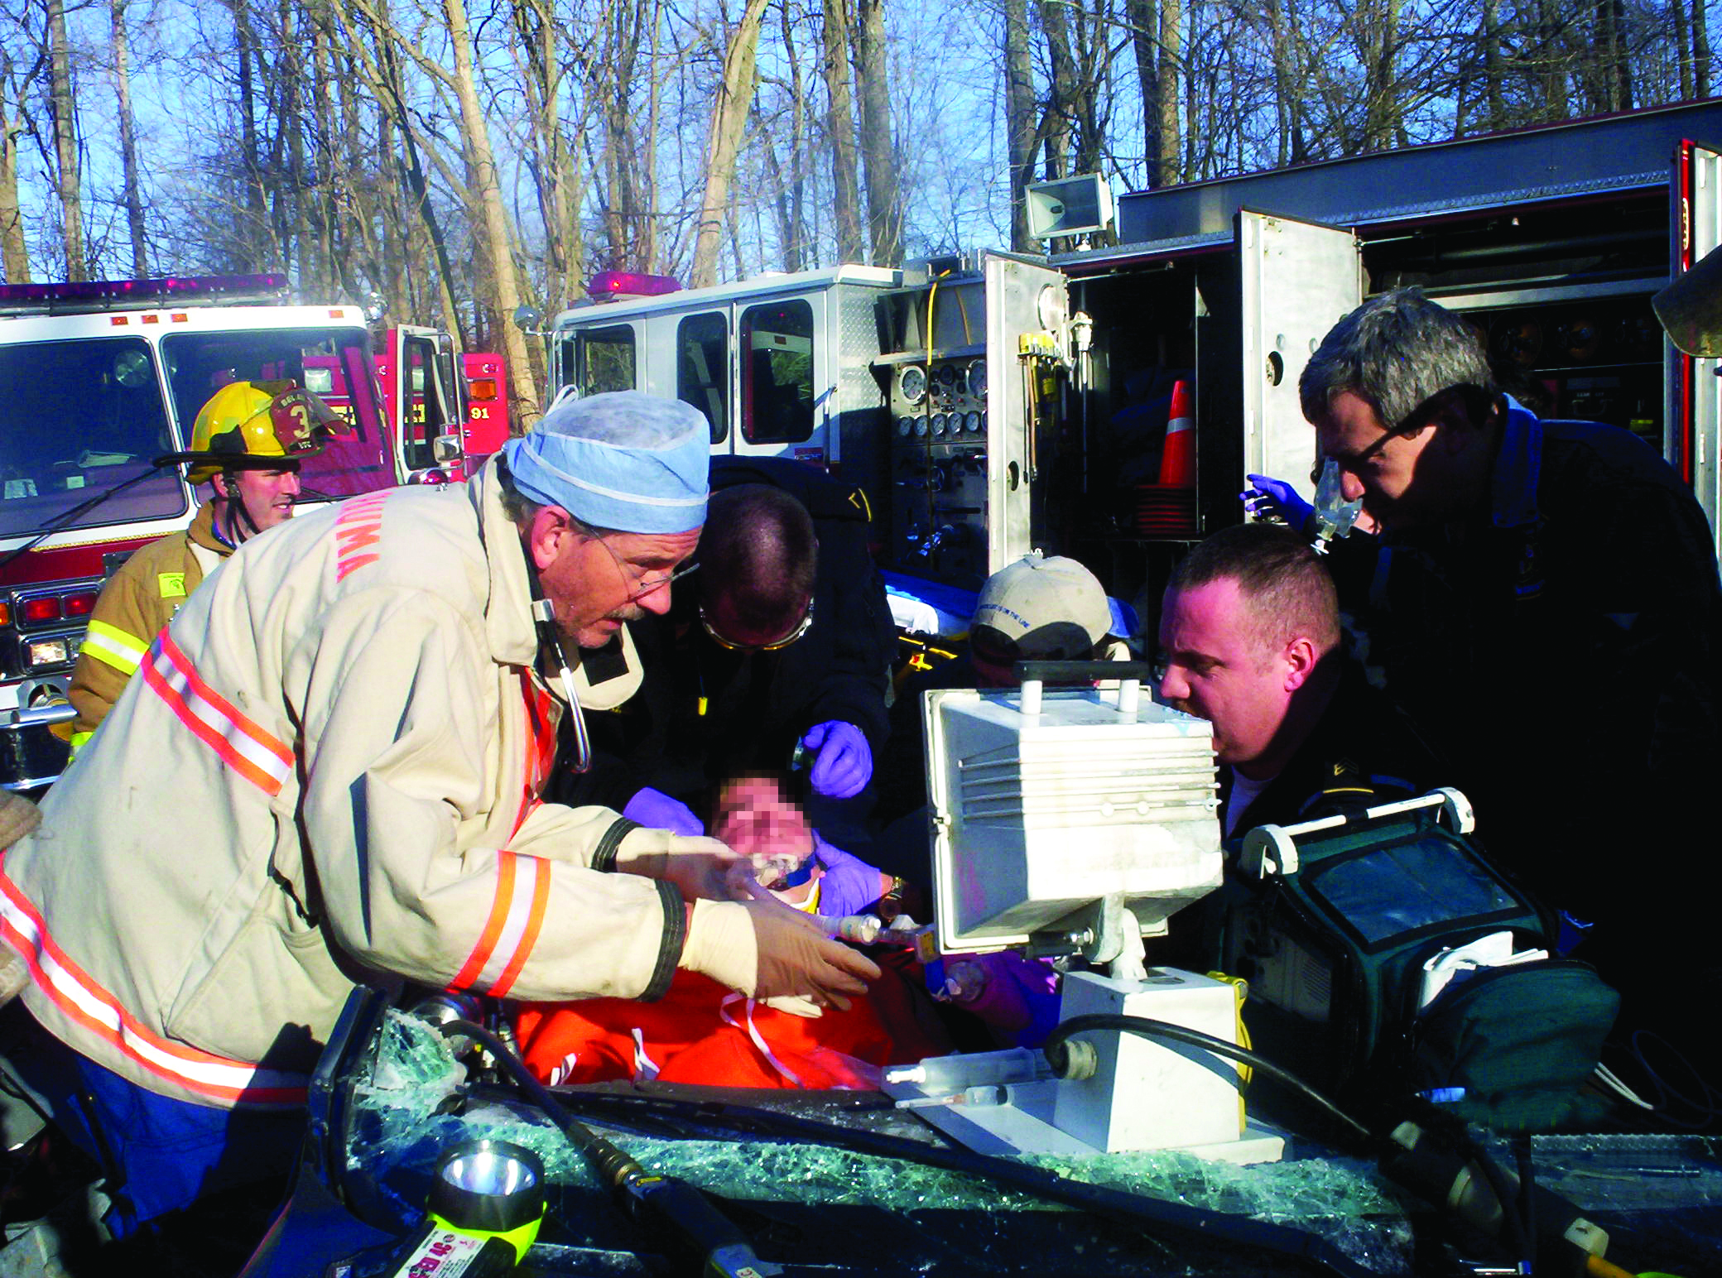
Initial Assessment: Case Scenario
EMS report: patient is lethargic, mumbling unintelligibly
Patient has facial injuries
Vital signs: HR 120; BP 90/40; RR 24, O2 sat 89%, temp 36°C
©ACS

Slide 18
Case
Scenario
18-year-old male , unrestrained driver in MVC vs. tree.
M
Arrival ER
Patient has facial injuries
S
HR 120; BP 90/40; RR 24,
O2 sat 89%, temp 36°C
T
O₂ by mask; fluids via single IV; spinal motion restricted on long spine board.
©ACS
©ACS
Notes:
CASE Scenario

Slide 19


X-Exsanguinating
Airway with C-spine protection
Breathing with adequate oxygenation
Circulation with hemorrhage control
Disability with adequate immobilisation
Exposure without hypothermia
©ACS

Slide 20
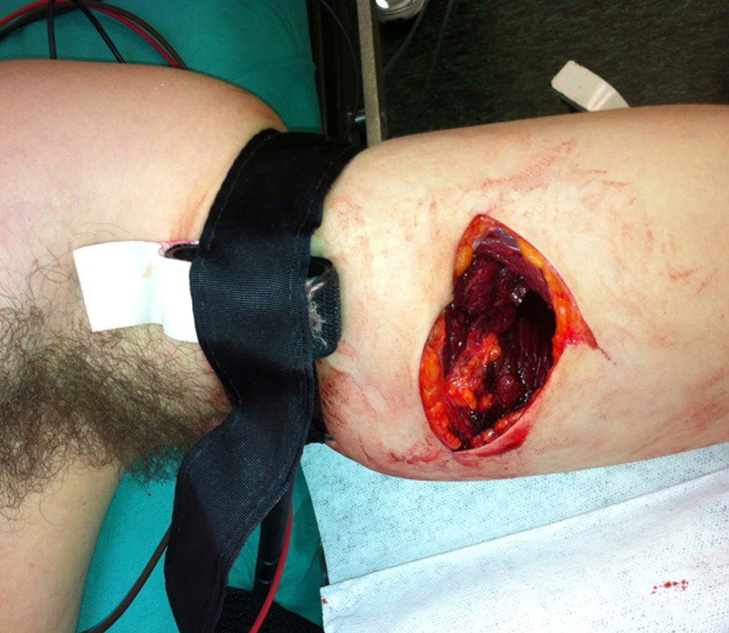
Update
11th Edition
  Direct pressure
  Pressure dressing
  Wound packing
  Tourniquet
Pain management
_{Pitfall}
©ACS

Slide 21
  Airway
Update
11th Edition
  Three failed intubation events – BVM, change approach
  Intubation confirmed by sustained ETCO2
  ETCO2 Waveforms discussion
  Needle Airway bara i yngre barn
  RSI technique (new table)
  Video Laryngoscopy preferred
  Volume resuscitation PRIOR to RSI meds
  Bolus vasopressors for RSI-induced hypotension WITH volume administration
  Surgical Airway = Incisional Airway
©ACS

Slide 22
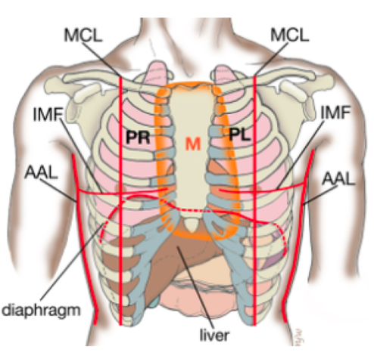
  Breathing
  Needle decompression
    Axillary site = Anerior chest
    Choice dependent on clinical situation
Update
11th Edition
  Importance of pain and critical care management for rib fractures
©ACS

Slide 23
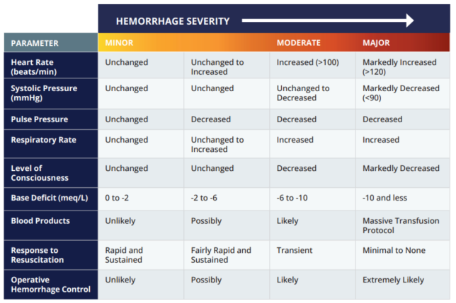
  Circulation
  New Hemorrhage Severity table replaces Classes of Shock table
Update
11th Edition
©ACS

Slide 24
  Circulation
Update
11th Edition
  Shock Index and ETCO2 monitoring discussed
  Discussion of traumatic cardiac arrest and resuscitation termination
  Whole blood, red cells, and other blood products are optimal hemorrhagic shock resuscitation fluids
  TXA administration supported
  Expanded table for Recommended Options for Reversal of Effects of Anticlotting Medications
©ACS

Slide 25
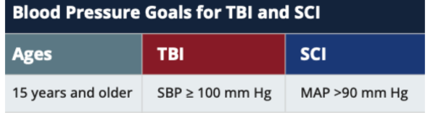
  Disability
  Expanded blunt cerebrovascular injury screening criteria
  Recommended blood pressure goals
  Recommend INR<1.4
Update
11th Edition
  TBI:
  hypotension + hypoxia = 2 x risk of death
  Term Neuroworsening introduced
    Spontaneous decrease in GCS motor score
    New decreased pupillary reactivity, asymmetry, bilateral dilation
    New focal motor deficit
    Cushing´s triad: Widened pulse pressure, bradycardia, irregular respiration
©ACS

Slide 26
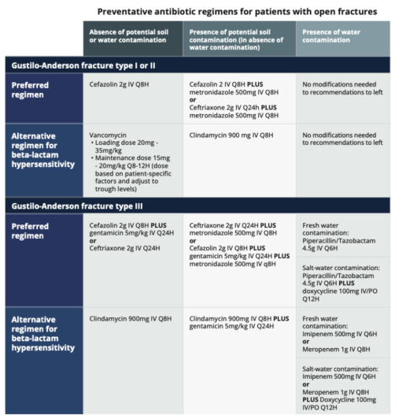
  Exposure
Update
11th Edition
  Musculoskeletal Injuries
  Added Gustilo- Anderson open fracture classification in guidelines for antibiotics
©ACS

Slide 27
Special Considerations

Slide 28
  Special Considerations
Update
11th Edition
  Pediatric Patient
  Blood product resuscitation recommended for hemorrhagic shock at 10 ml/kg
  Recommend infant RSI pretreatment with atropine
  Surgical cricothyroidotomy continues to be discouraged for younger children
  Needle airways do not provide adequate ventilation but may provide short term oxygenation
©ACS

Slide 29
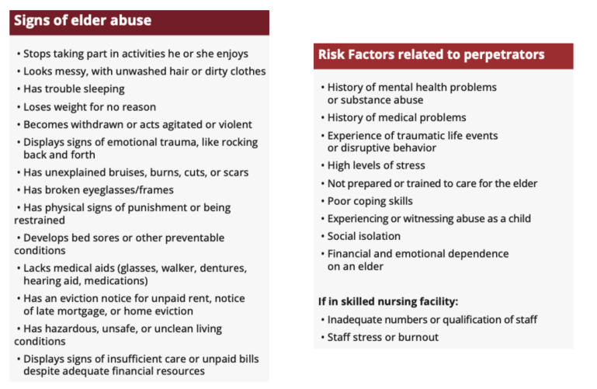
  Special Considerations
Update
11th Edition
  Older Adult
  Added frailty index
  Expanded discussion elder abuse
©ACS

Slide 30
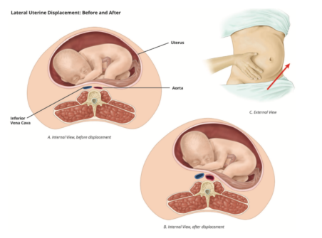
  Special Considerations
Update
11th Edition
  Pregnant Patient
  Uterine IVC compression early as 18wks
    Can decrease cardiac output up to 30%
    Left uterine displacement important adjunct
©ACS

Slide 31
  Special Considerations
Update
11th Edition
  Pregnant Patient
  Resuscitative cesarean delivery replaces perimortem cesarean delivery
    Considered if uterus at or above the umbilicus and no ROSC after 5min, regardless of fetal cardiac activity
    Early and rapid uterine evacuation (even if fetus nonviable) may have > 50% probability of ROSC
©ACS

Slide 32
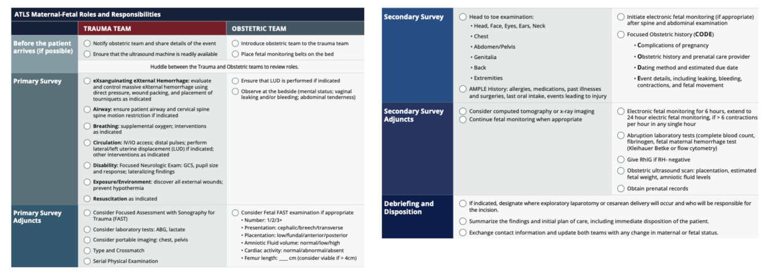
  Special Considerations
Update
11th Edition
  Pregnant Patient
  Maternal Fetal Trauma Checklist
©ACS

Slide 33
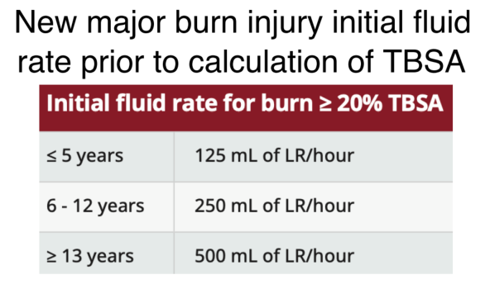
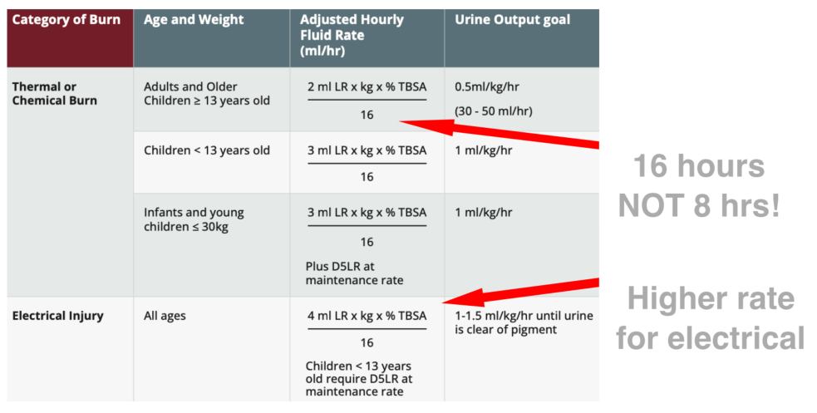
  Special Considerations
Update
11th Edition
  Thermal Injuries
©ACS

Slide 34
Secondary Survey

Slide 35

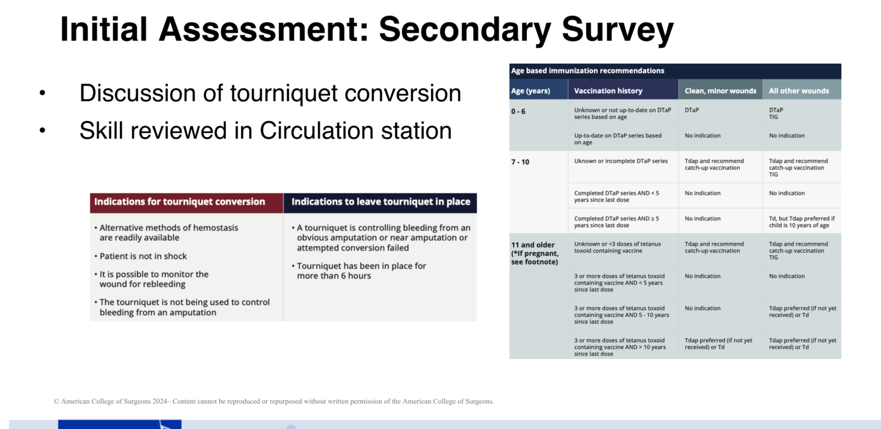

Secondary Survey
4 / 25
©ACS

Slide 36
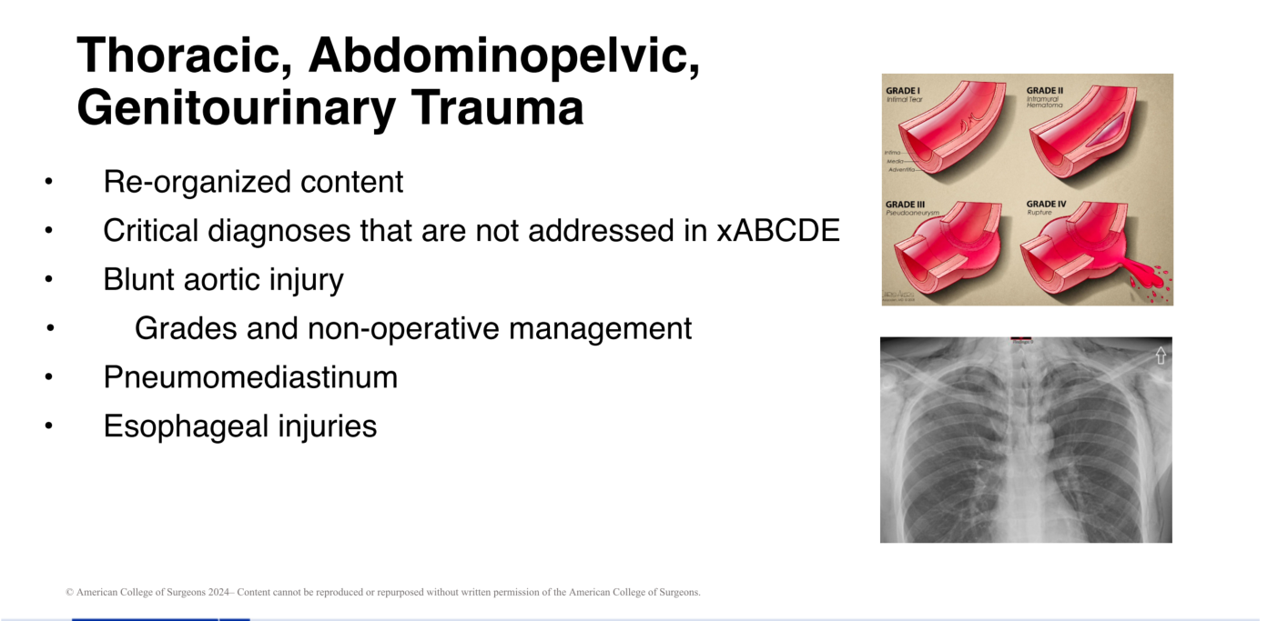
Secondary Survey Specific Injuries
4 / 25
©ACS

Slide 37
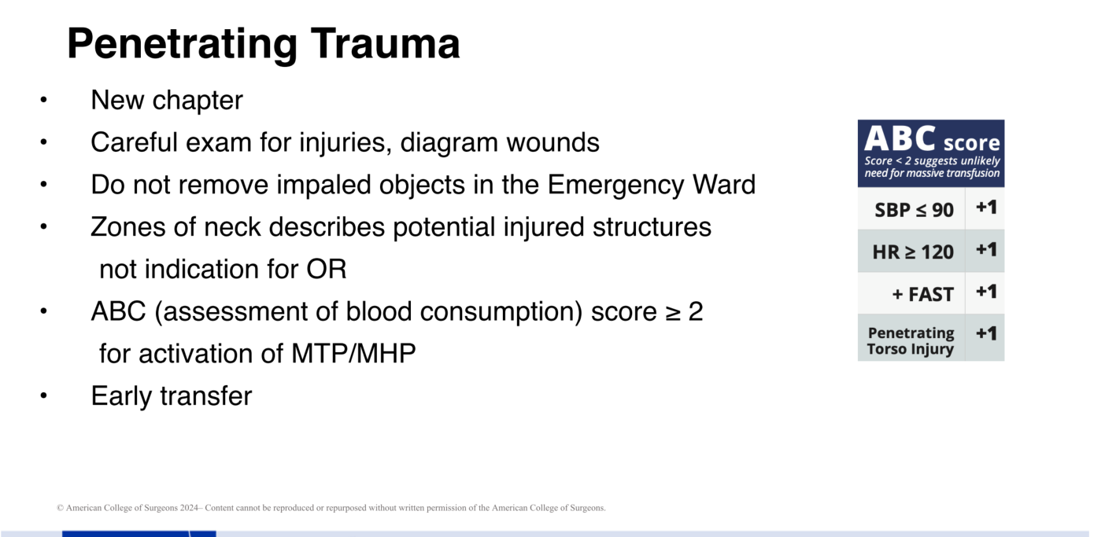
Secondary Survey Specific Injuries
4 / 25
©ACS

Slide 38
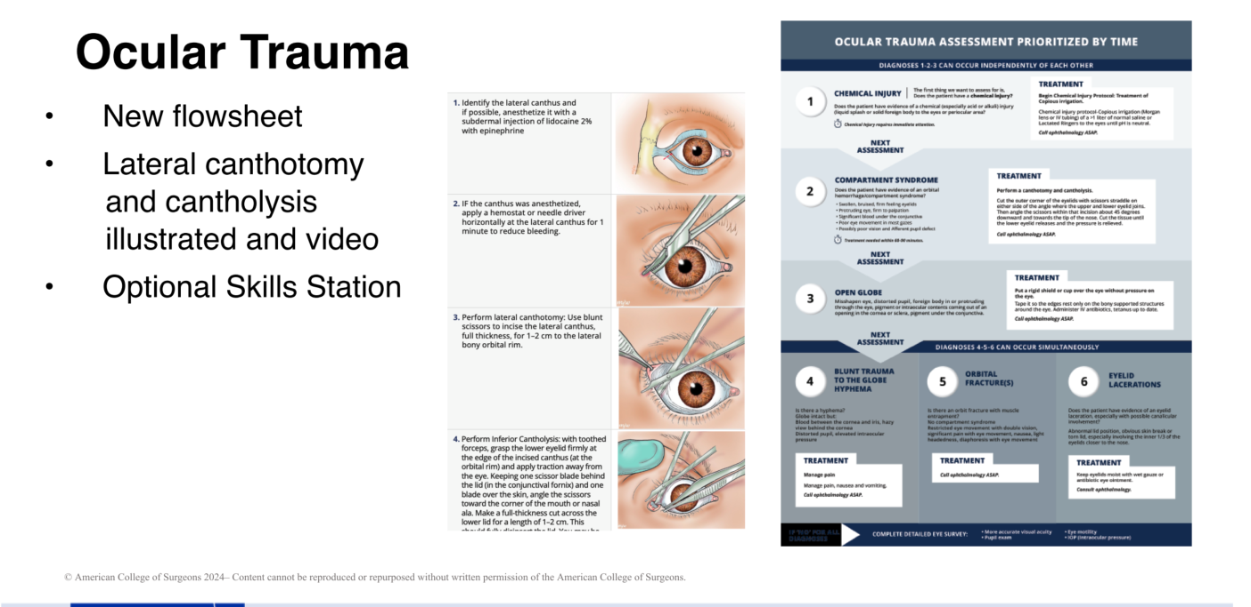
Secondary Survey Specific Injuries
4 / 25
©ACS

Slide 39
Continue
Scenario
18-year-old male , unrestrained driver in MVC vs. tree.
M
Patient has facial injuries
S
HR 120; BP 90/40; RR 24,
O2 sat 89%, temp 36°C
T
O₂ by mask; fluids via single IV; spinal motion restricted on long spine board.
©ACS
©ACS
Notes:
CASE Scenario

Slide 40
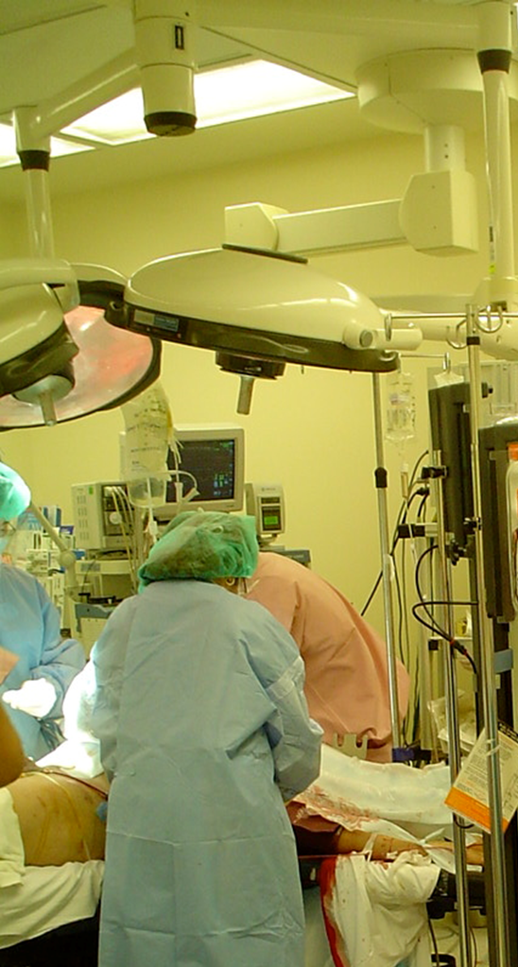
Initial Assessment: Case Scenario
Prior to intubation the patient begins to respond to verbal stimuli, opens eyes, and tries to brush away your hands
Patient intubated
Femur fracture reduced and immobilized; pelvic binder applied
250 mL warmed crystalloid bolus and 1 unit unmatched pRBCs IV
Vital signs:
HR 97; BP 110/64; RR 24; O2 sat 96%
©ACS

Slide 41
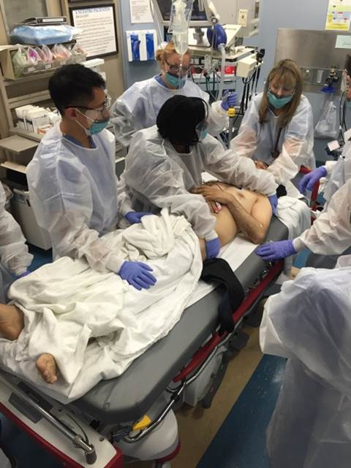
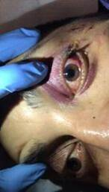
Case Progression
Reevaluation
Vital signs: HR 100; BP 100/60; RR 20
Good breath sounds bilaterally
Pupils: R: 4 mm, minimally reactive,
L: 6 mm, reactive
©ACS

Slide 42
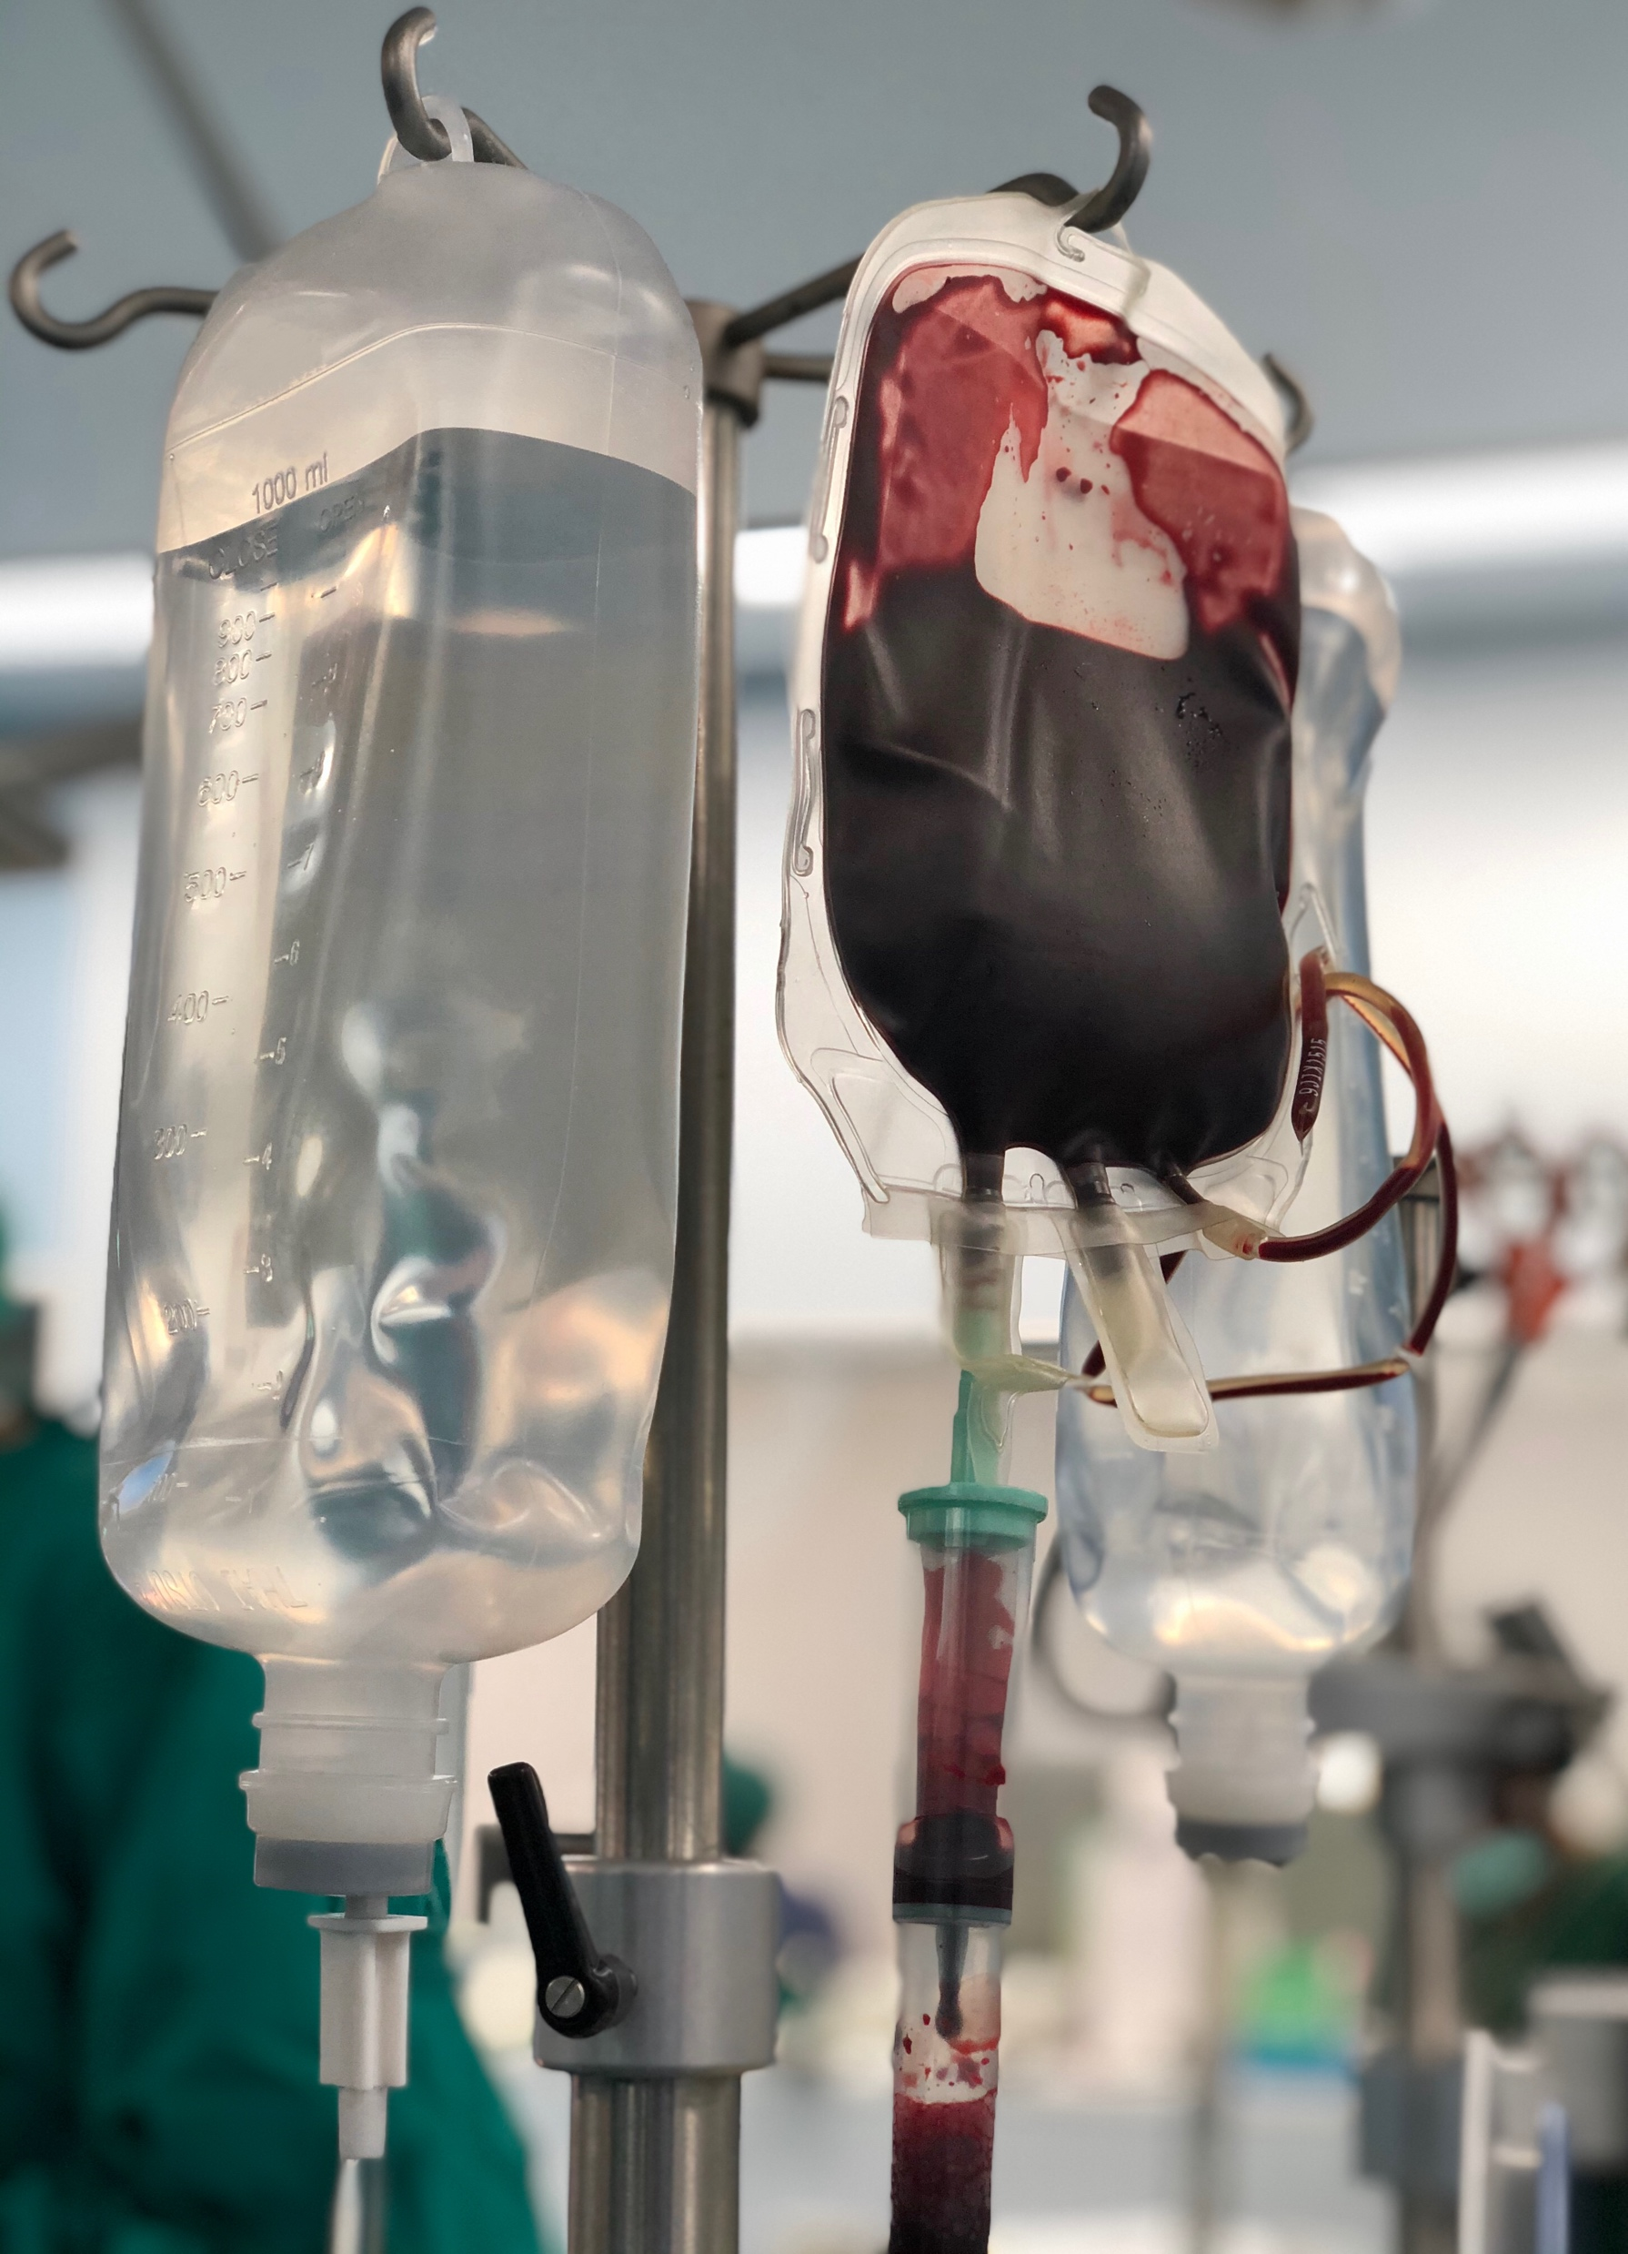
Case Progression / Secondary survey
Laceration and soft tissue injury,
L temporal-frontal region; no active bleeding
L hemotympanum
Large ecchymosis, L anterior chest
Abdomen soft, nondistended
©ACS
Notes:
In this Case Scenario update, blood administration is started. Depending on time constraints and the learner audience, the Instructor may ask the following optional question: (THESE CONCEPTS ARE ALSO COVERED IN THE CIRCULATION INTERACTIVE DISCUSSION)
Why are blood products preferable to crystalloid for volume resuscitation of a trauma patient in hemorrhagic shock?
Crystalloid can cause dilutional coagulopathy and can increase bleeding in patients in hemorrhagic shock. Studies have demonstrated superiority of blood product resuscitation.
2. What other blood products and medications might be useful to administer to this patient?
Platelets, Plasma, Tranexamic Acid. A Massive Transfusion Protocol/Massive Hemorrhage Protocol may be activated.
IF THESE QUESTION ARE ASKED AND ANSWERED, THE INSTRUCTOR SHOULD POINT OUT THAT NOT ALL HOSPITALS HAVE ACCESS TO BLOOD; IN THAT CIRCUMSTANCE JUDICIOUS CRYSTALLOID INFUSION MAY BE NECESSARY.
If the participants do not provide the information, ask additional questions to elicit the information from the participants, rather than providing it yourself.​

Slide 43
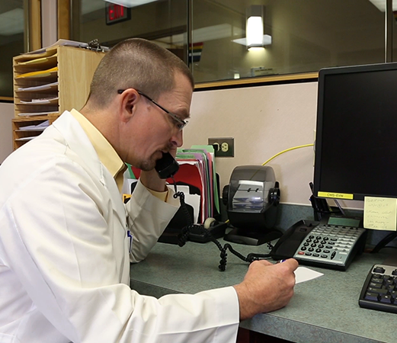
Initial Assessment: Case Scenario
The Trauma Center is on the phone.
No neurosurgery on site
Decision: transfer patient to another facility for definitive care
Contact the family to give update and obtain consent for transfer
©ACS
Notes:
THE LEARNERS SHOULD PROVIDE THE FOLLOWING ANSWERS TO THE QUESTION ON THE SLIDE:
What information should be communicated to the accepting trauma center?
Learners should relate that a systematic and structured communication method should be used such as the S-xABCDE-BAR method. It should include a concise history of the trauma, the list of injuries (diagnosed and suspected), any treatment/interventions performed, as well as the response to the treatment/intervention and the current clinical condition. Send copies of records and any imaging with the patient.
A useful technique to solicit this information is for the instructor to ask a learner(s) to “hand off” the patient as though the instructor were the clinician receiving report at the other facility.
If the participants do not provide the information, ask additional questions to elicit the information from the participants, rather than providing it yourself.​

Slide 44
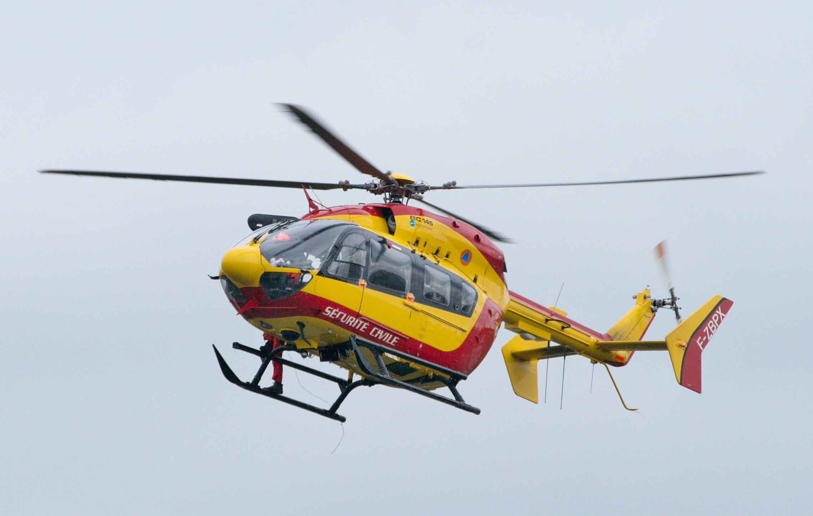

Case Scenario Conclusion
The patient is transferred to a trauma center via air and goes to surgery for evacuation of an intracranial hematoma.
PRIMARY
©ACS

Slide 45
Initial Assessment: Case Scenario
Engineering
& Environment
What factors might be considered to prevent an incident like this from happening again?
Safer vehicles
Improved restraint systems
Road construction and design
The 3 “E”s of Injury Prevention
Education
Enforcement
Driver Education courses
Education about vehicle maintenance
Post-crash counseling and education
Advocacy for:
Speed limits
Vehicle safety legislation
Substance misuse treatment programs
©ACS
Notes:
THE LEARNERS SHOULD PROVIDE THE FOLLOWING ANSWERS TO THE QUESTION ON THE SLIDE:
The Instructor should allow a brief discussion and then display the 3 “E”s of Injury Prevention on the right side of the slide, referring them to the Injury Prevention Chapter in the manual.
What factors might be considered to prevent an incident like this from happening again?
The learners may relate a variety of valid ideas about what might be done to prevent an incident like this, including: investigating the safety environment of the building itself and why the explosion occurred; investigating human error, etc.
Education = can be individual or community/societal education. In this case, safety education for workers would be important, how to handle equipment, etc.
Environment/Engineering = in this case, looking at the safety environment, materials being used, etc.
Enforcement = the equivalent of advocacy. Advocating for safety regulations, inspections, better working environments/staffing might impact this situation.
If the participants do not provide the information, ask additional questions to elicit the information from the participants, rather than providing it yourself.​

Slide 46

©ACS

Slide 47


Thank You.
©ACS

